Slide 1
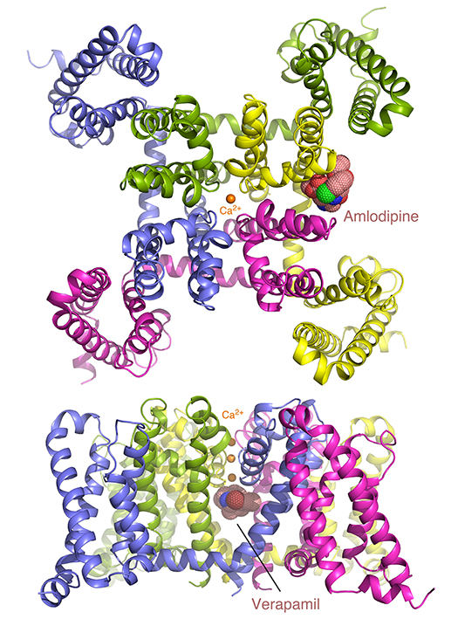
Two Basic Mechanisms of Cardiovascular Drugs
Scientific Achievement
Protein structures that control Ca²⁺ transport through cell membrane channels have been revealed, bound to two types of drugs whose therapeutic benefit in treating several heart diseases has been clarified.
Significance and Impact
This discovery could accelerate the development of safer and more effective drugs for treating cardio-vascular disorders, including high blood pressure, chest pain, and irregular heartbeat.
Research Details
Structure and function revealed by x-ray crystallography.
The drug, amlodipine, remodels the channel from the outside so that calcium lodges inside.
The drug, verapamil, plugs the molecular pore to prevent calcium entry.
Two different views of a calcium channel protein, bound to the drug molecules amlodipine (top) and verapamil (bottom).
Publication about this research: L. Tang, T.M. Gamal El-Din, T.M. Swanson, D.C. Pryde, T. Scheuer, N. Zheng, and W.A. Catterall, Nature 537, 117 (2016). Work was performed at Lawrence Berkeley National Laboratory, ALS Beamlines 8.2.1 and 8.2.2. Operation of the ALS is supported by the U.S. Department of Energy, Office of Basic Energy Sciences.
Read the full highlight: als.lbl.gov/two-basic-mechanisms-cardiovascular-drugs/
Notes:
Calcium channel blockers are widely prescribed for heart and blood-vessel diseases. With the help of the high-intensity x-ray beams and remotely controlled robots at the ALS, scientists have revealed, at atomic resolution, how two different classes of calcium channel blocker drugs produce their therapeutic effects. The results pave the way for optimizing these classic compounds for safer and more reliable pharmaceutical applications.
Research conducted by: L. Tang and N. Zheng (Univ. of Washington and Howard Hughes Medical Institute); T.M.Gamal El-Din, T.M. Swanson, T. Scheuer, and W.A. Catterall (Univ. of Washington); and D.C. Pryde (Curadev Pharma, UK).
Research funding: National Institutes of Health and Howard Hughes Medical Institute. Operation of the ALS is supported by the U.S. Department of Energy, Office of Basic Energy Sciences.
Full highlight: als.lbl.gov/two-basic-mechanisms-cardiovascular-drugs/

