Slide 1
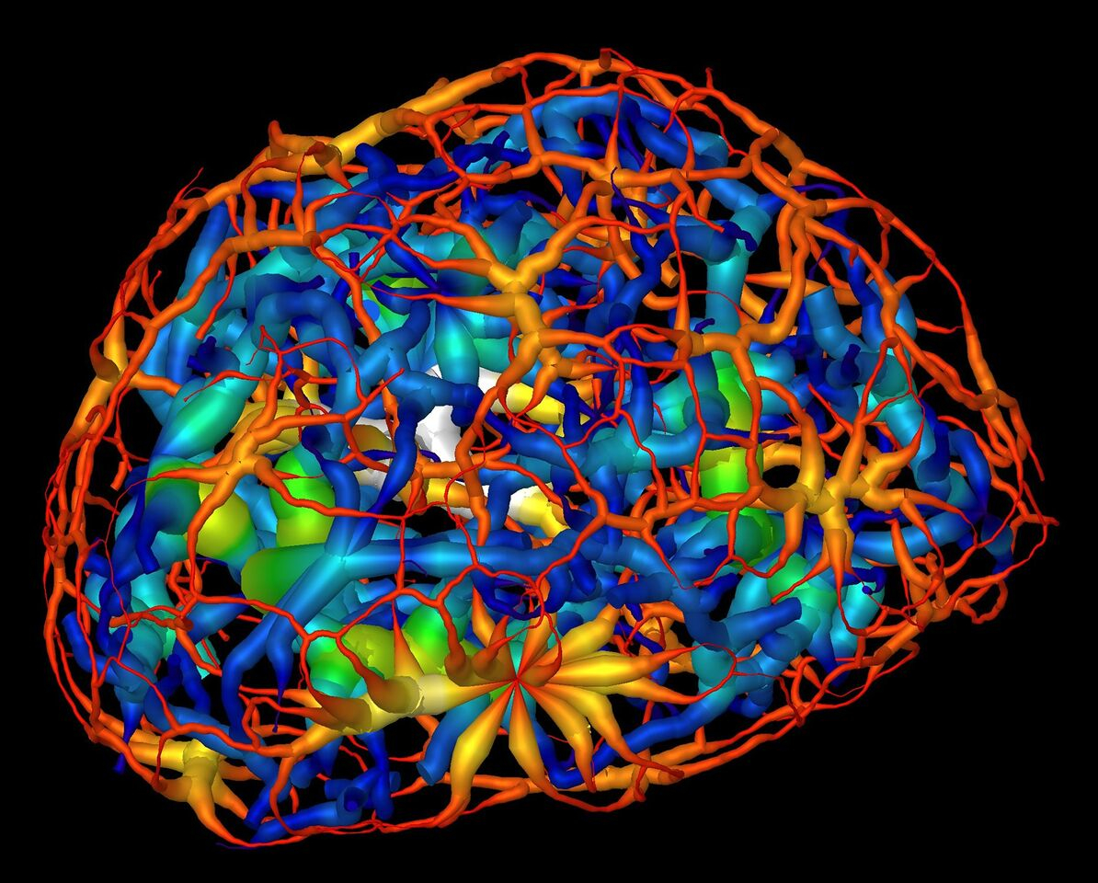
Mapping the Migration of Genetic Material
Scientific Achievement
Researchers have obtained microtomographic images of the genetic material (chromatin) in the nuclei of nerve cells at different stages of cell maturity.
Significance and Impact
The results could help explain how the reorg-anization of chromatin affects genetic function, providing new insight into genetic disorders.
Research Details
Soft x-ray tomography performed on intact, frozen cells at a resolution of about 50 nm.
Chromatin becomes more compact and migrates to center during cell maturation.
Protein HP1β regulates process in mature cells.
Computer rendering of the skeletonized structure of heterochromatin (red represents a thin region while white represents a thick region), a tightly packed form of DNA, surrounding another form of DNA-carrying material known as euchromatin (dark blue represents a thin region and yellow represent the thickest) in a mouse’s mature nerve cell. (Credit: Berkeley Lab, UCSF)
Publication about this research: M.A. Le Gros, E.J. Clowney, A. Magklara, A. Yen, E. Markenscoff-Papadimitriou, B. Colquitt, M. Myllys, M. Kellis, S. Lomvardas, and C.A. Larabell, Cell Reports 17, 2125 (2016). Work was performed at Lawrence Berkeley National Laboratory, ALS Beamline 2.1. Operation of the ALS is supported by the U.S. Department of Energy, Office of Basic Energy Sciences.
Notes:
Researchers have used a powerful soft x-ray microscope at the ALS to capture tomographic images of the genetic material in the nuclei of nerve cells at different stages of maturity. This study, the first quantitative analysis of nuclear organization in intact mammalian cells, has generated detailed 3D visualizations that show an unexpected connectivity in the genetic material, called chromatin. The results could help us understand how the patterning and reorganization of chromatin relate to the specialization of a stem cell's function as specific genes are activated or silenced.
Research conducted by: M.A. Le Gros and C.A. Larabell (UC San Francisco and Berkeley Lab); E.J. Clowney, E. Markenscoff-Papadimitriou, B. Colquitt, and S. Lomvardas (UC San Francisco); A. Magklara (Foundation for Research and Technology-Hellas, Greece); A. Yen and M. Kellis (Broad Institute and MIT); and M. Myllys (Univ. of Jyväskylä, Finland).
Research funding: National Institutes of Health and the U.S. Department of Energy (DOE), Office of Biological and Environmental Research. Operation of the ALS is supported by the DOE Office of Basic Energy Sciences.
Full highlight: https://als.lbl.gov/mapping-migration-genetic-material/

