Slide 1
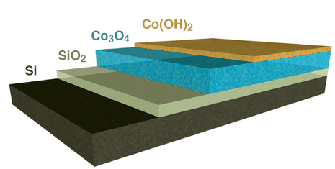
Multifunctional Catalyst Balances Stability, Efficiency
Scientific Achievement
Researchers developed a water-splitting catalyst tailored to balance the physical stability and chemical activity needed for a robust, efficient artificial photosynthetic system.
Significance and Impact
Integration of the thin-film catalyst with high-performance semiconductor photoanodes is a key step toward a viable system of artificial photosynthesis to generate clean fuel.
Research Details
X-ray spectroscopy/scattering revealed the chemical/structural properties of the catalyst.
Si photoelectrodes coated with catalyst can operate continuously for at least 72 h, versus immediate degradation otherwise.
Schematic of multifunctional Co catalyst layers on Si substrate layers, fabricated by plasma-enhanced atomic-layer deposition at The Molecular Foundry. The stability of the nanocrystalline Co₃O₄ ensures a durable interface with the substrate. The open, layered structure of Co(OH)₂ allows intercalation of water and ions from solution, as well as changes in Co oxidation state with minimal structural reorientation, thus supporting catalytic site formation not just at its surface but also within its bulk. (Credit: Ian Sharp/Berkeley Lab)
Publication about this research: J. Yang, J.K. Cooper, F.M. Toma, K.A. Walczak, M. Favaro, J.W. Beeman, L.H. Hess, C. Wang, C. Zhu, S. Gul, J. Yano, C. Kisielowski, A. Schwartzberg, and I.D. Sharp, Nat. Mater. 16, 335 (2017). Work was performed at Lawrence Berkeley National Laboratory, ALS Beamline 11.0.1, and SLAC National Accelerator Laboratory, SSRL Beamline 7.3. Operation of the ALS is supported by the U.S. Department of Energy, Office of Basic Energy Sciences.
Notes:
Scientists have found a way to engineer the atomic-scale chemical properties of a water-splitting catalyst for integration with a solar cell, and the result is a big boost to the stability and efficiency of artificial photosynthesis. The goal was to strike a careful balance between the contradictory needs for efficient energy conversion and chemically sensitive electronic components, in order to develop a viable system of artificial photosynthesis to generate clean fuel. The research, which involved multiple x-ray experiments performed at the ALS and the Stanford Synchrotron Radiation Lightsource (SSRL), comes out of the Joint Center for Artificial Photosynthesis (JCAP), a DOE Energy Innovation Hub established to develop a cost-effective method of turning sunlight, water, and carbon dioxide into fuel. JCAP is led by the California Institute of Technology with Berkeley Lab as a major partner.
Research conducted by: J. Yang, J.K. Cooper, F.M. Toma, K.A. Walczak, M. Favaro, J.W. Beeman, L.H. Hess, J. Yano, and I.D. Sharp (Joint Center for Artificial Photosynthesis [JCAP] and Berkeley Lab); C. Wang and C. Zhu (ALS); S. Gul, C. Kisielowski, and A. Schwartzberg (Berkeley Lab).
Research funding: Alexander von Humboldt Foundaton and the U.S. Department of Energy, Office of Basic Energy Sciences (DOE BES). Operation of the ALS is supported by DOE BES.
Full highlight: https://als.lbl.gov/multifunctional-catalyst-balances-stability-efficiency

