Slide 1
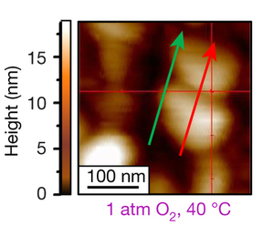
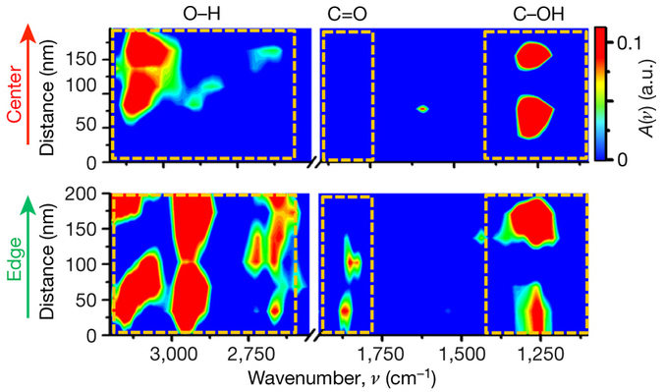
Mapping Catalytic Reactions on Single Nanoparticles
Scientific Achievement
Synchrotron infrared nanospectroscopy (SINS) has confirmed that structural defects and jagged surfaces at the edges of platinum and gold nanoparticles are key hot spots for chemical reactivity.
Significance and Impact
The results should help in the design of better catalysts that will reduce energy usage in the production of commodity chemicals (e.g. fertilizers, fuel, plastics).
Research Details
Au & Pt nanoparticles ~100 nm in dimension.
Coated w/ chemically active marker molecules.
Scans taken through particle edges & centers, confirmed greater activity at edges.
Atomic-force microscopy image of Pt particles; arrows show SINS scans through center (red) and edge (green).
Infrared spectra corresponding to red/green arrows in top image. Dashed boxes highlight regions of interest. The detection of new peaks at 1820 cm⁻¹ and the widening of the peaks at higher wavenumber (~3000 cm⁻¹) in the edge data indicate that oxidation occurred at the edges, not at centers.
Publication about this research: C.-Y. Wu, W.J. Wolf, Y. Levartovsky, H.A. Bechtel, M.C. Martin, F.D. Toste, and E. Gross, Nature 541, 511 (2017). Work was performed at Lawrence Berkeley National Laboratory, ALS Beamline 5.4. Operation of the ALS is supported by the U.S. Department of Energy, Office of Basic Energy Sciences.
Notes:
A new synchrotron infrared nanospectroscopy (SINS) study has confirmed that structural defects and jagged surfaces at the edges of platinum and gold nanoparticles are key hot spots for chemical reactivity. The experiments, conducted by a team of researchers from the ALS, Berkeley, and the Hebrew University of Jerusalem in Israel, pinpoint the most active areas of reactions on nanoscale particles and confirm that structural defects at the periphery are key to catalyst function. Experiments like this should help researchers customize the structural properties of catalysts to make them more effective in fostering chemical reactions.
Research conducted by: C.-Y. Wu, W.J. Wolf, and F.D. Toste (UC Berkeley and Berkeley Lab); Y. Levartovsky and E. Gross (The Hebrew University of Jerusalem); and H.A. Bechtel and M.C. Martin (ALS).
Research funding: U.S. Department of Energy, Office of Basic Energy Sciences (DOE BES) and National Science Foundation. Operation of the ALS is supported by DOE BES.
Full highlight: https://als.lbl.gov/mapping-catalytic-reactions-single-nanoparticles

