Slide 1
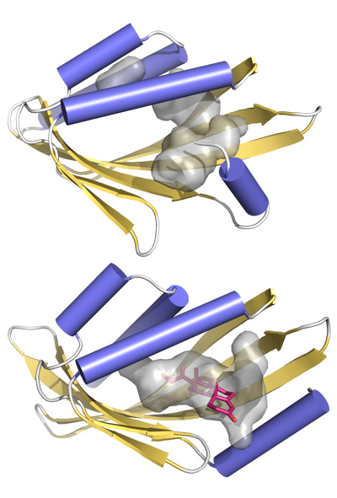
Bending the (β-Sheet) Curve to Shape Protein Cavities
Scientific Achievement
Protein cavities constructed with curved β sheets can now be designed and produced with atomic-level accuracy, opening the door to customized binding sites capable of entirely new functions.
Significance and Impact
The results could lead to the design of structures for a wide range of applications, from new diagnostic tests and medical treatments to more-efficient catalysis of chemical reactions for industrial processes.
Research Details
Researchers deciphered "rules" for β-sheet curvature in natural proteins & added them to computer models.
X-ray crystallography validated the accuracy of nine designed proteins.
Illustration of how a curved protein β sheet (yellow-gold) forms a pocket (gray) to poten-tially fit molecules. Top: Struc-ture based on atomic-resolution data. Bottom: Structure based
on a computational model. (Credit: Benjamin Basanta)
Publication about this research: E. Marcos, B. Basanta, T.M. Chidyausiku, Y. Tang, G. Oberdorfer, G. Liu, G.V.T. Swapna, R. Guan, D.-A. Silva, J. Dou, J.H. Pereira, R. Xiao, B. Sankaran, P.H. Zwart, G.T. Montelione, and D. Baker, Science 355, 201 (2017). Work was performed at Lawrence Berkeley National Laboratory, ALS Beamline 8.2.1, and Brookhaven National Laboratory, NSLS Beamline X4C. Operation of the ALS is supported by the U.S. Department of Energy, Office of Basic Energy Sciences.
Notes:
Curved β sheets are basic building blocks in the construction of protein cavities that, by serving as binding sites for other molecules, are essential to protein function. After analyzing classic protein formations and running folding simulations, researchers designed a series of novel proteins with curved β sheets, inspired by naturally occurring protein superfamilies. They then compared the predicted models to physical examples of these designed proteins using x-ray crystallography. All of the structures closely matched the predicted models, showing that β-sheet curvature can be controlled with atomic-level accuracy. The discovery opens the door to the design of new proteins capable of entirely new functions, including catalyzing reactions not seen in nature and the development of new diagnostic tests and medical treatments.
Research conducted by: E. Marcos (Univ. of Washington and Barcelona Institute of Science and Technology); B. Basanta, T.M. Chidyausiku, D.-A. Silva, and J. Dou (Univ. of Washington); Y. Tang, G. Liu, G.V.T. Swapna, R. Guan, R. Xiao, and G.T. Montelione (Rutgers Univ. and Northeast Structural Genomics Consortium); G. Oberdorfer (Univ. of Washington and Univ. of Graz, Austria); J.H. Pereira, B. Sankaran, and P.H. Zwart (Berkeley Lab and Joint BioEnergy Institute); and D. Baker (Univ. of Washington and Howard Hughes Medical Instiute).
Research funding: Howard Hughes Medical Institute, Defense Threat Reduction Agency, National Institutes of Health, European Commission (via Marie Curie International Outgoing Fellowships), Pew Charitable Trusts, Mexican National Council of Science and Technology (CONACYT), and U.S. Department of Energy, Office of Basic Energy Sciences (DOE BES). Operation of the ALS is supported by DOE BES.
Full highlight: https://als.lbl.gov/bending-beta-sheet-curve-shape-protein-cavities

