Slide 1
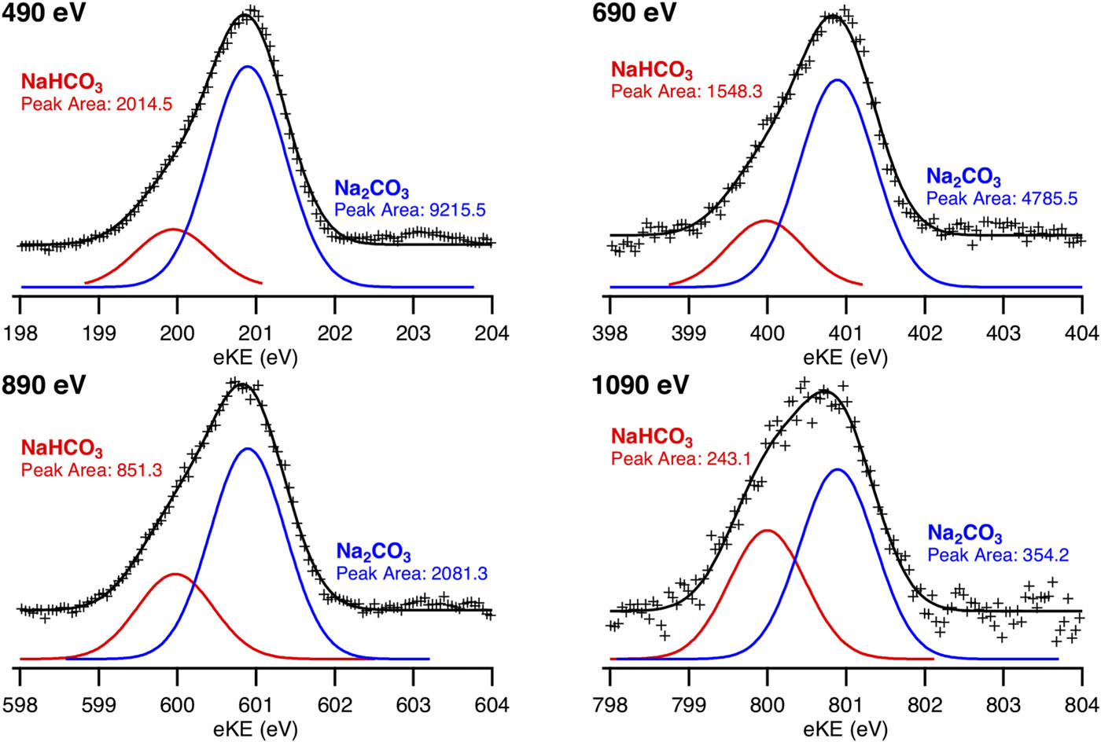
Reversal of Carbonate Abundance at Liquid Interfaces
Scientific Achievement
Researchers probed the concentrations of aqueous carbonate species near an interface, finding a surprising reversal in the expected abundances of carbonate (CO₃^{2–}) and bicarbonate (HCO₃–) as a function of depth.
Significance and Impact
The results are relevant to our understanding of a wide range of topics, including ocean chem-istry, the carbon cycle, and physiological systems.
Research Details
ALS technique: ambient-pressure x-ray photo-emission spectroscopy (APXPS).
APXPS data collected from 50:50 mixtures of Na₂CO₃:NaHCO₃ (black crosses) at four different incident-photon energies that correspond to increasing sample depths. Curves for the individual carbon species are shown in red (NaHCO₃) and blue (Na₂CO₃). Peak areas give relative concentrations.
Found more CO₃^{2–} than HCO₃– near interface, in conflict with recent models (doubly charged, strongly hydrated CO₃^{2–} should be less abundant near interface).
Conflict could be resolved if CO₃^{2–} adsorbs to the interface as an ion pair with sodium (i.e., Na⁺:CO₃^{2–}), reducing charge effects.
Publication about this research: R.K. Lam, J. Smith, A. Rizzuto, O. Karslıoğlu, H. Bluhm and R.J. Saykally, J. Chem. Phys. 146, 094703 (2017). Work was performed at Lawrence Berkeley National Laboratory, ALS Beamlines 11.0.2. Operation of the ALS is supported by the U.S. Department of Energy, Office of Science, Basic Energy Sciences program.
Notes:
Dissolving carbon dioxide (CO₂) in water produces carbonate systems that are key to many processes essential to life, from the buffer system that regulates pH levels in blood, to the carbon cycle that governs CO₂ uptake by Earth's oceans. A detailed understanding of such systems is complicated by the presence of an interface—a cell membrane or the ocean surface, for example—that the CO₂ must cross and that could affect the behavior of the various carbonate species (molecules containing the carbonate ion, CO₃^{2–}). At the ALS, researchers have used ambient-pressure x-ray photoemission spectroscopy (APXPS) to probe the relative concentrations of carbonates near an interface, finding a surprising reversal in the expected abundances of carbonate (CO₃^{2–}) and bicarbonate (HCO₃–) as a function of depth. The results raise important questions about what is really happening at interfacial regions, with relevance to topics ranging from carbon sequestration to biomedical research.
Research conducted by: R.K. Lam, J. Smith, A. Rizzuto, and R.J. Saykally (UC Berkeley and Berkeley Lab), O. Karslıoğlu (Berkeley Lab), and H. Bluhm (ALS and Berkeley Lab).
Research funding: U.S. Department of Energy, Office of Science, Basic Energy Sciences program (DOE BES). Operation of the ALS is supported by DOE BES.
Full highlight: https://als.lbl.gov/apxps-finds-carbonate-reversal-liquid-interfaces/

