Slide 1
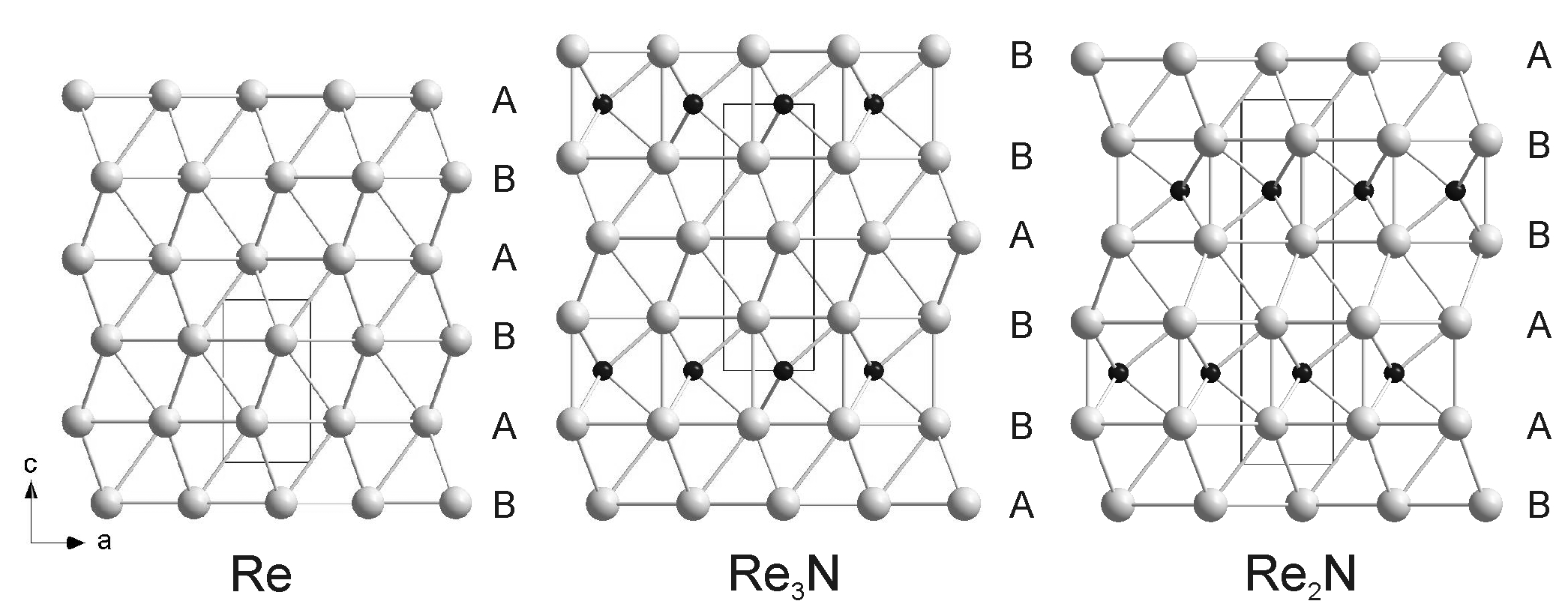
Two Novel Ultra-Incompressible Materials
New rhenium nitrides Re₂N and Re₃N synthesized, stable at extreme conditions.
The incorporation of nitrogen (black balls) into the rhenium (light grey) hcp lattice (AB stacking sequence of rhenium atoms) at increasing pressure and temperature conditions leads to the formation of Re₃N (ABB stacking) and Re₂N (AABB sequence). Nitrogen atoms occupy interstitial sites between AA or BB layers only.
Some current challenges in aerospace engineering and fission/fusion applications require materials that are mechanically, thermally, and chemically stable at extreme conditions.
- Ultrahigh temperature ceramics (often binary transition-metal carbides, borides, or nitrides)
Researchers from Germany, the United Kingdom, and Berkeley Lab working at ALS Beamlines 12.2.2 and 12.3.2 synthesized two novel, extremely incompressible bulk rhenium nitrides, Re₂N and Re₃N.
Rhenium foil and nitrogen were pressurized in a diamond-anvil pressure cell, then heated by laser beams.
Analysis done by powder x-ray diffraction; structural models confirmed by x-ray Laue microdiffraction.
Products’ bulk moduli is similar to that of the most incompressible binary transition-metal carbides/nitrides.
- These materials are also potentially ultrahard.
- Re₃N is synthesized between 10.5–16 GPa and 1700–2250 K, more moderate conditions than other incompressible period-six transition-metal carbides/nitrides, giving it potential for technological applications.
A. Friedrich et al., Phys. Rev. Lett. 105, 085504 (2010)
www-als.lbl.gov/index.php/science-highlights/science-highlights/566
Notes:
Some current challenges in aerospace engineering and fission/fusion applications require materials that are mechanically and chemically stable at extreme conditions. One such class of materials is ultra-high temperature ceramics, which are often binary transition metal carbides, borides, or nitrides. It is therefore of great interest to understand how to synthesize new compounds of this type. A research team from Germany, the United Kingdom, and Berkeley Lab working at ALS Beamlines 12.2.2 and 12.3.2 has now synthesized and characterized two novel bulk rhenium nitrides, Re₂N and Re₃N. Both phases are extremely incompressible, and Re₃N is also better placed for potential technological applications than are other incompressible transition metal carbides and nitrides of the period six elements because it can be formed at relatively moderate pressures and temperatures.
Research conducted by A. Friedrich, B. Winkler, L. Bayarjargal, and W. Morgenroth (Geowissenschaften, Goethe-Universitat, Germany), E.A. Juarez-Arellano (Universidad del Papaloapan, Mexico), V. Milman (Accelrys, UK), K. Refson (Rutherford-Appleton Laboratory, UK), and M. Kunz and K. Chen (ALS). The research team wishes to acknowledge S.M. Clark and J. Yan (ALS) for their technical support at Beamline 12.2.2.

