Slide 1
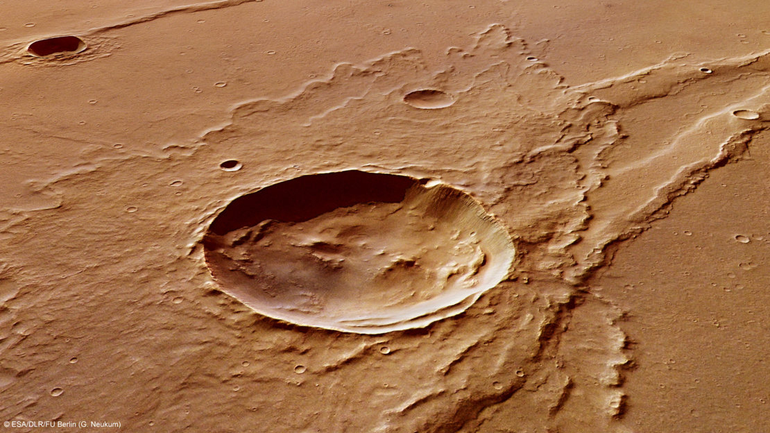
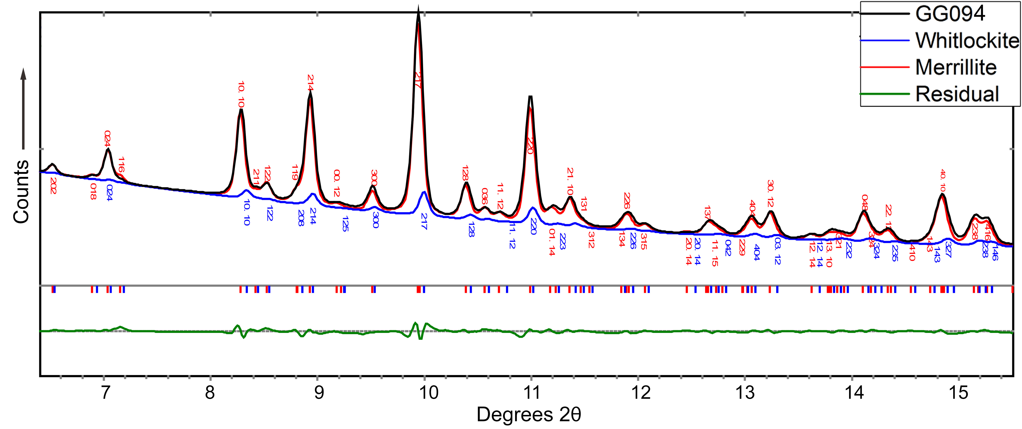
New Evidence for a Water-Rich History on Mars
Scientific Achievement
Researchers showed that the shocks experienced by Martian meteorites upon ejection into space can alter their mineral content, transforming whitlockite into its anhydrous analogue, merrillite.
Significance and Impact
Less merrillite and more whitlockite in unshocked Mars rocks implies that more water (and bioessen-tial phosphorus) could have been present on Mars in the distant past.
Research Details
Whitlockite samples were synthesized as proxies for Martian meteorites.
Samples were subjected to shocks (compression at 1678 mph, 20 GPa) and measured for mineral content using x-ray microdiffraction.
Impact crater on Mars. Image created by the European Space Agency's Mars Express. Credit: G. Neukum (ESA,DLR, FU Berlin)
X-ray microdiffraction data for sample GG094, in which about 12% of whitlockite was transformed into merrillite.
Publication about this research: C.T. Adcock, O. Tschauner, E.M. Hausrath, A. Udry, S.N. Luo, Y. Cai, M. Ren, A. Lanzirotti, M. Newville, M. Kunz, and C. Lin, Nat. Commun. 8, 14667 (2017). Work was performed at Lawrence Berkeley National Laboratory, ALS Beamline 12.2.2, and Argonne National Laboratory, APS Beamlines 13-ID-E and 16-BM-D. Operation of the ALS is supported by the U.S. Department of Energy, Office of Science, Basic Energy Sciences program.
Notes:
Mars may have been a wetter place than previously thought, according to experiments on lab-synthesized mineral samples—proxies for Martian meteorites—performed in part at the ALS. The samples were subjected to levels of shock experienced by meteorites ejected from Mars, then measured for mineral content using x-ray microdiffraction. The studies showed that such shocks can cause merrillite, a mineral found in Martian meteorites, to be generated from a similar mineral, whitlockite, the presence of which would indicate a more water-rich history for the Red Planet. The results have broad implications for the interpretation of meteorite petrology as well as for astrobiology, highlighting the importance of transporting unshocked samples directly from Mars to Earth for a more accurate picture of ancient Martian geology.
Research conducted by: C.T. Adcock, O. Tschauner, E.M. Hausrath, A. Udry, and M. Ren (University of Nevada, Las Vegas); S.N. Luo (Southwest Jiaotong University, China); Y. Cai (University of Science and Technology of China); A. Lanzirotti and M. Newville (University of Chicago); M. Kunz (ALS); and C. Lin (Carnegie Institution of Washington).
Research funding: National Aeronautics and Space Administration; National Science Foundation; University of Nevada, Las Vegas; U.S. Department of Energy (DOE), National Nuclear Security Administration; National Center for Scientific Research (France); 973 Project of China; National Natural Science Foundation (China); and DOE Office of Science, Basic Energy Sciences program (DOE BES). Operation of the ALS is supported by DOE BES.
Full highlight: https://als.lbl.gov/new-evidence-water-rich-history-mars/

