Slide 1
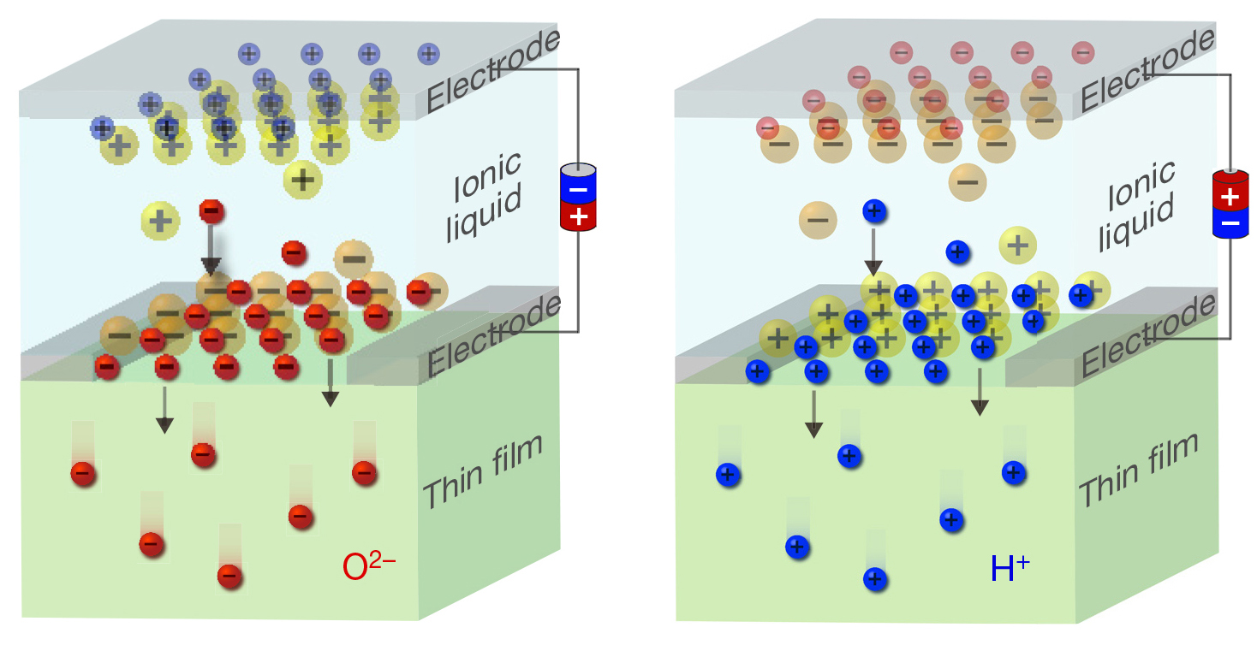
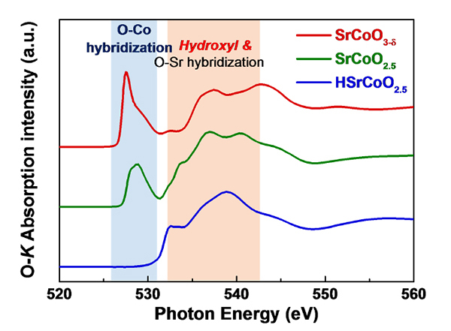
A Multifunctional Material with Electric-Field Control
Scientific Achievement
The diffusion of O²⁻ and H⁺ ions into/out of SrCoO_{x} was electrically controlled, giving access to three distinct material phases with different optical, electronic, and magnetic properties.
Significance and Impact
The work represents a new approach to designing multifunctional materials that is readily applied to
a broad range of systems.
Research Details
Diffusion is reversible; works at room temperature.
Transformations are nonvolatile.
Multiple methods, including x-ray absorption spectroscopy (XAS) and x-ray magnetic circular dichroism (XMCD), were used to characterize the new phases.
Unknown third phase identified as HSrCoO_{2.5}.
Coating thin films of SrCoO_{x} with ionic liquid enables electric-field control of dual-ion-mediated phase transformations.
XAS spectra of O K-edges helped verify and clarify the ion-mediated phase-transformation mechanism.
Publication about this research: N. Lu et al., Nature 546, 124 (2017). Work was performed in part at Lawrence Berkeley National Laboratory, ALS Beamlines 8.0.1 and 6.3.2. Operation of the ALS is supported by the U.S. Department of Energy, Office of Science, Basic Energy Sciences program.
Notes:
With the flip of a switch, three distinct crystalline phases can be induced in one material, with each phase exhibiting very different electronic, magnetic, and optical properties. Materials capable of such versatility are desirable for a wide range of applications, from smart windows and batteries to spintronic devices. In this work, the properties of thin films of strontium cobalt oxide (SrCoO_{x}) were reversibly transformed through the insertion and extraction of oxygen and hydrogen ions, a process controlled by an applied electric field at room temperature. At the ALS, soft x-ray absorption spectroscopy (XAS) and x-ray magnetic circular dichroism (XMCD) experiments were used to verify and clarify the mechanism behind the phase transformations. Overall, the work represents a new approach to the manipulation of material properties that can be readily applied to a broad range of systems.
Research conducted by: N. Lu, P. Zhang, H. Li, Y. Wang, J. Guo, D. Zhang, Z. Duan, Z. Li, M. Wang, S. Yang, M. Yan, and C.-W. Nan (Tsinghua University); Q. Zhang (Institute of Physics, Chinese Academy of Sciences; Tsinghua University); R. Qiao, E. Arenholz, and W. Yang (ALS); Q. He (Durham University, UK); S. Zhou and J. Wu (Tsinghua University; Collaborative Innovation Center of Quantum Matter, China); L. Gu (Institute of Physics, Chinese Academy of Sciences; Collaborative Innovation Center of Quantum Matter, China); Y. Tokura (RIKEN Center for Emergent Matter Science, Japan); and P. Yu (Tsinghua University; Collaborative Innovation Center of Quantum Matter, China; RIKEN Center for Emergent Matter, Japan).
Research funding: National Basic Research Program of China, National Natural Science Foundation of China, Tsinghua University, Beijing Advanced Innovation Center for Future Chip, and Chinese Academy of Sciences. Operation of the ALS is supported by the U.S. Department of Energy, Office of Science, Basic Energy Sciences Program.
Full highlight: https://als.lbl.gov/multifunctional-material-electric-field-control

