Slide 1
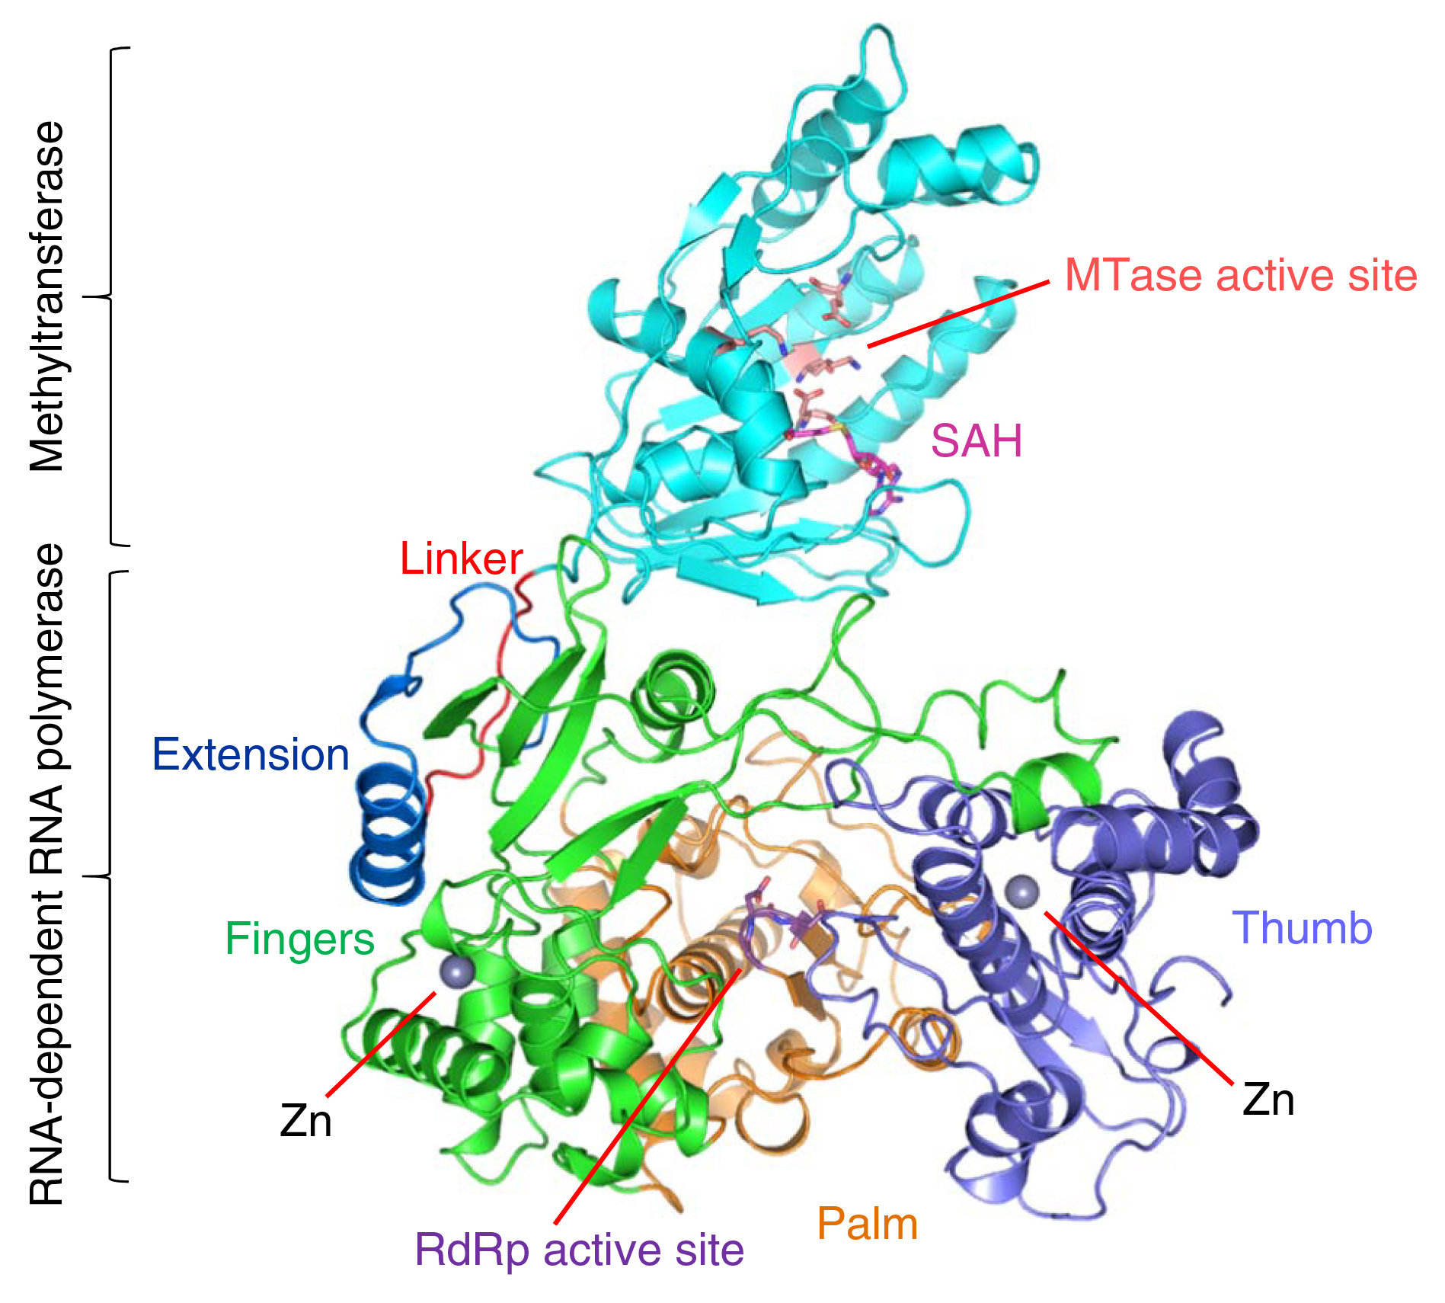
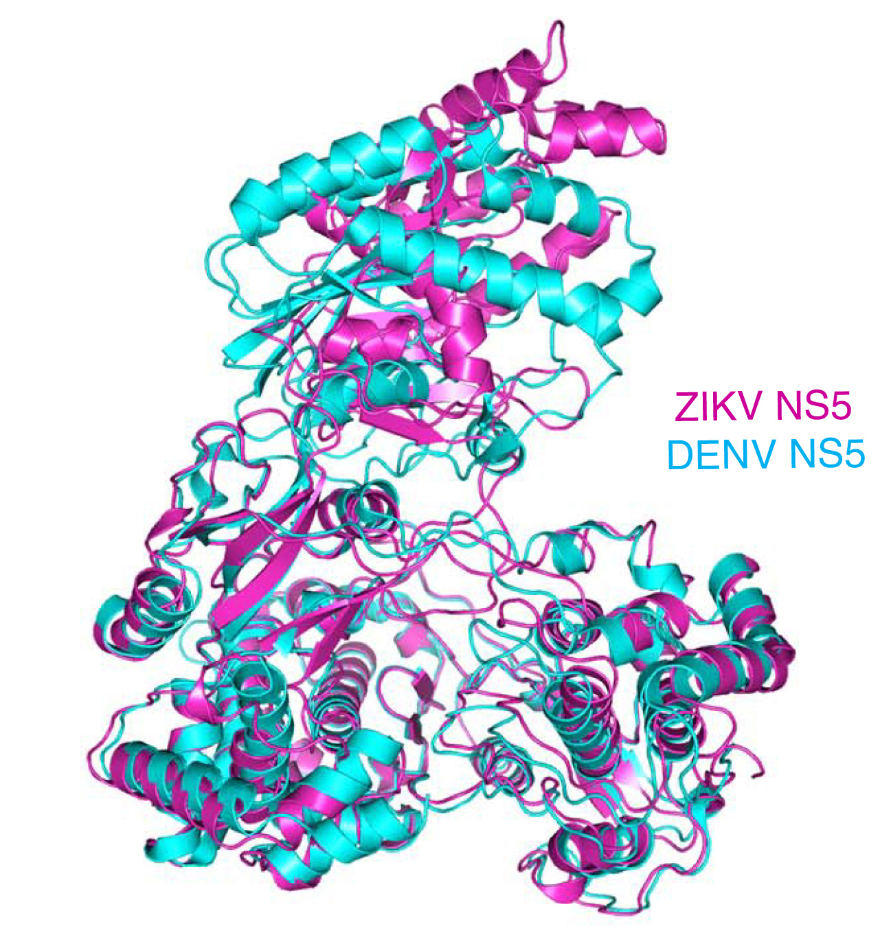
Structure of a Key Protein from the Zika Virus
Scientific Achievement
Protein crystallography studies performed at the Advanced Light Source have resolved the structure of a key protein from the Zika virus (ZIKV) to 3.0 Å.
Significance and Impact
The structure represents an important step toward the targeted development of drugs capable of disrupting ZIKV functions and halting the spread of the disease.
Research Details
Protein NS5 in ZIKV is central to viral function and is therefore an attractive drug target.
Structure showed remarkable similarities to equivalent structures from other viruses of the same family.
Suggests possibility of repurposing drugs used for treating related viral illnesses (e.g. dengue fever).
Structure of ZIKV NS5 protein showing active sites and subdomains.
Publication about this research: B. Zhao, G. Yi, F. Du, Y.-C. Chuang, R.C. Vaughan, B. Sankaran, C.C. Kao, and P. Li, Nat. Commun. 8, 14762 (2017). Work was performed at Lawrence Berkeley National Laboratory, ALS Beamline 5.0.2. Operation of the ALS is supported by the U.S. Department of Energy, Office of Science, Basic Energy Sciences program.
Comparison of ZIKV NS5 with dengue NS5 (DENV), from the same family.
Notes:
The Zika virus (ZIKV) is a mosquito-borne pathogen recently linked to certain birth defects in infants in South and Central America and the United States. Protein crystallography studies performed at the ALS have now resolved the structure of a key ZIKV protein (NS5) to 3.0 Å. The high-resolution structure has enabled researchers to make detailed comparisons to similar proteins from related viruses and gain insight into how their differences might affect viral replication and immune response. The availability of this structure is an important step toward the targeted, structure-based development (and repurposing) of drugs capable of disrupting viral functions and halting the spread of the disease.
Research conducted by: B. Zhao, F. Du, and P. Li (Texas A&M University); G. Yi, Y.-C. Chuang, R.C. Vaughan, and C.C. Kao (Indiana University); and B. Sankaran (Berkeley Lab).
Research funding: Johnson Center for Innovation and Translational Research, National Institutes of Health, and Howard Hughes Medical Institute. Operation of the ALS is supported by the U.S. Department of Energy, Office of Science, Basic Energy Sciences Program.
Full highlight: https://als.lbl.gov/structure-key-protein-zika-virus

