Slide 1
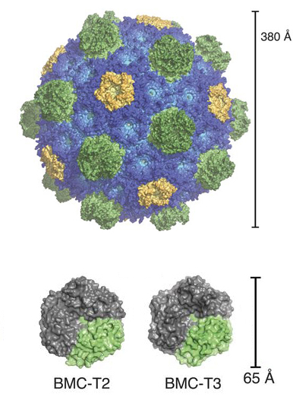
A Bacterial Jigsaw Puzzle Is Solved
Scientific Achievement
X-ray crystallography revealed how individual protein subunits fit together to form bacterial microcompart-ments (BMCs)—hollow protein shells that encapsulate enzymes involved in bacterial metabolism.
Significance and Impact
The resulting atomic-resolution views provide important information for fighting pathogens and for bioenergy or biotechnology applications.
Research Details
Pentamer, hexamer, and pseudo-hexamer subunits self-assemble into a 20-sided polyhedron.
Pores in the center of the hexamer/pseudo-hexamer subunits make the shell selectively permeable.
Details influencing curvature and size were elucidated, resulting in scaling principles for a range of shell sizes.
Top: Fully assembled BMC structure. Bottom: Structures of two of the five BMC shell components, solved for the first time in this work.
Publication about this research: M. Sutter, B. Greber, C. Aussignargues, and C.A. Kerfeld, Science 356, 1293 (2017). Work was performed at Lawrence Berkeley National Laboratory, ALS Beamline 5.0.2, and at SLAC National Accelerator Laboratory, SSRL Beamline 12.2. Operation of the ALS is supported by the U.S. Department of Energy, Office of Science, Basic Energy Sciences program.
Notes:
Bacterial microcompartments (BMCs) are hollow protein shells that encapsulate enzymes involved in bacterial metabolism. They serve to co-localize the enzymes and their reactants for greater efficiency, as well as to sequester reaction products from the rest of the cell. Despite the availability of structural information on individual shell components, the principles governing how the pieces fit together have remained elusive. Researchers have now performed protein crystallography studies at the ALS and at Stanford Synchrotron Radiation Lightsource (SSRL) of a fully assembled BMC as well as its separate building blocks. The resulting atomic-resolution views reveal the basic principles of shell construction and provide important information for fighting pathogens and for bioenergy or biotechnology applications.
Research conducted by: M. Sutter and C.A. Kerfeld (Michigan State University and Berkeley Lab), B. Greber (Berkeley Lab and UC Berkeley), and C. Aussignargues (Michigan State University).
Research funding: National Institutes of Health, Swiss National Science Foundation, and the U.S. Department of Energy, Office of Science, Basic Energy Sciences Program (DOE BES). Operation of the ALS is supported by DOE BES.
Full highlight: https://als.lbl.gov/bacterial-microcompartments-3d-jigsaw-puzzle

