Slide 1
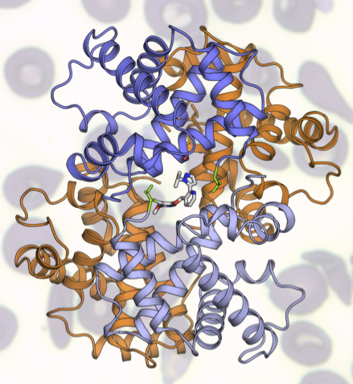
GBT Uses ALS to Tackle Sickle Cell Disease
Scientific Achievement
Global Blood Therapeutics (GBT) is using the crystallography capabilities at the ALS to develop a treatment for sickle cell disease (SCD) that prevents the polymerization of hemoglobin, the key event in the progression of SCD.
Significance and Impact
GBT has developed a compound, GBT440, which is currently in phase 3 clinical trials.
Research Details
GBT440 works by binding to hemoglobin, increasing its affinity for oxygen, inhibiting hemoglobin polymerization and preventing sickling.
The setup at Beamline 8.3.1 gives GBT the ability to immediately adapt their research based on results.
The structure of a compound that GBT studied at the ALS. This model of the hemoglobin S tetramer bound to the compound shows how the compound helps stabilize hemoglobin to prevent sickling.
Publications about this research: B. Metcalf, C. Chuang, K. Dufu, M.P. Patel, A. Silva-Garcia, C. Johnson, Q. Lu, J.R. Partridge, L. Patskovska, Y. Patrkovsky, S.C. Almo, M.P. Jacobson, L. Hua, Q. Xu, S.L. Gwaltney, C. Yee, J. Harris, B.P. Morgan, J. James, D. Xu, A. Hutchaleelaha, K. Paulvannan, D. Oksenberg, and Z. Li, ACS Med. Chem. Lett. 8, 3 (2017). Li, J. Partridge, A. Silva-Garcia, P. Rademacher, A. Betz, Q. Xu, H. Sham, Y. Hu, Y. Shan, B. Liu, Y. Zhang, H. Shi, Q. Xu, X. Ma, and L. Zhang, ACS Med. Chem. Lett. 8, 3 (2017). Work was performed in part at Lawrence Berkeley National Laboratory, ALS Beamline 8.3.1. Operation of the ALS is supported by the U.S. Department of Energy, Office of Science, Basic Energy Sciences program.
Notes:
Sickle cell disease (SCD) affects millions of people worldwide and is one of the most common genetic disorders in the United States. The most-used therapy for the disease is a cytotoxic drug with additional negative side effects and variable patient response. Bay Area biopharmaceutical company Global Blood Therapeutics (GBT) is on a mission to develop a better treatment and is using the ALS to help.
SCD is caused by a single cellular mutation in hemoglobin, a protein in red blood cells that carries oxygen throughout the body. This “sickled” hemoglobin can form stiff rods that adhere to blood vessel walls, causing a blockage that slows or stops the flow of blood. This prevents oxygen from reaching nearby tissues, causing attacks of sudden, severe pain and organ damage. SCD patients also often have trouble producing enough new red blood cells to replace the old cells, resulting in chronic anemia.
GBT is working to address SCD by developing a therapy that prevents the polymerization of hemoglobin, the key event in promoting the sickle shape. The ALS’s protein crystallography capabilities at Beamline 8.3.1 are critical to their work, giving them insights into potential molecular targets that they wouldn’t be able to access otherwise. Based on results from the ALS, GBT has developed a clear understanding of the molecular mechanism of their compound, GBT440, which works by binding to hemoglobin and increasing the affinity for oxygen, which inhibits hemoglobin polymerization and prevents “sickling.”
Full highlight: https://als.lbl.gov/global-blood-therapeutics-uses-als-tackle-sickle-cell-disease/

