Slide 1
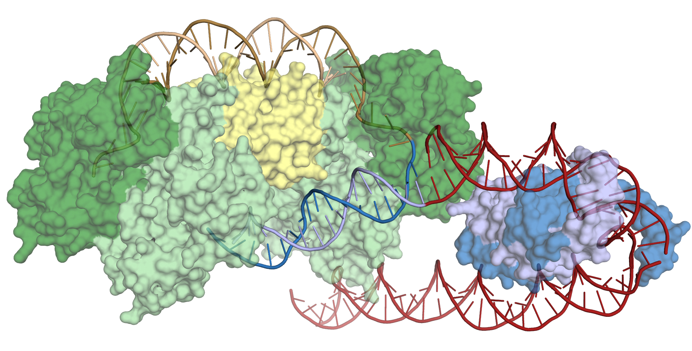
The CRISPR Target-Recognition Mechanism
Scientific Achievement
Structures of CRISPR-associated (Cas) proteins co-crystallized with DNA substrates reveal how the CRISPR-Cas system recognizes highly specific target-DNA sites for the integration of donor-DNA fragments.
Significance and Impact
The results provide insight into the evolution of sequence specificity in the CRISPR-Cas system and inform its development as a tool for encoding information in genomes.
Cas1-Cas2 (green/yellow) integrates a donor-DNA fragment (brown) into target DNA (blue/red) at a precise location in the CRISPR array. Bending of the target DNA by IHF (blue/purple) brings an upstream recognition sequence into contact with Cas1, increasing both the specificity and efficiency of integration.
Research Details
X-ray crystallography and cryo-EM were performed on Cas1-Cas2 in complex with DNA and an accessory protein (IHF) critical for the integration of DNA fragments.
IHF sharply bends the target DNA, bringing an upstream recognition sequence into contact with Cas1, increasing both the specificity and efficiency of integration.
Publication about this research: A.V. Wright, J.-J. Liu, G.J. Knott, K.W. Doxzen, E. Nogales, and J.A. Doudna, Science 357, 1113 (2017). Work was performed at Lawrence Berkeley National Laboratory, ALS Beamline 8.3.1, and SLAC National Accelerator Laboratory, SSRL Beamline 9-2. Operation of the ALS is supported by the U.S. Department of Energy, Office of Science, Basic Energy Sciences program.
Notes:
CRISPR-associated (Cas) proteins have recently revolutionized gene editing by vastly simplifying the insertion of short snippets of new ("donor") DNA into very specific locations of target DNA. Now, researchers have discovered how Cas proteins are able to recognize their target locations with such great specificity. X-ray crystallography was used to solve the structures of Cas1 and Cas2—responsible for DNA-snippet capture and integration—as they were bound to synthesized DNA strands designed to mimic different stages of the process. The resulting structures not only show how the system works in its native context (as part of a bacterial immune system), they also inform the development of the CRISPR-Cas system as a general-purpose molecular recording device—a tool for encoding information in genomes.
Research conducted by: A.V. Wright, G.J. Knott, and K.W. Doxzen (UC Berkeley); J.-J. Liu (UC Berkeley and Berkeley Lab); and E. Nogales and J.A. Doudna (UC Berkeley, Berkeley Lab, and Howard Hughes Medical Institute).
Research funding: National Science Foundation, National Institutes of Health, and Howard Hughes Medical Institute. Operation of the ALS is supported by the U.S. Department of Science, Office of Science, Basic Energy Sciences Program.
Full highlight: https://als.lbl.gov/the-crispr-target-recognition-mechanism/

