Slide 1
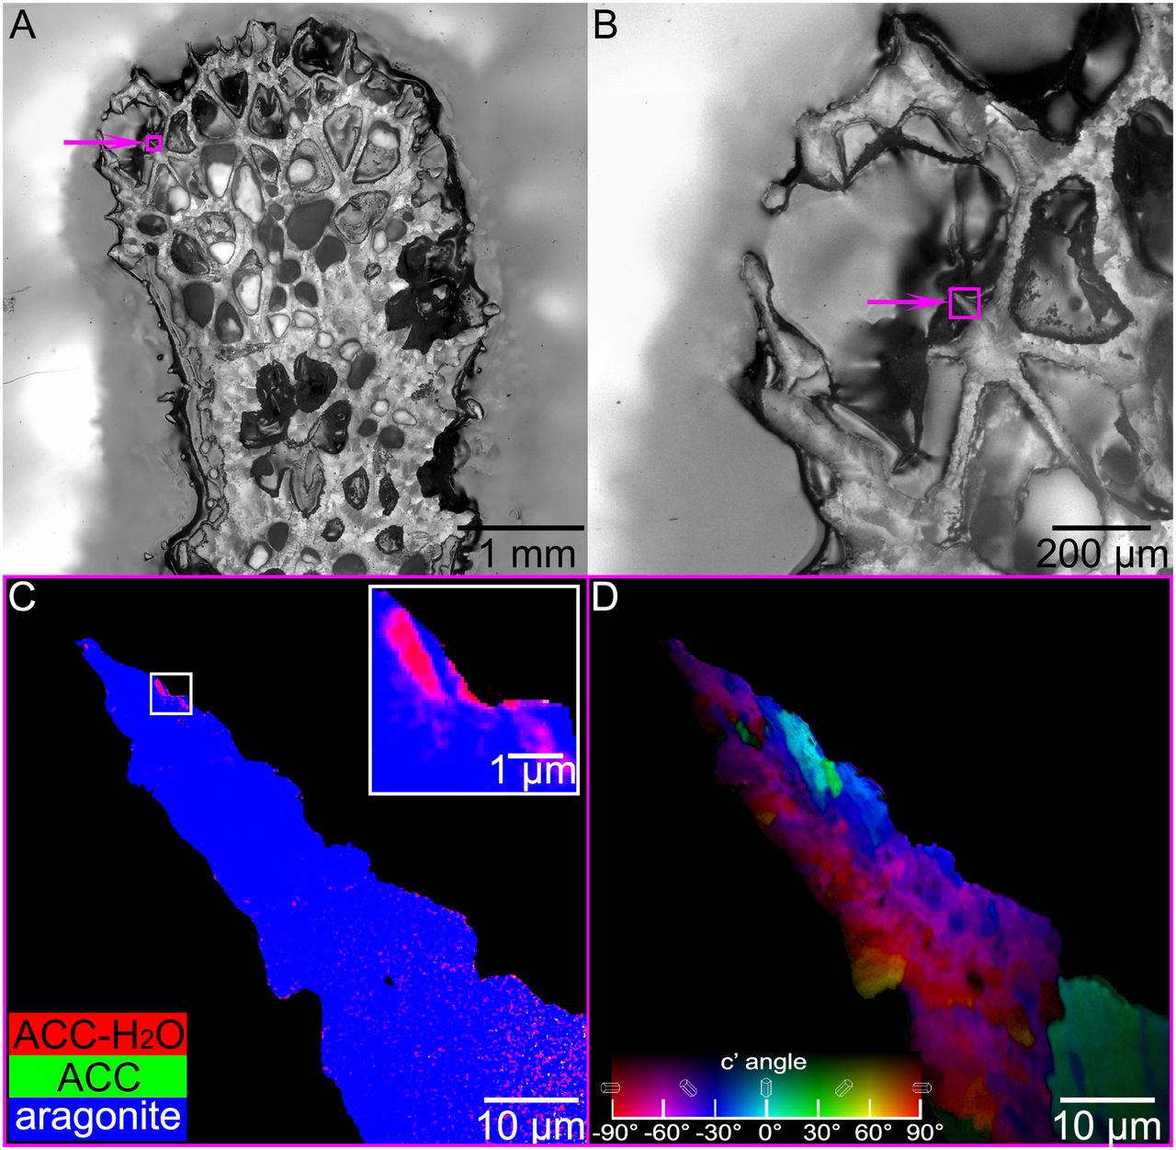
Coral Exoskeleton Growth Begins Inside Living Tissue
Scientific Achievement
Researchers found that skeleton growth for the coral S. pistillata begins with the formation of large, amorphous particles inside the coral’s living tissue.
Significance and Impact
The results provide direct evidence for a particle-by-particle model of growth that is over 100 times faster than the classical ion-by-ion model, giving the coral a physiological advantage in competitive reef ecosystems.
Research Details
Photoemission electron microscopy (PEEM) studies found large, amorphous calcium carbonate (ACC) particles at the tissue-skeleton interface.
(A-B) Micrographs of coral skeleton, with areas of new growth highlighted. (C) PEEM map of highlighted area showing presence of ACC (inset).
(D) PEEM polarization-dependent imaging contrast (PIC) map showing particle size.
Grain sizes averaged about 400 nm, much larger than the expected tens of nm.
The ACC growth model could offer protection against effects of ocean acidification.
Publication about this research: T. Mass, A.J. Giuffre, C.-Y. Sun, C.A. Stifler, M.J. Frazier, M. Neder, N. Tamura, C.V. Stan, M.A. Marcus, and P.U.P.A. Gilbert, PNAS 114, E7670 (2017). Work was performed at Lawrence Berkeley National Laboratory, ALS Beamlines 11.0.1 and 12.3.2. Operation of the ALS is supported by the U.S. Department of Energy, Office of Science, Basic Energy Sciences program.
Notes:
As coral colonies thrive, they build strong, sculptural exoskeletons on which they live. How will ocean acidification affect these living works of art? Researchers have recently discovered some good news: coral skeletons grow by the aggregation of surprisingly large particles that form within the coral’s living tissue, where acidity can be controlled biologically. The evidence was provided by photoemission electron microscopy (PEEM) at the ALS, an x-ray technique that can map the chemical and physical characteristics of materials on a microscopic scale. The discovery has ramifications, not only for the health of coral reefs, but for applications such as 3D printing as well.
Research led by P.U.P.A. Gilbert and conducted by: T. Mass (U. of Haifa, Israel); A.J. Giuffre, C.-Y. Sun, C.A. Stifler, M.J. Frazier, and P.U.P.A. Gilbert (U. of Wisconsin–Madison); M. Neder (U. of Haifa and Interuniversity Institute for Marine Sciences–Eilat, Israel); and N. Tamura, C.V. Stan, and M.A. Marcus (ALS).
Research funding: U.S. Department of Energy, Office of Science, Basic Energy Sciences Program (DOE BES); National Science Foundation; United States–Israel Binational Science Foundation; and Israel Science Foundation. Operation of the ALS is supported by DOE BES.
Full highlight: https://als.lbl.gov/coral-exoskeleton-growth-begins-inside-living-tissue/

