Slide 1
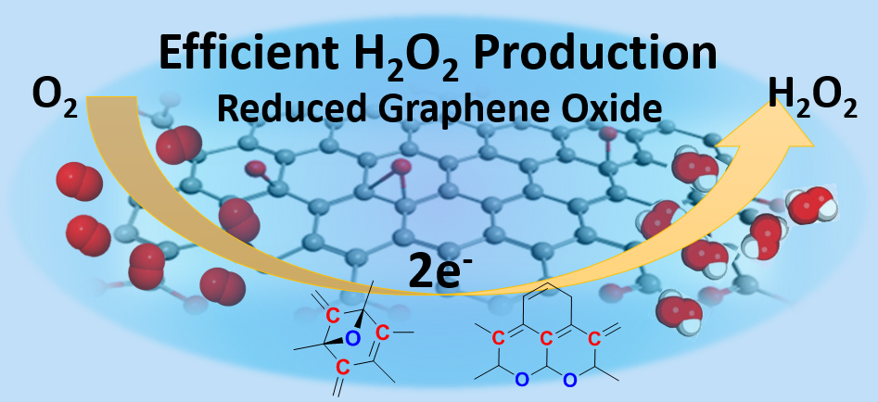
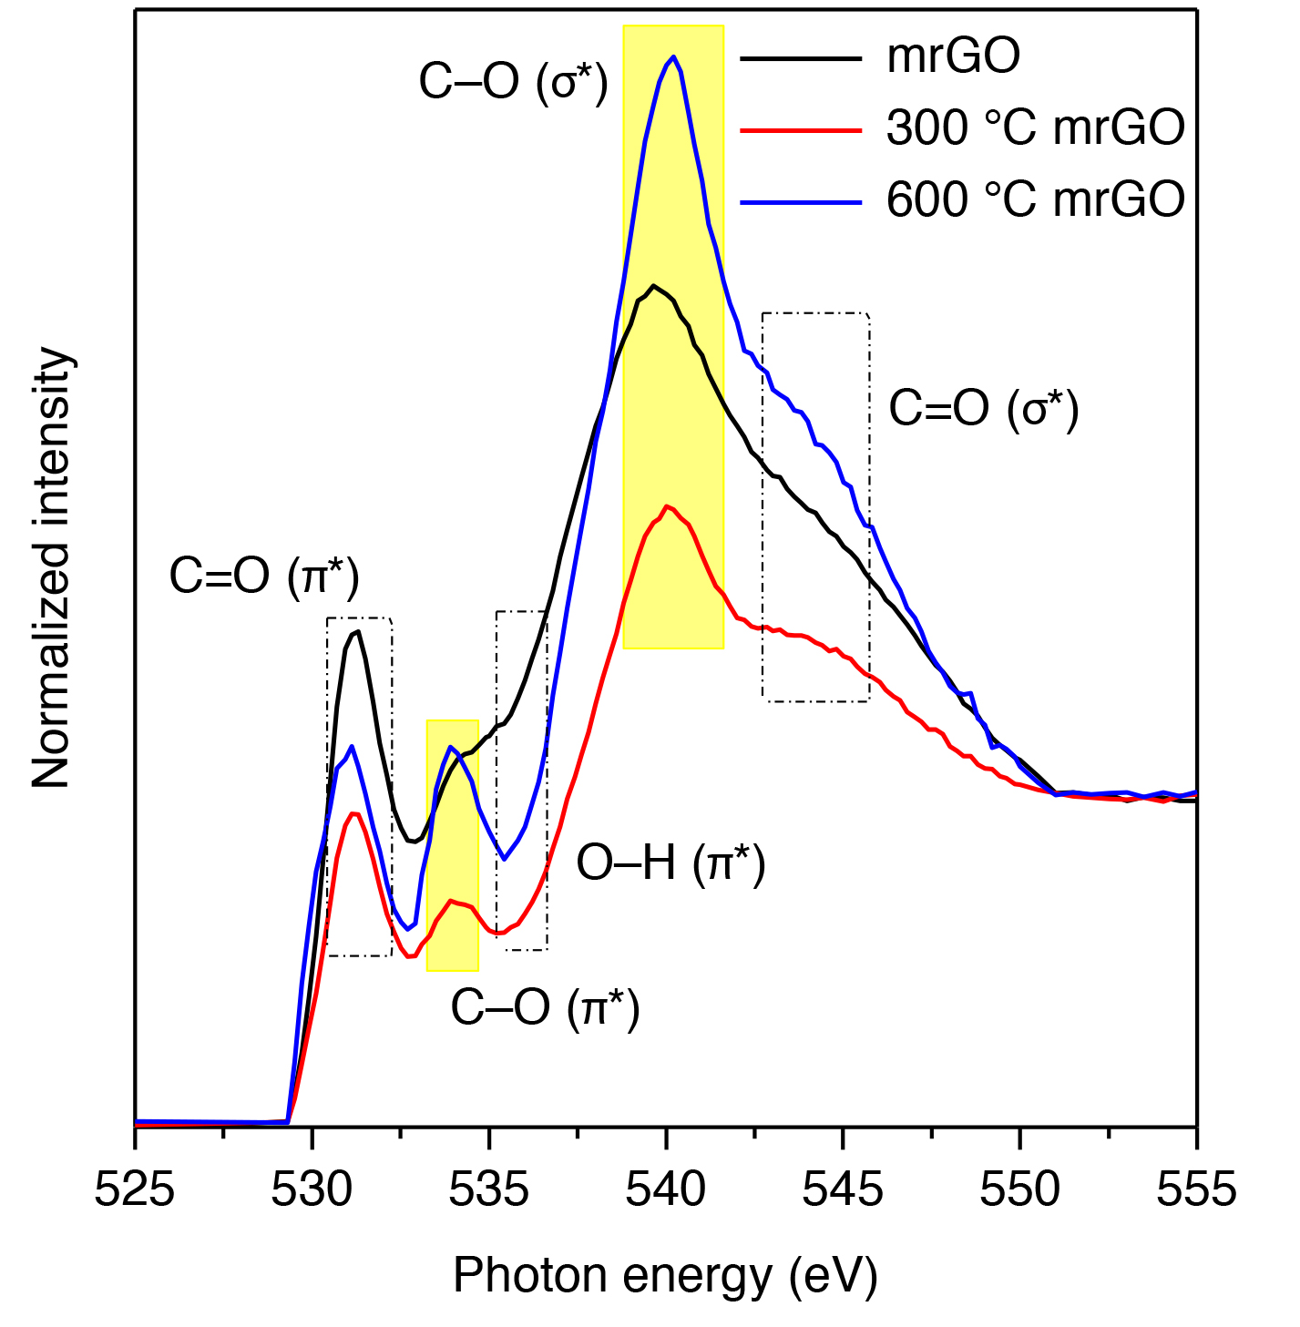
Graphene-Based Catalyst Improves Peroxide Production
Scientific Achievement
Scientists formulated and characterized a graphene oxide electrocatalyst that potentially makes the production of hydrogen peroxide more selective, efficient, and cost effective.
Production of hydrogen peroxide (H₂O₂) from oxygen (O₂), catalyzed by graphene oxide.
Significance and Impact
Hydrogen peroxide is an important commodity chemical
with a growing demand in many areas, including the elec-tronics industry, paper recycling, and wastewater treatment.
Research Details
"Mildly reduced" graphene oxide (mrGO) samples preserve oxygen defects (centers of catalytic activity).
Near-edge x-ray absorption fine structure (NEXAFS) and other spectroscopic techiques were used to probe the relationship between defect structure and function.
"Ring ether" oxygen defects, located at edges of mrGO plane, are primarily responsible for catalytic activity.
High-resolution oxygen K-edge NEXAFS. A sharp peak at 540.4 eV indicates that "ring ether" defects at graphene edges is responsible for observed catalytic activity.
Publication about this research: H.W. Kim, M. Ross, N. Kornienko, L. Zhang, J.-H. Guo, P. Yang, and B. McCloskey, Nat. Catal. 1, 282 (2018). Work was performed at Lawrence Berkeley National Laboratory, ALS Beamline 8.0.1. Operation of the ALS is supported by the U.S. Department of Energy, Office of Science, Basic Energy Sciences program.
Notes:
Compared to chlorine-based bleaches, hydrogen peroxide is more environmentally benign: the only degradation product of its use is water. However, it's currently produced through a multistep chemical reaction that consumes significant amounts of energy, generates substantial waste, and requires a catalyst of palladium—a rare and expensive metal. Furthermore, the transport and storage of bulk hydrogen peroxide can be hazardous, making local, on-demand production highly desirable. Scientists seek a way to generate hydrogen peroxide electrochemically—by a much simpler process called the oxygen reduction reaction (ORR). To realize the advantages of electrochemical production, however, electrodes that catalyze the ORR selectively, efficiently, and cost effectively need to be developed. A suite of experimental techniques, including NEXAFS at the ALS, helped researchers understand the relationship between defect structures and catalytic properties in a graphene oxide electrocatalyst.
Researchers: H.W. Kim, P. Yang, and B. McCloskey (UC Berkeley and Berkeley Lab); M. Ross and N. Kornienko (UC Berkeley); and L. Zhang and J.-H. Guo (ALS).
Funding: National Science Foundation, National Research Foundation of Korea, Royal Society International Newton Fellowship, and U.S. Department of Energy, Office of Science, Basic Energy Sciences Program (DOE BES). Operation of the ALS is supported by DOE BES.
Full highlight: https://als.lbl.gov/graphene-based-catalyst-improves-peroxide-production/

