Slide 1
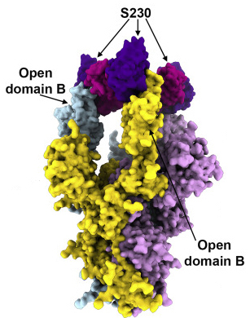
Antibody Uses Mimicry to Block SARS Coronavirus
Scientific Achievement
Protein structures not only revealed how SARS and MERS antibodies inhibit the viruses from attaching to host cells, they also revealed an unprecedented example of receptor mimicry that triggers the cell-invasion machinery of the SARS virus.
Significance and Impact
The results inform efforts to prevent and treat these serious, often deadly, respiratory diseases.
Research Details
Coronaviruses have spike proteins projecting from their surfaces that mediate fusion with host cells.
Spike/antibody complexes studied using cryo-EM, mass spectrometry, and protein crystallography.
The SARS spike protein (with three protomers colored light blue, plum, and yellow) in complex with three S230 neutralizing antibodies (purple/pink), from combined cryo-EM and crystallography data.
SARS antibody induces structural changes necessary for spike to begin cell fusion.
If triggered before attachment to host cell, changes effectively neutralize the virus.
Publication about this research: A.C. Walls, X. Xiong, Y.-J. Park, M.A. Tortorici, J. Snijder, J. Quispe, E. Cameroni, R. Gopal, M. Dai, A. Lanzavecchia, M. Zambon, F.A. Rey, D. Corti, and D. Veesler, Cell 176, 1026 (2019). Work was performed at Lawrence Berkeley National Laboratory, ALS Beamline 5.0.1. Operation of the ALS is supported by the U.S. Department of Energy, Office of Science, Basic Energy Sciences program.
Notes:
Severe acute respiratory syndrome (SARS) emerged in 2002, spreading across the globe and resulting in 8,000 infections and nearly 800 deaths. Middle East respiratory syndrome (MERS) emerged in 2012 and caused numerous outbreaks, with a fatality rate of 35%. Currently, there are no specific treatments or vaccines for viruses of this type (i.e., coronaviruses). Their effects range from mild cold-like symptoms to life-threatening pneumonias. In bats and other animals, coronaviruses with high genomic similarity to the human-infecting strains are constantly circulating, increasing the likelihood of future cross-species transmission. And although coronaviruses are genomically related, functionally they can be quite specialized. For example, antibodies that work against SARS won’t necessarily work against MERS, and vice versa. To better understand how the antibodies work, researchers used cryo-electron microscopy (cryo-EM), mass spectrometry, and protein crystallography to perform structural analyses of the SARS and MERS spike protein together with their antibodies.
Researchers: A.C. Walls, X. Xiong, Y.-J. Park, J. Snijder, J. Quispe, and D. Veesler (University of Washington); M.A. Tortorici (University of Washington and Pasteur Institute); E. Cameroni and D. Corti (Humabs Biomed, Switzerland); R. Gopal and M. Zambon (Public Health England); M. Dai (Francis Crick Institute); A. Lanzavecchia (Università della Svizzera italiana, Switzerland); and F.A. Rey (Pasteur Institute).
Funding: National Instututes of Health, Pew Charitable Trusts, Burroughs Wellcome Fund, Netherlands Organisation for Scientific Research, European Molecular Biology Organization, Zoonoses Anticipation and Preparedness Initiative, Pasteur Institute, French National Center for Scientific Research, and the University of Washington Arnold and Mabel Beckman CryoEM Center and Proteomics Resource. Operation of the ALS is supported by the U.S. Department of Energy, Office of Science, Basic Energy Sciences Program.
Full highlight: https://als.lbl.gov/antibody-uses-mimicry-to-block-sars-coronavirus

