Slide 1
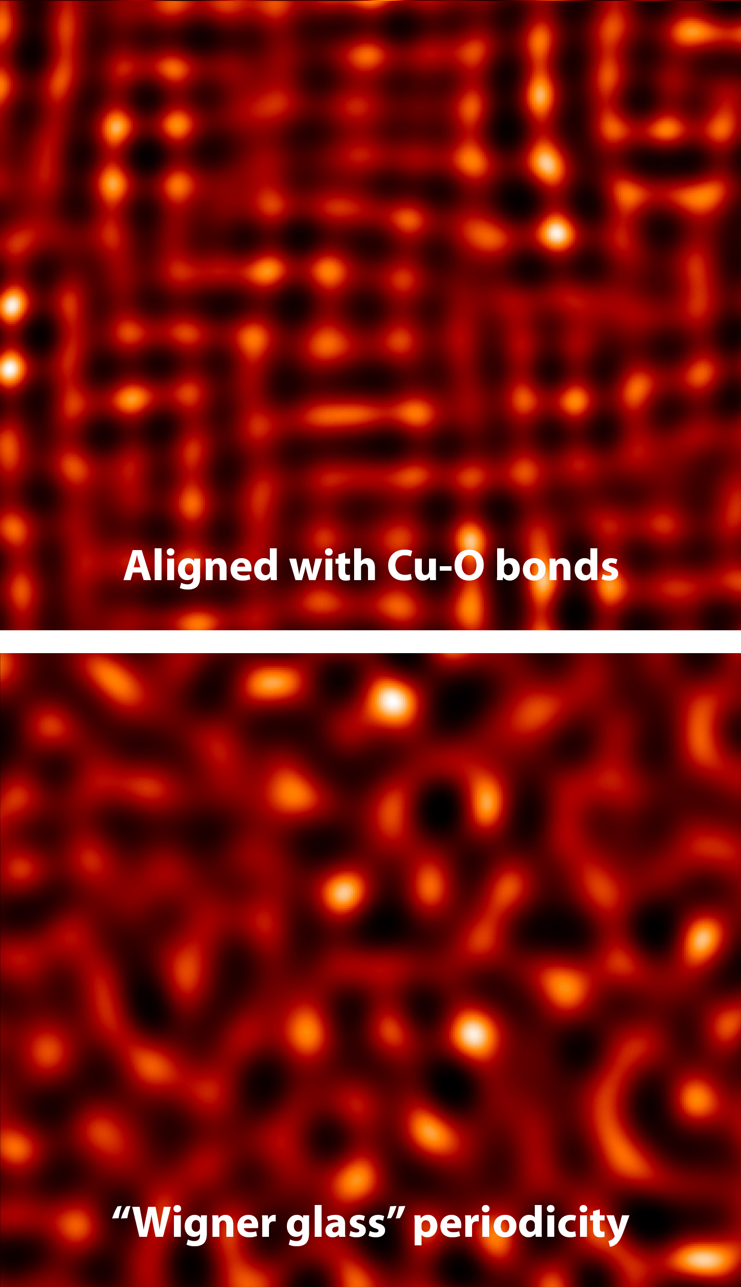
Superconductor Exhibits "Glassy" Electronic Phase
Scientific Achievement
Researchers discovered that electrons in a high-temperature superconductor can exhibit a new type of collective behavior that is more “glassy” (disordered) than expected.
Significance and Impact
The study provides valuable insight into the nature of collective electron behaviors and how they relate to high-temperature superconductivity.
Research Details
Electron-doped cuprates, Nd₂CuO₄ and Pr₂CuO₄, studied using resonant soft x-ray diffraction (RSXD).
Charge-density waves typically align with Cu–O bonds.
RSXD data showed that, at low doping levels, charge order has no orientational preference ("Wigner glass").
Calculations suggest that this behavior arises from the interplay between antiferromagnetism and charge order.
Charge ordering in electron-doped cuprates, calculated from RSXD data. Charge-density waves take on a "glassy" character in the presence of antiferro-magnetism (bottom image).
Publication about this research: M. Kang, J. Pelliciari, A. Frano, N. Breznay, E. Schierle, E. Weschke, R. Sutarto, F. He, P. Shafer, E. Arenholz, M. Chen, K. Zhang, A. Ruiz, Z. Hao, S. Lewin, J. Analytis, Y. Krockenberger, H. Yamamoto, T. Das, and R. Comin, Nat. Phys. 15, 335 (2019). Work was performed at Lawrence Berkeley National Laboratory, ALS Beamline 4.0.2. Operation of the ALS is supported by the U.S. Department of Energy, Office of Science, Basic Energy Sciences program.
Notes:
At extremely low temperatures, superconductors conduct electricity without resistance, a characteristic that’s already being used in cryogenically cooled power lines and quantum-computer prototypes. To apply this characteristic more widely, however, it's necessary to raise the temperature at which materials become superconducting. Unfortunately, the exact mechanism by which this happens remains unclear. Recently, scientists found that electrons in cuprate superconductors can self-organize into charge-density waves—periodic modulations in electron density that hinder the flow of electrons. As this effect is antagonistic to superconductivity, tremendous effort has been devoted to fully characterizing this charge-order phase and its interplay with high-temperature superconductivity. Although previous studies found that charge-density waves align parallel to the copper–oxide bonds in cuprate materials, the situation can be more complex in the presence of the strong electron–electron interactions found in superconductors. In this work, the researchers broadened the investigation of charge order by performing diffraction experiments along multiple directions, using resonant soft x-ray diffraction.
Researchers: M. Kang, J. Pelliciari, and R. Comin (Massachusetts Institute of Technology); A. Frano (UC Berkeley and UC San Diego); N. Breznay, M. Chen, K. Zhang, A. Ruiz, Z. Hao, S. Lewin, and J. Analytis (UC Berkeley); E. Schierle and E. Weschke (Helmholtz Zentrum Berlin für Materialien und Energie, Germany); R. Sutarto and F. He (Canadian Light Source); P. Shafer and E. Arenholz (ALS); Y. Krockenberger and H. Yamamoto (NTT Basic Research Laboratories, Japan); and T. Das (Indian Institute of Science, India).
Funding: National Science Foundation, Canada Foundation for Innovation, Natural Sciences and Engineering Research Council of Canada, University of Saskatchewan, Government of Saskatchewan, Western Economic Diversification Canada, National Research Council Canada, Canada Institutes of Health Research, Samsung Foundation of Culture, Swiss National Science Foundation, Gordon and Betty Moore Foundation, Infosys Science Foundation, and U.S. Department of Energy, Office of Science, Basic Energy Sciences Program (DOE BES). Operation of the ALS is supported by DOE BES.
Full highlight: https://als.lbl.gov/superconductor-exhibits-glassy-electronic-phase

