Slide 1
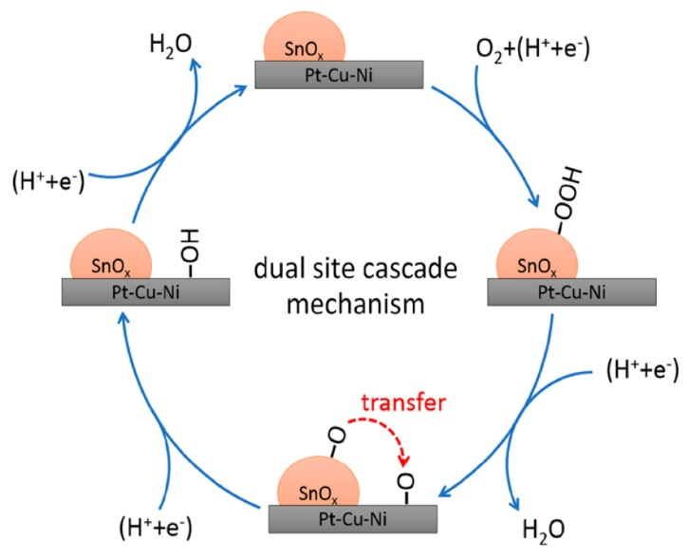
ALS Confirms Mechanism for Improved Fuel Cell Catalysis
Scientific Achievement
Researchers from Toyota and the University of Akron used the Advanced Light Source to uncover a new catalysis mechanism that improves oxidation-reduction reactions in certain fuel cells by 40%.
Significance and Impact
Improving the efficiency of fuel cells will enable car companies like Toyota to increase vehicle fuel efficiency and drive range while decreasing costs and component sizes.
Research Details
Spectroscopy at Beamlines 5.3.1 and 7.3.1 revealed the oxidation state of tin in the fuel cell samples to be Sn4+.
The tin oxide provides an active site for an initial oxidation-reduction reaction that has a lower activation energy than the platinum-based active site currently used in fuel cells.
Adding a tin oxide active site decreases the energy required for oxidation-reduction reactions in fuel cells that use platinum-based active sites. An initial oxidation-reduction reaction occurs at the tin oxide active site, and an oxygen is transferred to the platinum-based active site, where further oxidation-reduction takes place.
Publication about this research: X. Shen, T. Nagai, L.Q. Zhou, Y. Pan, L. Yao, D. Wu, Y.-S. Liu, J. Feng, J. Guo, H. Jia, Z. Peng, J. Am. Chem. Soc. 141, 9463 (2019). Work was performed at Lawrence Berkeley National Laboratory, ALS Beamlines 5.3.1 and 7.3.1. Operation of the ALS is supported by the U.S. Department of Energy, Office of Science, Basic Energy Sciences program.
Notes:
Toyota has set ambitious targets for products to reach the market by 2030. To achieve their goals, they have prioritized fundamental research in fuel cell catalysis. A recent collaboration between the Toyota Research Institute of North America and the University of Akron, enhanced by characterization at the Advanced Light Source (ALS), yielded a 40% improvement on existing catalysis technology.
Fuel cells currently on the market rely on a series of slow oxidation-reduction reactions, requiring a platinum-based catalyst to speed up each step. However, current technology has reached a plateau. Scientists from the Toyota Research Institute of North America (TRINA) worked with researchers at the University of Akron, introducing a second active site to the catalyst in the form of tin oxide. Not only is tin oxide less costly than platinum, the energy required to use this active site is lower as well. They approached the ALS to clarify the new catalysis mechanism. X-ray absorption near-edge structure (XANES) spectroscopy measurements revealed the oxidation state of tin in the samples to be Sn⁴⁺, allowing a deeper understanding of how tin oxide increases the efficiency of the catalyst. In the new fuel cell samples, oxidation-reduction reactions proceed from a lower- to a higher-energy requirement.
Researchers: X. Shen, Y. Pan, L. Yao, D. Wu, and Z. Peng (University of Akron); F. Yang (University of Akron and the Advanced Light Source); T. Nagai, L.Q. Zhou, and H. Jia (Toyota Research Institute of North America); Y.-S. Liu, J. Feng, and J. Guo (Advanced Light Source).
Funding: Toyota Research Institute of North America; University of Akron; Ohio Research Scholars Program. Operation of the ALS is supported by the DOE Office of Science, Basic Energy Sciences Program.
Full highlight: https://als.lbl.gov/als-confirms-mechanism-for-improved-fuel-cell-catalysis

