Slide 1
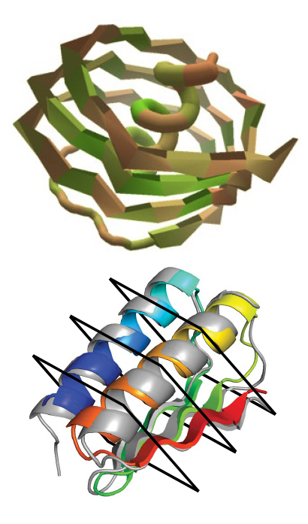
A Citizen-Science Computer Game for Protein Design
Scientific Achievement
Using the computer game, "Foldit," nonexpert citizen scientists designed new proteins whose structures, verified at the ALS, were equivalent in quality to and more structurally diverse than computer-generated designs.
Significance and Impact
The work shows the potential of using crowd-based creativity in the design of new proteins for fighting illness and disease.
Research Details
Players given a completely unfolded amino-acid chain.
Of 146 designs generated, 56 adopted stable structures when produced in a lab.
Three of the structures were verified experimentally using high-resolution x-ray crystallography at the ALS.
Top: Foldit players explore structures that lie outside the limited "protein space" in which natural proteins are found. Bottom: A viable gamer-designed protein (colored ribbons) closely matches the crystallographic structure (gray).
Publication about this research: B. Koepnick, J. Flatten, T. Husain, A. Ford, D.-A. Silva, M.J. Bick, A. Bauer, G. Liu, Y. Ishida, A. Boykov, R.D. Estep, S. Kleinfelter, T. Nørgård-Solano, L. Wei, Foldit Players, G.T. Montelione, F. DiMaio, Z. Popović, F. Khatib, S. Cooper, and D. Baker, Nature 570, 390 (2019). Work was performed at Lawrence Berkeley National Laboratory, ALS Beamlines 5.0.1, 8.2.1, and 8.2.2. Operation of the ALS is supported by the U.S. Department of Energy, Office of Science, Basic Energy Sciences program.
Notes:
Proteins constitute the biomachinery—the cellular gears and levers—that make our bodies work. When the machinery breaks down, the tools needed to fix the problem (i.e. drug molecules) are often proteins themselves. Until recently, the pool of proteins available for such therapeutic purposes was limited to those found in nature. But natural proteins represent a small subset of all the possible ways to link 20 amino acids—the basic building blocks of all proteins—into chains hundreds, even thousands, of units long. On top of this, there are countless ways in which any given protein chain can fold—a key aspect of functionality. "Foldit," a free online computer game, was developed to enable players to predict and design protein structures. Because the game encodes the specialized knowledge of experts on molecular interactions, players are free to let their imaginations (and competitive spirit) guide their decisions.
Researchers: B. Koepnick, J. Flatten, T. Husain, A. Ford, D.-A. Silva, M.J. Bick, A. Bauer, F. DiMaio, and Z. Popović (University of Washington); G. Liu (Rutgers University and Nexomics Biosciences); Y. Ishida and G.T. Montelione (Rutgers University); A. Boykov, R.D. Estep, S. Kleinfelter, T. Nørgård-Solano, L. Wei, and Foldit Players (unaffiliated); F. Khatib (University of Massachusetts Dartmouth); S. Cooper (Northeastern University); and D. Baker (University of Washington and Howard Hughes Medical Institute).
Funding: National Science Foundation, National Institutes of Health, and Howard Hughes Medical Institute. Operation of the ALS is supported by the U.S. Department of Energy, Office of Science, Basic Energy Sciences Program.
Full highlight: https://als.lbl.gov/a-citizen-science-computer-game-for-protein-design/

