Slide 1
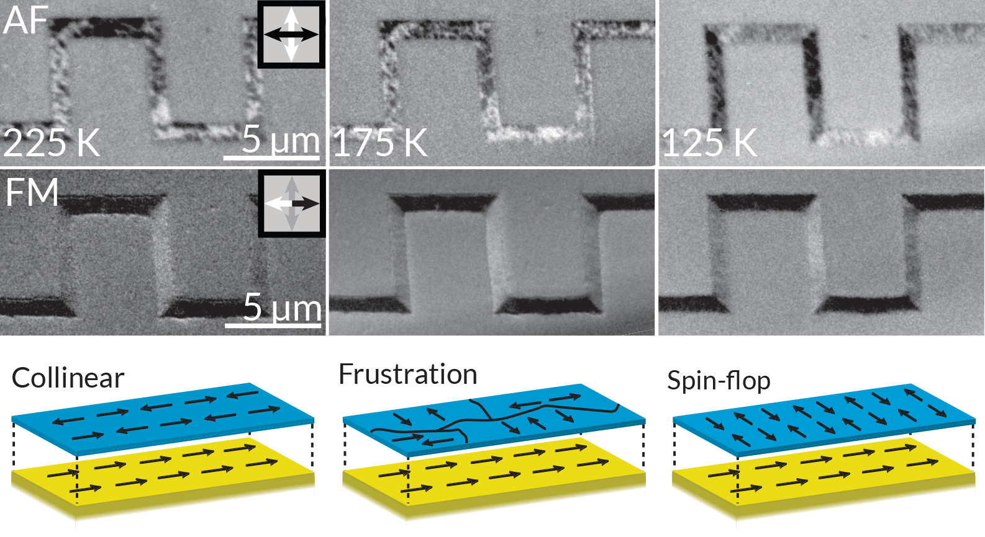
Controlling Spin in Antiferromagnetic Nanostructures
Scientific Achievement
Researchers using the ALS discovered that the spin configuration of a nano-structured antiferromagnetic material can be affected by the dimensions of features imprinted onto the material.
Significance and Impact
The results suggest that nanoscale patterning can be a viable tool for engineering spin configurations in future antiferromagnetic spintronic devices.
“Square wave” patterns of various thicknesses were imprinted onto a thin antiferromagnetic (AF) layer on top of a ferromagnetic (FM) layer. PEEM revealed how the AF and FM spin configurations were affected by changes in temperature and linewidth. Bottom: Schematic of AF (blue) and FM (yellow) spin configurations corresponding to the images above.
Research Details
Samples consisted of patterned thin-film AF/FM bilayers (LaFeO₃/La_{0.3}Sr_{0.7}MnO₃).
Studied using circularly and linearly polarized x-ray absorption spectroscopy (XAS) and photemission electron microscopy (PEEM).
Spin alignment is temperature-dependent, tunable by varying pattern linewidths.
Publication about this research: A.D. Bang, I. Hallsteinsen, F.K. Olsen, S.D. Slöetjes, S.T. Retterer, A. Scholl, E. Arenholz, E. Folven, and J.K. Grepstad, Appl. Phys. Lett. 114, 192403 (2019). Work was performed at Lawrence Berkeley National Laboratory, ALS Beamlines 4.0.2 and 11.0.1. Operation of the ALS is supported by the U.S. Department of Energy, Office of Science, Basic Energy Sciences program.
Notes:
The inclusion of antiferromagnetic (AF) materials in future information technology hardware is an enticing prospect, promising fast, energy-efficient devices with unparalleled robustness of the encoded information. Unlike their ferromagnetic (FM) cousins, AF materials are magnetically compensated (i.e., there is no net magnetization, since the material’s antiparallel spins cancel each other out). Therefore, AF-based spintronic components would not be adversely affected by infringing stray fields. However, the absence of a net magnetization is a double-edged sword, as it also renders the spin configuration notoriously difficult to control. A “handle” for manipulating spin will be important for future AF spintronic devices. One potential handle is a little-understood AF "shape effect" on spin configurations near the edges of nano- and microstructures. Another handle is the interface exchange coupling between AF and FM layers. By investigating the impact of these competing forces as a function of structural dimensions, temperature, and applied magnetic fields, researchers can better understand the origins and engineering opportunities offered by these phenomena.
Researchers: A.D. Bang, F.K. Olsen, S.D. Slöetjes, E. Folven, and J.K. Grepstad (Norwegian University of Science and Technology); I. Hallsteinsen (Norwegian University of Science and Technology and ALS); S.T. Retterer (Oak Ridge National Laboratory); and A. Scholl and E. Arenholz (ALS).
Funding: Research Council of Norway and U.S. Department of Energy, Office of Science, Basic Energy Sciences Program (DOE BES). Operation of the ALS is supported by DOE BES.
Full highlight: https://als.lbl.gov/controlling-spin-in-antiferromagnetic-nanostructures/

