Slide 1
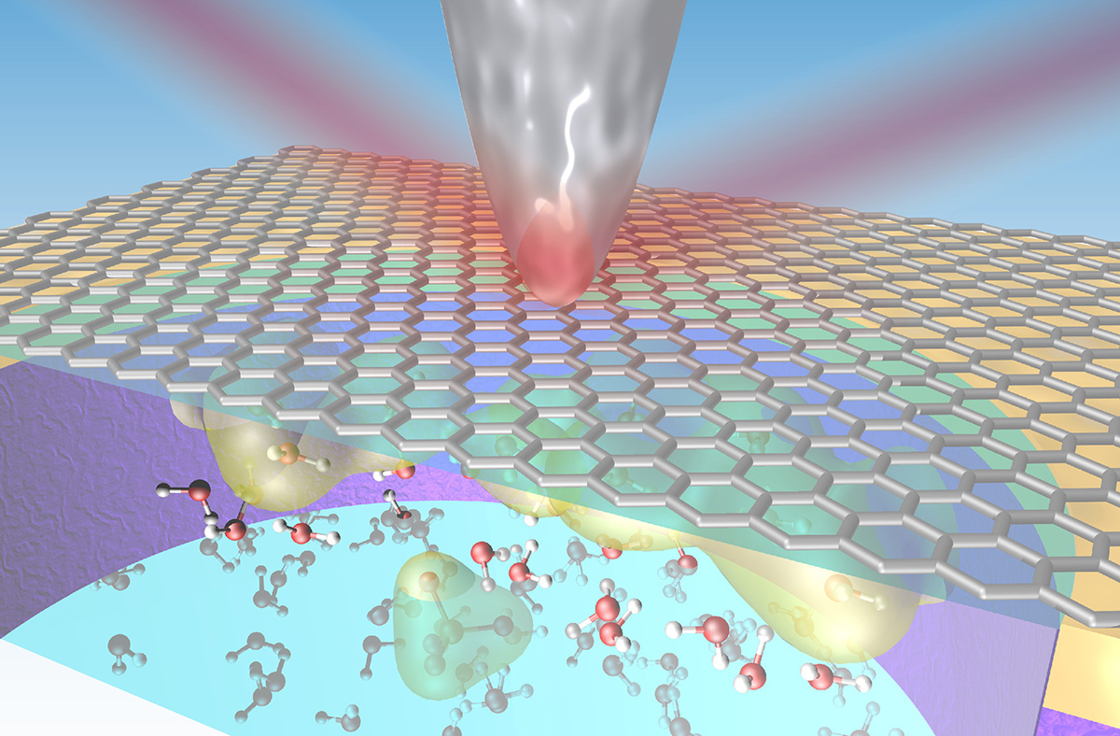
IR Nanospectroscopy at Graphene–Liquid Interfaces
Scientific Achievement
At the Advanced Light Source, researchers developed a new infrared (IR) approach to probing the first few molecular layers of a liquid in contact with a graphene electrode under operating conditions.
Significance and Impact
The work offers a new way to study the interfaces that are key to understanding batteries, corrosion, and other bio- and electrochemical phenomena.
0.1M
1.0M
Absorbance (au)
2.0M
µm
0.1M
nm
Absorbance (au)
Research Details
Synchrotron IR nanospectroscopy (SINS) overcomes IR diffraction limit; enables nanoscale spatial resolution.
Use of graphene-capped liquid cell; graphene also acts as working electrode for operando studies.
Results open door to future simulation work identi-fying species in electrical double layers.
Wavenumber /cm⁻¹
Top: IR light focused onto the tip of an atomic force microscope enables the acquisition of vibrational spectra from graphene–liquid interfaces with nanometer spatial resolution.
Bottom: Comparison of conventional IR spectroscopy (ATR-FTIR) with nanospectroscopy (nano-FTIR).
Publication about this research: Y.-H. Lu, J.M. Larson, A. Baskin, X. Zhao, P.D. Ashby, D. Prendergast, H.A. Bechtel, R. Kostecki, and M. Salmeron, Nano Lett. 19, 5388 (2019). Work was performed at Lawrence Berkeley National Laboratory, ALS Beamlines 2.4 and 5.4. Operation of the ALS is supported by the U.S. Department of Energy, Office of Science, Basic Energy Sciences program.
Notes:
Solid–liquid interfaces are vital to physical and chemical processes in many subjects, including corrosion, the generation and storage of energy (fuel cells, batteries), biology (ion transport through cell membranes), and environmental science (chemical weathering). However, solid–liquid interfaces are difficult to experiment on because they are buried under the bulk of the materials on either side of the interface. Furthermore, the interface region is extremely thin—only a few atomic layers. Many techniques for probing materials reveal just surface information, or, if they can penetrate more deeply, provide information averaged over a large volume, rather than from a thin slice close to an interface. In this work, researchers from several Berkeley Lab divisions—Materials Sciences, Energy Storage and Distributed Resources, the Molecular Foundry, and the ALS—developed a way to collect infrared vibrational spectra at a graphene–electrolyte interface with nanoscale spatial resolution.
Researchers: Y.-H. Lu, J.M. Larson, A. Baskin, P.D. Ashby, D. Prendergast and R. Kostecki (Berkeley Lab); X. Zhao and M. Salmeron (Berkeley Lab and UC Berkeley); and H.A. Bechtel (ALS).
Funding: U.S. Department of Energy, Office of Science, Basic Energy Sciences Program (DOE BES); and Energy Biosciences Institute (EBI)-Shell Research Program. Operation of the ALS is supported by DOE BES.
Full highlight: https://als.lbl.gov/infrared-nanospectroscopy-at-graphene-liquid-interfaces/

