Slide 1
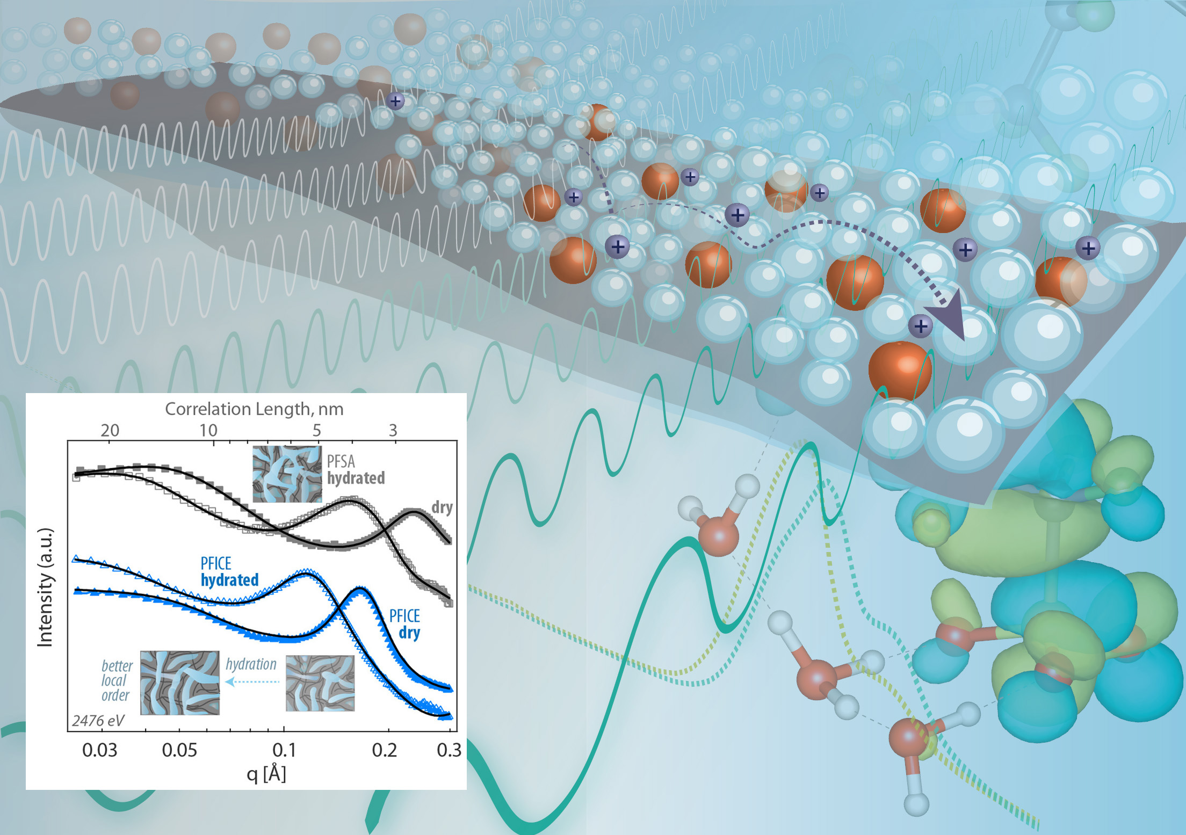
Multimodal Study of Ion-Conducting Membranes
Scientific Achievement
Using multiple x-ray characterization tools at the Advanced Light Source, researchers showed how chemical and structural changes improve the performance of a novel ion-conducting polymer (ionomer) membrane from 3M Company.
Significance and Impact
The work provides insight into factors impacting the proton conductivity of ionomers used for fuel cells and the production of hydrogen fuel.
Resonant x-ray scattering (RXS) and x-ray absorption spectroscopy (XAS) with tender x-rays provide the elemental sensitivity needed to unravel structural features and chemical factors affecting morphology and ion transport in proton-conducting membranes. Inset: Scattering curves provide data on the connectivity of transport networks.
Research Details
Interplay between chemistry, structure, and function explored using resonant scattering and spectroscopy with tender x-rays.
Conventional (PFSA) and novel (PFICE) materials studied in wet and dry conditions.
PFICE showed overall greater connectivity of its proton-conducting domains.
Publication about this research: G.M. Su, I.A. Cordova, M.A. Yandrasits, M. Lindell, J. Feng, C. Wang, and A. Kusoglu, J. Am. Chem. Soc. 141, 13547 (2019). Work was performed at Lawrence Berkeley National Laboratory, ALS Beamlines 5.3.1, 7.3.3, and 11.0.1.2. Operation of the ALS is supported by the U.S. Department of Energy, Office of Science, Basic Energy Sciences program.
Notes:
In fuel cells (which generate clean power from hydrogen fuel) and electrolyzers (water-splitting devices that produce hydrogen fuel), positive and negative electrodes are separated by membranes composed of ion-conducting polymers (ionomers). These membranes prevent contact between the electrodes—thus avoiding catastrophic failure—while allowing ions to pass through to complete the circuit. Generally, such membranes are based on a class of perfluorosulfonic acid (PFSA) ionomers with remarkable proton conductivity and stability. Recently, however, companies such as 3M have been developing new ionomers with improved performance. In this work, researchers took a closer look at the structural and chemical properties of these materials at the nanometer scale, using x-ray absorption spectroscopy and resonant scattering techniques with tender x-rays. The resulting insights provide valuable guidance on design strategies for optimally performing ionomers.
Researchers: G.M. Su, I.A. Cordova, J. Feng, and C. Wang (ALS); M.A. Yandrasits and M. Lindell (3M Corporation); and A. Kusoglu (Berkeley Lab).
Funding: U.S. Department of Energy (DOE), Office of Energy Efficiency and Renewable Energy, Fuel Cell Technologies Office, Fuel Cell Performance and Durability (FC-PAD) consortium. Operation of the ALS is supported by DOE Office of Science, Basic Energy Sciences Program.
Full highlight: https://als.lbl.gov/https://als.lbl.gov/multimodal-study-of-ion-conducting-membranes/

