Slide 1
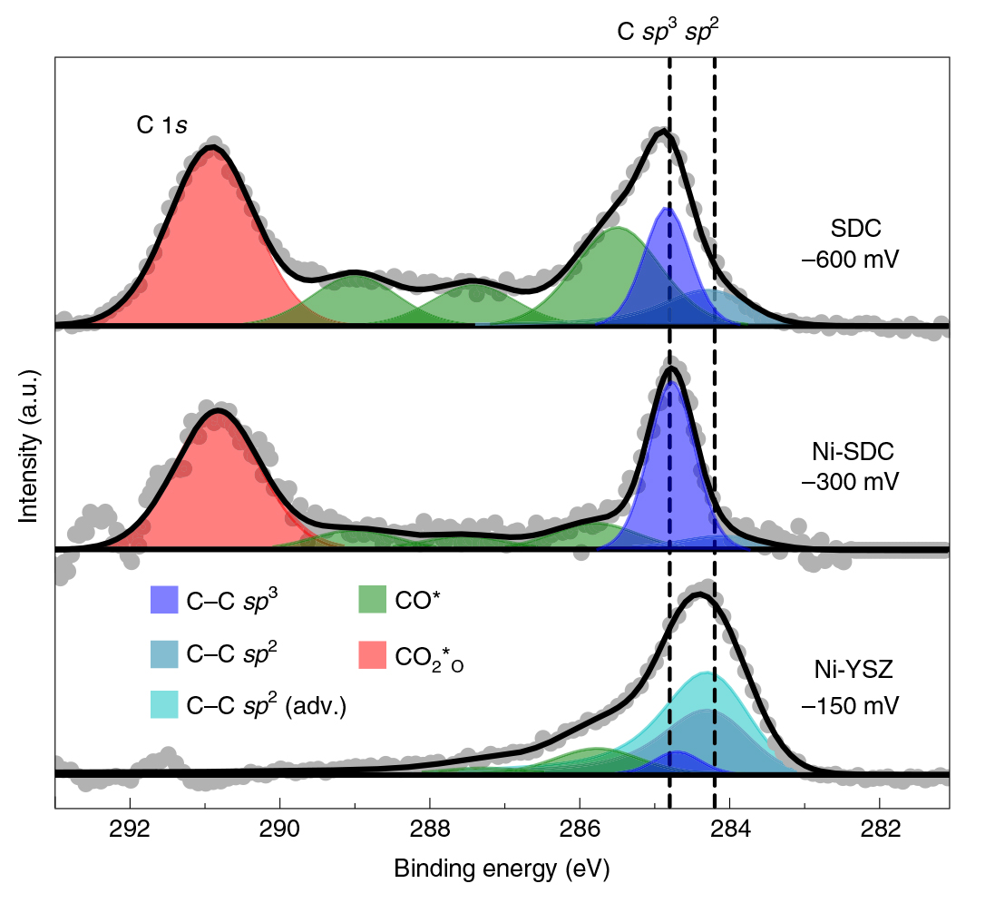
New Catalyst Resists Destructive Carbon Buildup
Scientific Achievement
Researchers used the Advanced Light Source (ALS) to reveal the crucial role of oxidized carbon intermediates in preventing carbon buildup in the electrodes of solid oxide electrolysis cells, resulting in substantially improved device lifetimes.
Significance and Impact
The results are likely to have far-reaching consequences for the practical utilization of CO₂ electrolysis devices in producing synthetic hydrocarbon fuels for transportation.
APXPS data for electrodes containing catalysts based on ceria (SDC, Ni-SDC) and nickel (Ni-YSZ). The C 1s peaks correspond to various oxidized carbon species that prevent carbon buildup.
Research Details
Electrodes containing ceria-based catalysts (SDC, Ni-SDC) and those without (Ni-YSZ) were analyzed using ambient-pressure x-ray photoelectron spectroscopy (APXPS) and density functional theory (DFT) calculations.
In the ceria-containing electrodes, carbon atoms are energetically trapped as oxidized carbon intermediates and thus are not easily reduced to carbon.
Publication about this research: T.L. Skafte, Z. Guan, M.L. Machala, C.B. Gopal, M. Monti, L. Martinez, E. Stamate, S. Sanna, J.A. Garrido Torres, E.J. Crumlin, M. Gárcia-Melchor, M. Bajdich, W.C. Chueh, and C. Graves, Nat. Energy 4, 846 (2019). Work was performed at Lawrence Berkeley National Laboratory, ALS Beamlines 9.3.2 and 11.0.2. Operation of the ALS is supported by the U.S. Department of Energy, Office of Science, Basic Energy Sciences program.
Notes:
Key challenges in the transition to sustainable energy include the long-duration storage of cheap, renewable electricity and the electrification of the heavy-freight transportation sector. Both challenges can be met using electrochemical cells. Solid oxide electrolysis cells are capable of highly efficient splitting of steam and CO₂ to produce a synthetic H₂–CO gas mixture (syngas), which can be converted into synthetic hydrocarbon transportation fuels using conventional industrial reactors. However, the efficiency of the process is limited by the risk of destructive carbon deposition inside the cells’ porous solid electrodes. A nickel catalyst is responsible for the carbon growth, but replacing this long-standing conventional catalyst has turned out to be highly challenging. Now, researchers have used ambient-pressure x-ray photoelectron spectroscopy (APXPS) at ALS Beamlines 9.3.2 and 11.0.2 to probe the mechanisms by which carbon grows on different catalysts during CO₂ electrolysis.
Researchers: T.L. Skafte and C. Graves (Technical University of Denmark, Stanford University, and SLAC National Accelerator Laboratory); Z. Guan, M.L. Machala, C.B. Gopal, M. Monti, and W.C. Chueh (Stanford University); L. Martinez, E. Stamate, and S. Sanna (Technical University of Denmark); J.A. Garrido Torres and M. Bajdich (SLAC National Accelerator Laboratory); E.J. Crumlin (ALS); and M. Gárcia-Melchor (Trinity College Dublin, Ireland).
Funding: Haldor Topsoe A/S; Innovation Fund Denmark; Danish Agency for Science, Technology and Innovation; Energinet.dk; National Science Foundation; U.S. Department of Energy (DOE), Office of Science, Basic Energy Sciences Program (DOE BES). Operation of the ALS is supported by DOE BES.
Full highlight: https://als.lbl.gov/new-catalyst-resists-destructive-carbon-buildup-in-electrodes/

