Slide 1
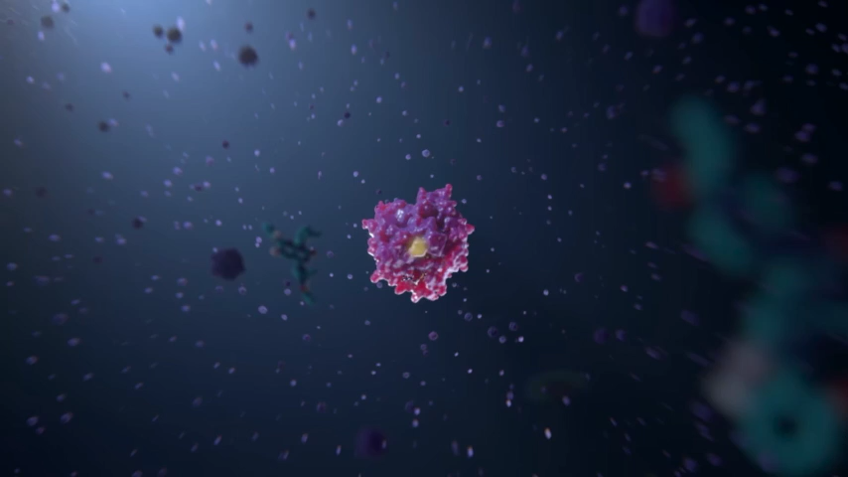
ALS Reveals Vulnerability in Cancer-Causing Protein
Scientific Achievement
A promising anticancer drug, AMG 510, was developed by Amgen with the help of novel structural insights gained from protein structures solved at the Advanced Light Source (ALS).
Significance and Impact
AMG 510, which is currently in phase II clinical trials for efficacy, targets tumors caused by mutations in the KRAS protein, one of the most common causes of cancer.
Research Details
Animation showing AMG 510 binding to a pocket
on the KRAS protein, locking it in an inactive state. (Credit: Amgen Inc.).
Research Details
X-ray crystallography of the mutated KRAS protein, KRAS(G12C), revealed a hidden groove that enables binding of AMG 510, an investigational drug molecule.
Upon binding, AMG 510 permanently locks KRAS(G12C) in its inactive state.
Publication about this research: J. Canon, K. Rex, A.Y. Saiki, C. Mohr, K. Cooke, D. Bagal, K. Gaida, T. Holt, C.G. Knutson, N. Koppada, B.A. Lanman,
J. Werner, A.S. Rapaport, T. San Miguel, R. Ortiz, T. Osgood, J.-R. Sun, X. Zhu, J.D. McCarter, L.P. Volak, B.E. Houk, M.G. Fakih, B.H. O’Neil, T.J. Price,
G.S. Falchook, J. Desai, J. Kuo, R. Govindan, D.S. Hong, W. Ouyang, H. Henary, T. Arvedson, V.J. Cee, and J.R. Lipford, Nature 575, 217 (2019). Work
was performed at Lawrence Berkeley National Laboratory, ALS Beamline 5.0.1. Operation of the ALS is supported by the U.S. Department of Energy, Office of Science, Basic Energy Sciences program.
Notes:
Mutations in a signaling protein, KRAS, are known to drive many human cancers. One specific KRAS mutation, KRAS(G12C), accounts for approximately 13% of non-small cell lung cancers, 3% to 5% of colorectal cancers, and 1% to 2% of numerous other solid tumors. Approximately 30,000 patients are diagnosed each year in the United States with KRAS(G12C)-driven cancers. Despite their cancer-triggering significance, KRAS proteins have for decades resisted attempts to target their activity, leading many to regard these proteins as “undruggable.” Recently, however, a team led by researchers from Amgen identified a small molecule capable of inhibiting the activity of KRAS(G12C) and driving anti-tumor immunity. Protein crystallography studies at the ALS provided crucial information about the structural interactions between the potential drug molecule and KRAS(G12C).
Researchers: J. Canon, K. Rex, A.Y. Saiki, C. Mohr, K. Cooke, D. Bagal, K. Gaida, T. Holt, C.G. Knutson, N. Koppada, B.A. Lanman, J. Werner, A.S. Rapaport, T. San Miguel, R. Ortiz, T. Osgood, J.-R. Sun, X. Zhu, J.D. McCarter, L.P. Volak, B.E. Houk, W. Ouyang, H. Henary, T. Arvedson, V.J. Cee, and J.R. Lipford (Amgen Inc.); M.G. Fakih (City of Hope Comprehensive Cancer Center); B.H. O’Neil (Indiana University); T.J. Price (The Queen Elizabeth Hospital and University of Adelaide, Australia); G.S. Falchook (Sarah Cannon Research Institute); J. Desai (Peter MacCallum Cancer Center, Australia); J. Kuo (Scientia Clinical Research, Australia); R. Govindan (Washington University in St. Louis); and D.S. Hong (The University of Texas MD Anderson Cancer Center).
Funding: Amgen Inc., National Institutes of Health, and Howard Hughes Medical Institute. Operation of the ALS is supported by the U.S. Department of Energy, Office of Science, Basic Energy Sciences Program.
Full highlight: https://als.lbl.gov/als-reveals-vulnerability-in-cancer-causing-protein/

