Slide 1
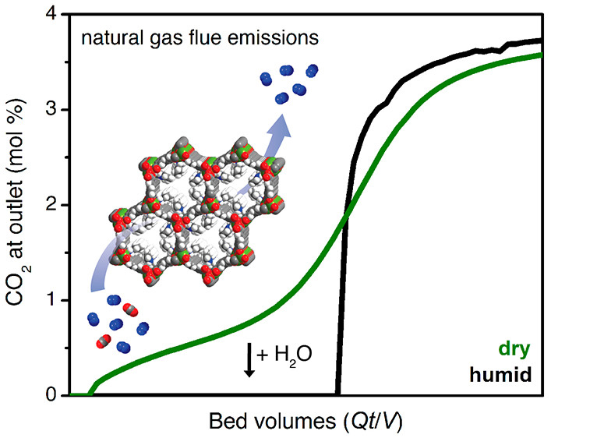
Water Improves Material's Ability to Capture CO₂
Scientific Achievement
With the help of the Advanced Light Source (ALS), researchers from UC Berkeley and ExxonMobil fine-tuned a material to capture CO₂ in the presence of water.
Significance and Impact
The parties have applied for a patent on the material, which was developed for use on the relatively humid flue gases emitted by certain natural gas power plants, a cleaner-burning alternative to coal.
Research Details
CO₂ in flue gases after passage through MOF. Under humid conditions (black), CO₂ leakage is effectively zero until saturation. Under dry conditions (green), some CO₂ leaks through, even at very early stages. Inset: Schematic of CO₂ adsorption.
Research Details
Single-crystal x-ray diffraction revealed structural details of 2-ampd–Zn₂(dobpdc), a crystal isostructural to the MOF that was functionalized with diamines.
The presence of water makes CO₂ bind more strongly while preserving the ability to cycle CO₂ in and out with small temperature swings.
Publication about this research: R.L. Siegelman, P.J. Milner, A.C. Forse, J.-H. Lee, K.A. Colwell, J.B. Neaton, J.A. Reimer, S.C. Weston, and J.R. Long, J. Am. Chem. Soc. 141, 13171 (2019). Work was performed at Lawrence Berkeley National Laboratory, ALS Beamline 12.2.1. Operation of the ALS is supported by the U.S. Department of Energy, Office of Science, Basic Energy Sciences program.
Notes:
Compared to coal-fired power plants, natural gas combined cycle (NGCC) plants produce flue gases with low CO₂ concentrations. This reduces the carbon footprint, but increases the technical difficulty of CO₂ capture. Also, materials capable of adsorbing such low concentrations of CO₂ often require high temperatures to release it for sequestration, an important part of the cycle that offsets initial low-carbon benefits. NGCC emissions also have a higher concentration of O₂, which has a corrosive effect on adsorbent materials, and both NGCC and coal flue streams are saturated in water, which can both degrade materials and reduce efficiency. Thus, an effective NGCC CO2-capture material must selectively bind low-concentration CO₂ under humid conditions while being thermally and oxidatively stable. In previous work done at the Center for Gas Separations (a DOE Energy Frontier Research Center), UC Berkeley researchers discovered a metal–organic framework (MOF) that releases CO₂ using much less energy than current materials. The work attracted the attention of ExxonMobil, which was interested in optimizing the new material to make it even more effective. In this work, the Berkeley group, with support from ExxonMobil, worked on fine-tuning the MOF by functionalizing it with cyclic diamine compounds.
Researchers: R.L. Siegelman, P.J. Milner, J.-H. Lee, J.A. Reimer, and J.R. Long (UC Berkeley and Berkeley Lab); A.C. Forse and K.A. Colwell (UC Berkeley); J.B. Neaton (UC Berkeley, Berkeley Lab, and Kavli Energy Nanosciences Institute); and S.C. Weston (ExxonMobil Research and Engineering Company).
Funding: ExxonMobil Research and Engineering Company, National Institutes of Health, Philomathia Foundation, Berkeley Energy and Climate Institute, and University of California, Berkeley. Operation of the ALS is supported by the U.S. Department of Energy, Office of Science, Basic Energy Sciences Program.
Full highlight: https://als.lbl.gov/water-improves-materials-ability-to-capture-co2/

