Slide 1
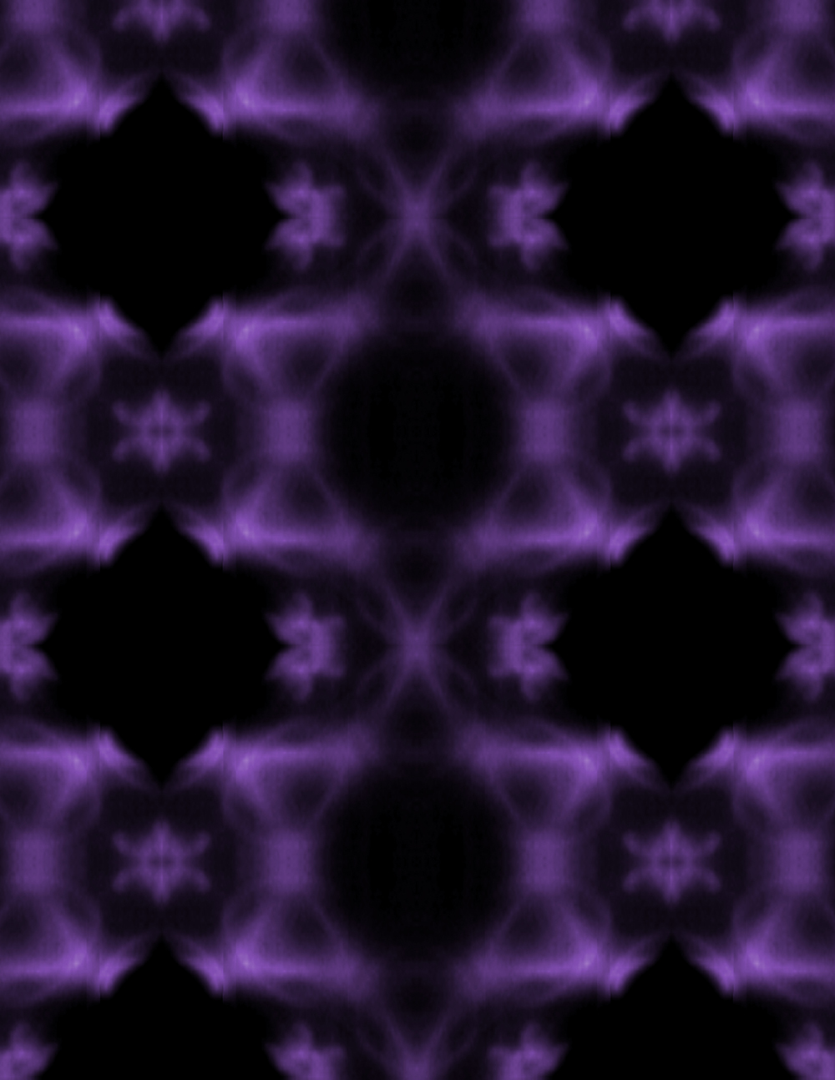
Elusive Kagome Electronic Structures Revealed
Scientific Achievement
Electronic-structure studies at the Advanced Light Source (ALS) showed that both infinitely light and infinitely massive particles coexist in a material with a star-shaped (kagome) crystal lattice.
Significance and Impact
The material’s rich array of electronic behaviors shows promise for future spintronic applications and represents a new frontier for studying exotic phases of matter.
Research Details
FeSn studied using angle-resolved photoemission spec-troscopy (ARPES) and a magnetic-field-based bulk probe.
Experimental Fermi surface of FeSn showing the kagome lat-tice pattern in momentum space. (Credit: Min Gu Kang, MIT)
Micro-ARPES was able to distinguish between kagome and non-kagome layers and independently measured the electronic structures of each.
Unambiguously demonstrated the simultaneous emergence of both Dirac cones (Dirac fermions) and flat bands (signature of infinitely massive particles).
Publication about this research: M. Kang, L. Ye, S. Fang, J.-S. You, A. Levitan, M. Han, J.I. Facio, C. Jozwiak, A. Bostwick, E. Rotenberg, M.K. Chan, R.D. McDonald, D. Graf, K. Kaznatcheev, E. Vescovo, D.C. Bell, E. Kaxiras, J. van den Brink, M. Richter, M. Prasad Ghimire, J.G. Checkelsky, and R. Comin, Nat. Mater. 19, 163 (2019). Work was performed at Lawrence Berkeley National Laboratory, ALS Beamline 7.0.2. Operation of the ALS is supported by the U.S. Department of Energy, Office of Science, Basic Energy Sciences program.
Notes:
Electrons in kagome lattices have long been predicted to behave as if they were infinitely light (like Dirac fermions in graphene) or infinitely heavy (highly localized and confined). Materials with these properties plus the intrinsic ferromagnetism of iron can exhibit topological and correlated electronic phenomena that could be useful in future device applications, including spintronic technologies. In band-structure diagrams, the presence of Dirac fermions is indicated by Dirac cones, and the signature of infinitely massive particles is a flat band. While both these features have been predicted by theoretical models of ideal kagome metals, their experimental realization has proven to be elusive. Since 2016, a team of MIT researchers has focused on Fe_{m}Sn_{n} compounds (m:n = 3:1, 3:2, 1:1) with different stacking structures. A breakthrough came when they synthesized a 1:1 compound (FeSn) in which the kagome layers were well separated by a spacer layer of Sn.
Researchers: M. Kang, L. Ye, A. Levitan, M. Han, J.G. Checkelsky, and R. Comin (Massachusetts Institute of Technology); S. Fang, D.C. Bell, and E. Kaxiras (Harvard University); J.-S. You, J.I. Facio, and J. van den Brink (Leibniz Institute for Solid State and Materials Research Dresden, Germany); C. Jozwiak, A. Bostwick, and E. Rotenberg (ALS); M.K. Chan and R.D. McDonald (National High Magnetic Field Laboratory, Los Alamos); D. Graf (National High Magnetic Field Laboratory, Tallahassee); K. Kaznatcheev and E. Vescovo (Brookhaven National Laboratory); M. Richter (Leibniz Institute for Solid State and Materials Research Dresden, and Dresden Center for Computational Materials Science, Germany); and M. Prasad Ghimire (Leibniz Institute for Solid State and Materials Research, Germany, and Tribhuvan University, Nepal).
Funding: Alfred P. Sloan Foundation, Gordon and Betty Moore Foundation, National Science Foundation, Samsung Foundation of Culture, Tsinghua Education Foundation, German Research Foundation, Alexander von Humboldt Foundation, Leibniz Institute for Solid State and Materials Research Dresden, State of Florida, and U.S. Department of Energy, Office of Science, Basic Energy Sciences Program (DOE BES). Operation of the ALS is supported by DOE BES.
Full highlight: https://als.lbl.gov/elusive-kagome-electronic-structures-revealed/

