Slide 1
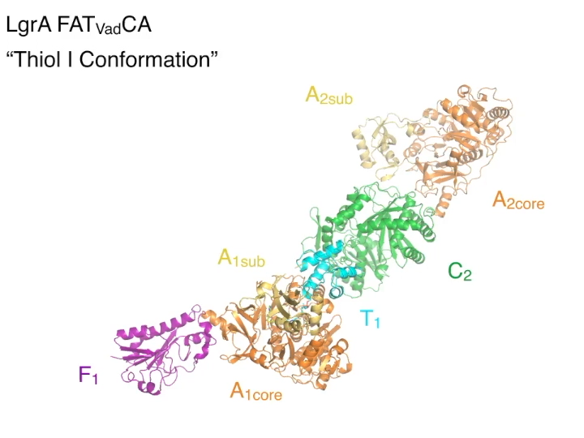
Assembly Lines for Designer Bioactive Compounds
Scientific Achievement
Researchers successfully bioengineered changes to a molecular “assembly line” for bioactive compounds, based in part on insights gained from small-angle x-ray scattering at the Advanced Light Source (ALS).
Significance and Impact
The ability to re-engineer these assembly lines could improve their performance and facilitate the synthesis of new medically useful compounds.
Research Details
Movie clip displaying large variations in LgrA conformations, confirmed using SAXS experiments. SAXS complements crystallog-raphy by enabling fast, accurate analysis of protein shape and flexibility in the protein’s more natural solution state.
Structure of LgrA, part of a biomolecular assembly line, was studied using crystallography as well as small-angle x-ray scattering (SAXS) in solution.
The results guided researchers in using module-swapping and mutagenesis techniques to produce a chimeric version of LgrA with double the activity.
Publication about this research: J.M. Reimer, M. Eivaskhani, I. Harb, A. Guarné, M. Weigt, and T.M. Schmeing, Science 366, 706 (2019). Work was performed at Lawrence Berkeley National Laboratory, ALS Beamline 12.3.1; Argonne National Laboratory, APS Beamline 24-ID-C; and the Canadian Light Source, Beamline 08ID-1. Operation of the ALS is supported by the U.S. Department of Energy, Office of Science, Basic Energy Sciences program.
Notes:
Microbes are known to possess molecular “assembly lines” that produce an important class of compounds, many of which have uses as antibiotics, antifungals, and immunosuppressants. The compounds are peptides—chains of amino acids like proteins, but shorter and produced, not by ribosomes, but by cellular machines known as nonribosomal peptide synthetases (NRPSs). Researchers have previously established that NRPSs are large, multi-enzyme clusters that synthesize compounds by passing a precursor molecule from one module to the next, with each “station” catalyzing an addition to the molecule. In the past decade, a great deal has been learned about how individual NRPS domains and modules work, but an understanding of how the assembly lines function as a whole has been lacking. X-ray crystallography on linear gramicidin synthetase subunit A (LgrA), a two-module NRPS complex (performed at the Canadian Light Source and the Advanced Photon Source) showed that the relative orientations of adjacent modules can vary dramatically, suggesting an unexpectedly high level of flexibility. To assess whether the conformational variability seen in the crystal structures is an accurate reflection of what happens in a more natural state (i.e., in solution), the researchers analyzed the behavior of LgrA modules using small-angle x-ray scattering (SAXS) at ALS Beamline 12.3.1.
Researchers: J.M. Reimer, M. Eivaskhani, I. Harb, A. Guarné, and T.M. Schmeing (McGill University, Canada), and M. Weigt (Sorbonne University, France).
Funding: Canadian Institutes of Health Research, European Union Horizon 2020, Natural Sciences and Engineering Research Council of Canada, and Boehringer Ingelheim Fonds. Operation of the ALS is supported by the U.S. Department of Energy, Office of Science, Basic Energy Sciences Program.
Full highlight: https://als.lbl.gov/assembly-lines-for-designer-bioactive-compounds

