Slide 1
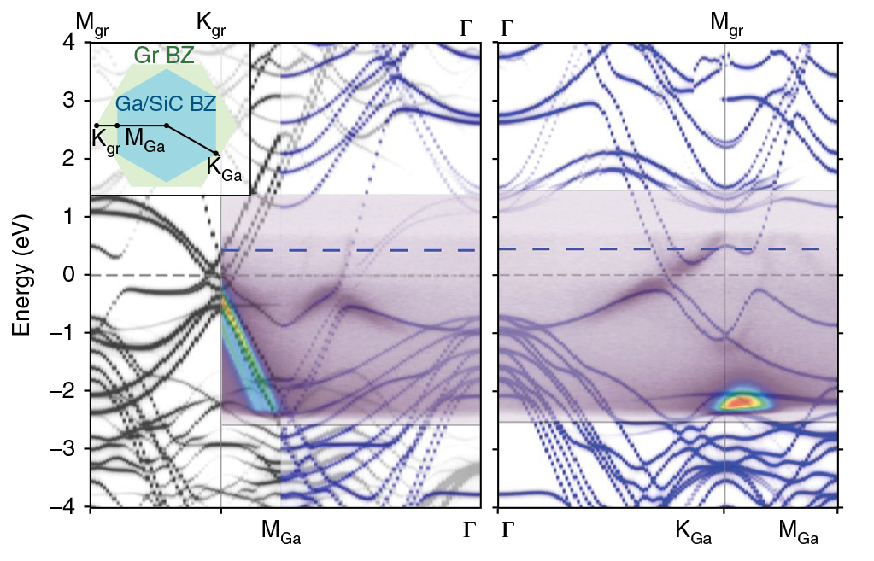
A Scalable Platform for Two-Dimensional Metals
Scientific Achievement
Using a new method for stabilizing a two-dimensional (2D) metal on a large-area platform, researchers probed the origins of the material’s superconductivity at the Advanced Light Source (ALS).
Significance and Impact
The work represents a notable milestone in advancing 2D materials toward broad applications in topological computing, advanced optics, and molecular sensing.
Band structure of graphene/Ga/SiC sample. Black lines = calculated band structure of graphene; blue lines = calculated band structure of Ga/SiC; purple overlay = measured ARPES.
Research Details
Confinement heteroepitaxy (CHet) produces wafer-scale, environmentally stable, 2D metal layers (e.g., Ga), sandwiched between SiC and graphene.
Angle-resolved photoemission spectroscopy (ARPES) of graphene/Ga/SiC sample confirmed structural quality and Ga as source of superconductivity.
Publication about this research: N. Briggs, B. Bersch, Y. Wang, J. Jiang, R.J. Koch, N. Nayir, K. Wang, M. Kolmer, W. Ko, A. De La Fuente Duran, S. Subramanian, C. Dong, J. Shallenberger, M. Fu, Q. Zou, Y.-W. Chuang, Z. Gai, A.-P. Li, A. Bostwick, C. Jozwiak, C.-Z. Chang, E. Rotenberg, J. Zhu, A.C.T. van Duin, V. Crespi, and J. Robinson, Nat. Mater., doi:10.1038/s41563-020-0631-x (2020). Work was performed at Lawrence Berkeley National Laboratory, ALS Beamline 7.0.2. Operation of the ALS is supported by the U.S. Department of Energy, Office of Science, Basic Energy Sciences Program.
Notes:
The ability to synthesize such two-dimensional (2D) metals means that the range of materials available for novel uses can be expanded to different areas of the periodic table—providing a much richer “scientific palette” of properties for applications in topological computing, advanced optics, and molecular sensing. However, low-dimensional metals must be integrated into stable heterostructures at the wafer scale (currently up to about 15 cm in diameter). Also, metal surfaces exposed to air will oxidize (rust), and a 2D metal—essentially nothing but surface—would require protection from this kind of environmental degradation. In earlier work, a team of researchers led by Joshua Robinson (Penn State University) developed a method to synthesize atomically thin, single-crystal layers of a semiconductor, sandwiched between a stable substrate of silicon carbide (SiC) and a protective top layer of epitaxial graphene. Competing synthesis methods are specific to certain metallic species and generally produce thicker layers without encapsulation, whereas CHet produces stable, atomically thin crystalline forms of diverse metals that do not otherwise exist in nature. The stability of these 2D metals in air over a period of months greatly facilitates ex situ characterization and enables facile processing and device fabrication. Here, the researchers explored the origins of superconductivity in 2D gallium (Ga).
Researchers: N. Briggs, B. Bersch, Y. Wang, J. Jiang, N. Nayir, K. Wang, A. De La Fuente Duran, S. Subramanian, C. Dong, J. Shallenberger, Y.-W. Chuang, C.-Z. Chang, J. Zhu, A.C.T. van Duin, V. Crespi, and J. Robinson (Pennsylvania State University); R.J. Koch (ALS and Berkeley Lab); M. Kolmer, W. Ko, M. Fu, Q. Zou, Z. Gai, and A.-P. Li (Oak Ridge National Laboratory); and A. Bostwick, C. Jozwiak, and E. Rotenberg (ALS).
Funding: Northrop Grumman, Semiconductor Research Corporation, Intel, National Science Foundation, Chinese Scholarship Council, and Alfred P. Sloan Foundation. Operation of the ALS is supported by the U.S. Department of Energy, Office of Science, Basic Energy Sciences Program.
Full highlight: https://als.lbl.gov/a-scalable-platform-for-two-dimensional-metals/

