Slide 1
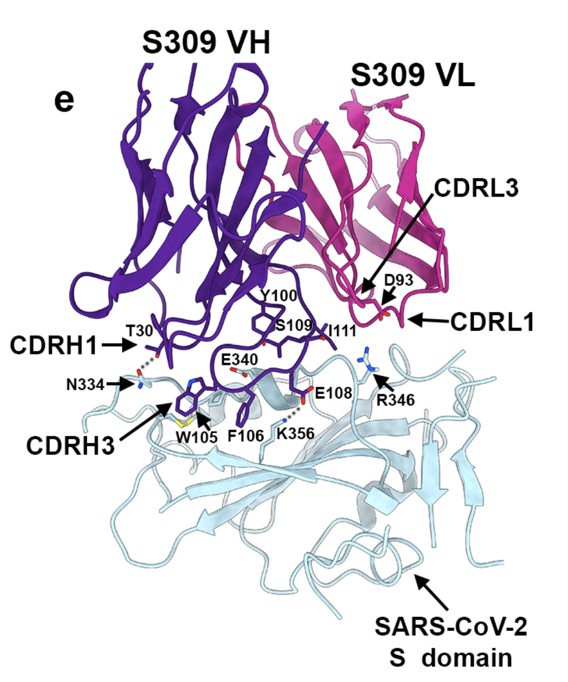
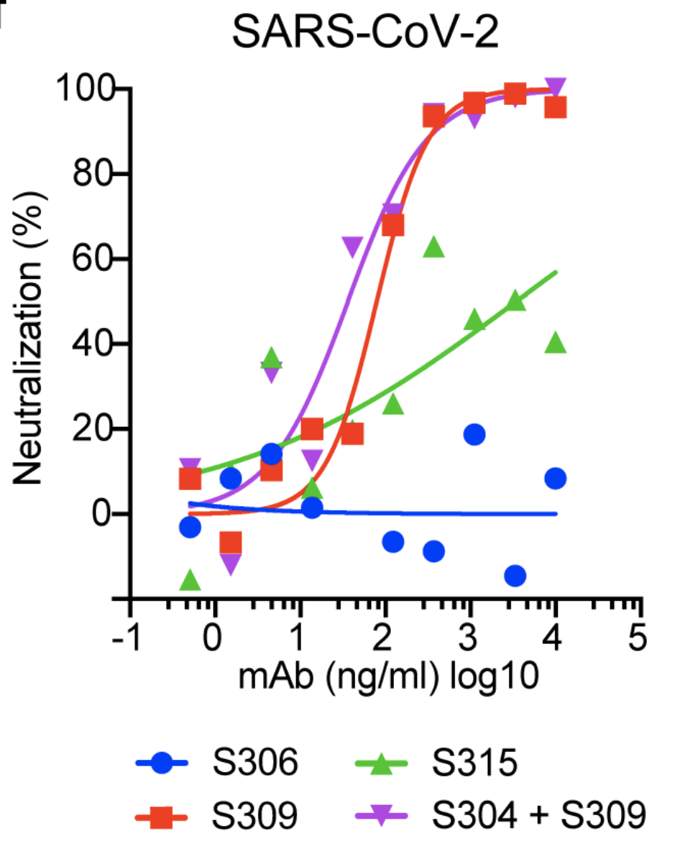
Antibody from SARS Survivor Neutralizes SARS-CoV-2
Scientific Achievement
Using structural data from the Advanced Light Source (ALS) and cryo-EM, researchers have characterized how an antibody binds to and neutralizes SARS-CoV-2.
Significance and Impact
This work provides the basis for therapeutic and vaccine development for the SARS-CoV-2 virus, which is responsible for the COVID-19 pandemic.
Research Details
Left: The antibody S309 (purple and pink) makes contact with SARS-CoV-2 (blue) via complemen-tarity-determining regions (CDR), or loops that attach to residues in the virus’s spike protein. Right: S309 and antibody cocktails containing S309 are effective in neutralizing SARS-CoV-2 in Vero E6, a primate cell line.
Antibodies from an individual who survived SARS in 2003 were tested for their ability to neutralize the related virus SARS-CoV-2, currently ravaging the globe.
The structural data showed that one antibody, S309, has six loops that recognize and attach to the spike protein of SARS-CoV-2, neutralizing the virus and recruiting other antiviral mechanisms.
Publication about this research: D. Pinto, Y.-J. Park, M. Beltramello, A.C. Walls, M.A. Tortorici, S. Biachi, S. Jaconi, K. Culap, F. Zatta, A. De Marco, A. Peter, B. Guarino, R. Spreafico, E. Cameroni, J.B. Case, R.E. Chen, C. Havenar-Daughton, G. Snell, A. Telenti, H.W. Virgin, A. Lanzavecchia, M.S. Diamond, K. Fink, D. Veesler, and D. Corti, Nature, doi:10.1038/s41586-020-2349-y (2020). Work was performed at Lawrence Berkeley National Laboratory, ALS/BCSB Beamline 5.0.2. Operation of the ALS is supported by the U.S. Department of Energy, Office of Science, Basic Energy Sciences Program.
Notes:
As the COVID-19 pandemic rages in 2020, researchers look for therapeutic and prophylactic strategies to fight the underlying virus: SARS-CoV-2. A research team analyzed samples from an individual who survived SARS in 2003 and studied whether the antibodies were effective for the current virus. One antibody (S309) was able to neutralize SARS-CoV-2 and several other related viruses. Using cryogenic electron microscopy and x-ray crystallography, the team determined the structure of S309 bound to the SARS-CoV-2 spike glycoprotein and showed S309 recognizes a protein/glycan epitope on SARS-CoV-2. When attached, S309 not only neutralizes the virus, but also recruits other immune mechanisms like effector cells. In light of S309’s ability to target SARS-CoV-2 and other related viruses, this antibody is valuable for developing SARS-CoV-2 countermeasures.
Researchers: D. Pinto, M. Beltramello, S. Bianchi, S. Jaconi, K. Culap, F. Zatta, A. De Marco, A. Peter, B. Guarino, E. Cameroni, K. Fink, and D. Corti (Humabs Biomed SA); Y.-J. Park, A.C. Walls, and D. Veesler (University of Washington); M.A. Tortorici (University of Washington and Institut Pasteur); R. Spreafico, C. Havenar-Daughton, G. Snell, A. Telenti, and H.W. Virgin (Vir Biotechnology); A. Lanzavecchia (Humabs BioMed SA and Università della Svizzera italiana); J.B. Case, R.E. Chen, and M.S. Diamond (Washington University School of Medicine).
Funding: National Institutes of Health, Pew Biomedical Scholars, Burroughs Wellcome Fund, University of Washington, Institut Pasteur, Vir Biotechnology Inc, Humabs BioMed SA, and Moderna. Operation of the ALS is supported by the U.S. Department of Energy, Office of Science, Basic Energy Sciences Program.
Full highlight: https://newscenter.lbl.gov/2020/05/19/xray-covid19-antibodies/

