Slide 1
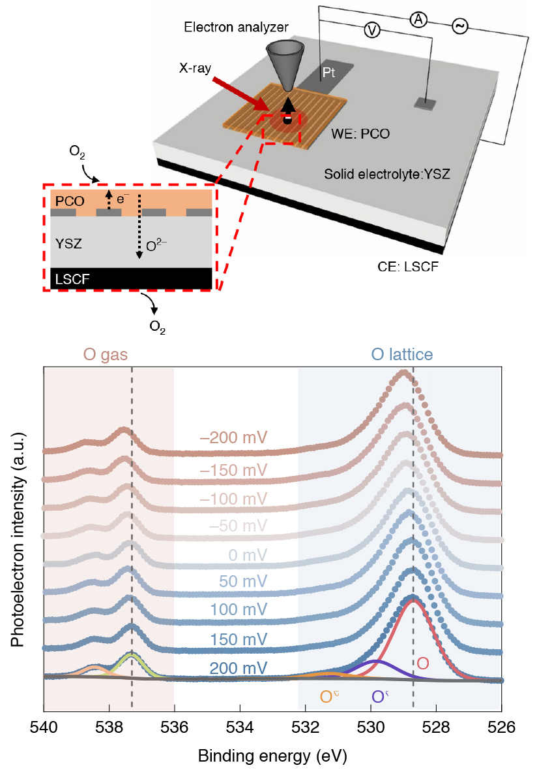
The Bottleneck Step of a Complex Catalytic Reaction
Scientific Achievement
The rate-limiting step in catalysis involving oxygen uptake was identified through detailed analysis of the reaction pathways, combined with observations performed under operating conditions at the Advanced Light Source (ALS).
Significance and Impact
The work lays the foundation for improving the efficiency of energy conversion and storage devices such as fuel cells, catalytic reactors, and batteries.
Research Details
Ambient-pressure x-ray absorption and photoemission spectroscopies (APXAS, APXPS) were performed on Pr_{0.1}Ce_{0.9}O_{2−x} (PCO), a promising electrode material for solid-oxide fuel cells and electrolyzers.
Combined with microkinetic modeling, the data enabled identification of the rate-limiting step: the dissociation of the neutral molecular oxygen on the surface.
Top: APXPS experimental set-up. Bottom: Oxygen 1s spectra showing binding energies of oxygen gas and lattice oxygen on the electrode (PCO) surface at various external voltages. The binding-energy differ-ence was key information used in the microkinetic analysis.
Publication about this research: D. Chen, Z. Guan, D. Zhang, L. Trotochaud, E. Crumlin, S. Nemsak, H. Bluhm, H.L. Tuller, and W.C. Chueh, Nat. Catal. 3, 116 (2020). Work was performed at Lawrence Berkeley National Laboratory, ALS Beamlines 9.3.2 and 11.0.2. Operation of the ALS is supported by the U.S. Department of Energy, Office of Science, Basic Energy Sciences program.
Notes:
Solids that catalyze chemical reactions involving gas-phase reactants and products are called heterogenous catalysts, and they are the backbone of the petrochemical industry. This type of catalyst also enables renewable-energy technologies, including fuel cells and electrolyzers. Many heterogenous catalysts work well because because they are also able to incorporate the gas reactant into their bulk, which enhances reaction rates. For example, many oxide catalysts, like cerium oxide, are known to take up oxygen gas in the form of oxygen ions. The electrochemical reduction of an oxygen gas molecule into oxygen ions requires the addition of four electrons and produces two ions, all of which cross the solid–gas interface—a mixed ion and electron transfer (MIET) reaction. To engineer interfaces that allow such reactions to proceed faster or more efficiently, scientists first need to identify the rate-determining step and understand it at the molecular, electronic, and point-defect levels. However, interfacial charge-transfer reactions involving both electrons and ions increase the complexity of a reaction, making it difficult to disentangle the numerous interaction pathways involved. The ambient-pressure x-ray photoelectron spectroscopy (APXPS) technique pioneered at the ALS allows operando studies of heterogenous catalysts at temperatures and pressures not far removed from that of a real device or reactor. The data, combined with microkinetic modeling, enabled researchers to precisely pinpoint the step, out of more than 100 possibilities, that was limiting the overall reaction rate.
Researchers: D. Chen, Z. Guan, D. Zhang, and W.C. Chueh (Stanford University); L. Trotochaud, S. Nemsak, and H. Bluhm (Berkeley Lab); E. Crumlin (ALS); and H.L. Tuller (Massachusetts Institute of Technology).
Funding: National Science Foundation and U.S. Department of Energy, Office of Science, Basic Energy Sciences Program (DOE BES). Operation of the ALS is supported by DOE BES.
Full highlight: https://als.lbl.gov/the-bottleneck-step-of-a-complex-catalytic-reaction/

