Slide 1
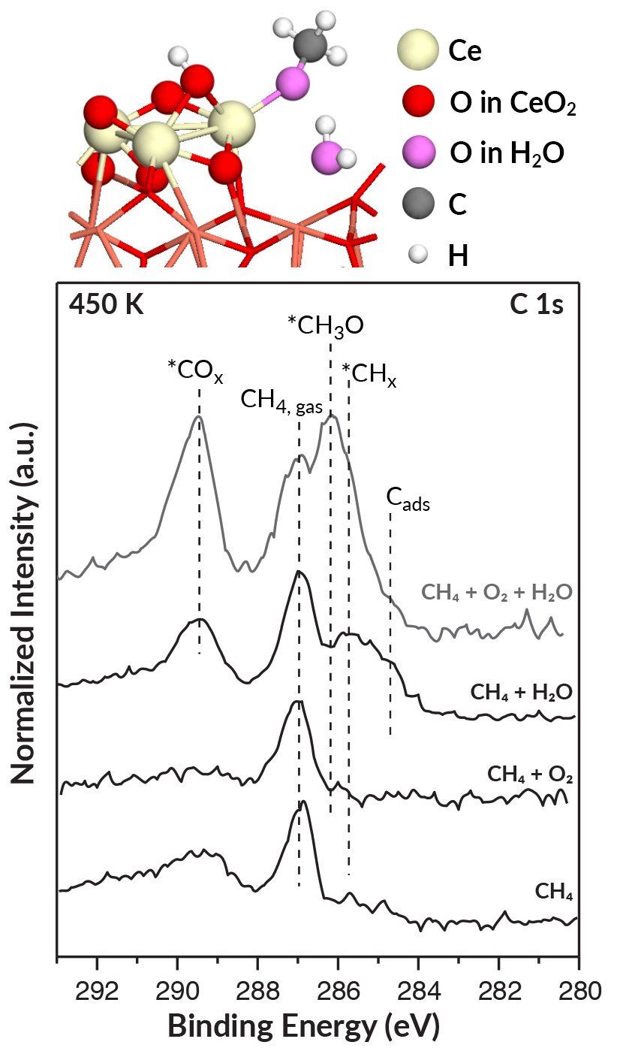
How Water Promotes Catalysis of Methane to Methanol
Scientific Achievement
Researchers used the Advanced Light Source (ALS) to unravel how water helps catalyze the conversion of methane, the main component of natural gas, into methanol, a liquid fuel.
Significance and Impact
The work supports the efficient production of methanol and other useful chemicals and could help reduce the amount of greenhouse gases released by the flaring and venting of methane.
Research Details
Ambient-pressure x-ray photoelectron spectroscopy (APXPS) provided direct evidence for the essential role of H₂O.
Spectral signature of CH₃O, immediate precursor of methane, appeared only when H₂O was present.
Triple role of H₂O: blocking an unwanted reaction, activating the desired reaction, and extracting the final product.
Top: Theory and simulations predicted that H₂O promotes formation of methoxy (CH₃O) at ceria “islands” on catalyst surface. Bottom: In APXPS data, signatures of methoxy surface groups (*CH₃O) appear with H₂O, disappear without.
Publication about this research: Z. Liu, E. Huang, I. Orozco, W. Liao, R.M. Palomino, N. Rui, T. Duchoň, S. Nemšák, D.C. Grinter, M. Mahapatra, P. Liu, J.A. Rodriguez, and S.D. Senanayake, Science 368, 513 (2020). Work was performed at Lawrence Berkeley National Laboratory, ALS Beamline 9.3.2. Operation of the ALS is supported by the U.S. Department of Energy, Office of Science, Basic Energy Sciences program.
Notes:
The main component of natural gas, methane (CH₄), can be converted into a liquid fuel, methanol (CH₃OH), which in turn can be used as a feedstock for other commodity chemicals. However, the unfavorable economics of capturing, transporting, and processing the methane released during oil drilling means that significant amounts of it get burned off or vented, contributing harmful greenhouse gases to the atmosphere. The direct conversion of methane to methanol would make the recovery of natural gas more profitable and sustainable. In earlier work, a group of researchers from Brookhaven National Laboratory discovered a promising catalyst, CeO₂-Cu₂O, that converts methane to methanol with high (70%) selectivity at room temperature in the presence of water. The group studied the material’s morphology using various microscopic probes and predicted its step-by-step molecular rearrangements using Monte Carlo simulations and density functional theory (DFT) calculations. To confirm the predictions and obtain direct evidence for the essential role of water, the researchers used ambient-pressure x-ray photoelectron spectroscopy (APXPS) at the ALS.
Researchers: Z. Liu, R.M. Palomino, N. Rui, M. Mahapatra, and S.D. Senanayake (Brookhaven National Laboratory); E. Huang, I. Orozco, and W. Liao (Stony Brook University); T. Duchoň (Peter-Grünberg-Institut, Germany); S. Nemšák (ALS); D.C. Grinter (Diamond Light Source, UK); and P. Liu and J.A. Rodriguez (Brookhaven National Laboratory and Stony Brook University).
Funding: National Science Foundation and U.S. Department of Energy, Office of Science, Basic Energy Sciences program (DOE BES). Operation of the ALS is supported by DOE BES.
Full highlight: https://als.lbl.gov/how-water-promotes-catalysis-of-methane-to-methanol/

