Slide 1
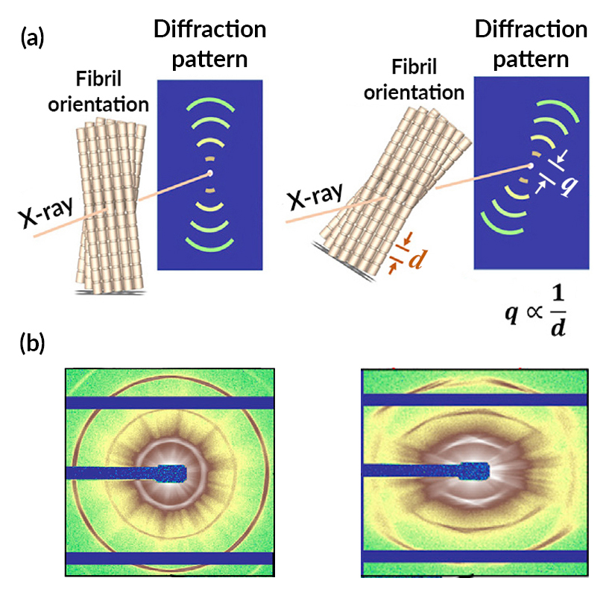
Toughening Mechanisms in Carp Scales at the Nanoscale
Scientific Achievement
Scientists have characterized carp scales down to the nanoscale, using the Advanced Light Source (ALS) to watch how the fibers in the scales react as stress is applied.
Significance and Impact
The resulting insights provide inspiration for the design of advanced synthetic structural materials with unprecedented toughness and penetration resistance.
Research Details
Small-angle x-ray scattering (SAXS) performed on carp scales during in situ tensile testing.
Synergetic fiber stretching, rotation, and sliding mechanisms act to delocalize damage.
(a) The periodic d-spacing of collagen fibrils in the specimens enable them to act as diffraction gratings, providing information about nanoscale structural changes, including stretching and rotation. (b) The diffraction pattern for a specimen under zero stress is circular (left), while the pattern for a specimen at maxium stress is hexagon-like (right).
Publication about this research: H. Quan, W. Yang, M. Lapeyriere, E. Schaible, R.O. Ritchie, and M.A. Meyers, Matter, doi:10.1016/j.matt.2020.05.011 (2020). Work was performed at Lawrence Berkeley National Laboratory, ALS Beamline 7.3.3. Operation of the ALS is supported by the U.S. Department of Energy, Office of Science, Basic Energy Sciences program.
Notes:
Humans have drawn technological inspiration from fish scales going back to ancient times: Romans, Egyptians, and other civilizations would dress their warriors in scale armor, providing both protection and mobility. Now, using advanced x-ray imaging techniques, scientists have characterized carp scales down to the nanoscale, enabling them to understand how the material is resistant to penetration while retaining flexibility. Fish scales have a hard outer shell with a softer inner layer that is tough and ductile. The fibers in this inner layer are made up of fibrils (sub-fibers) of collagen molecules plus minerals. These fibrils are aligned in layers, with the fibril “grain” in each successive layer rotated by roughly 36 degrees (a “Bouligand structure”). When stress is applied to the material, the fibers rotate in sequence to absorb the excess load—a process known as adaptive reorientation. At the ALS, the researchers used small-angle x-ray scattering (SAXS) to measure nanometer-scale structural changes in scale specimens as they were stretched in situ. The scattering works because collagen fibrils have a banded structure with a periodic d-spacing, due to the way in which the collagen molecules bundle together. This structural periodicity enables the collagen fibers to act as a molecular diffraction grating, generating a well-defined pattern that can be used for quantitative analysis.
Researchers: H. Quan, M. Lapeyriere, and M.A. Meyers (Univ. of California San Diego); W. Yang (Univ. of California San Diego and Berkeley Lab); E. Schaible (ALS); and R.O. Ritchie (Univ. of California Berkeley and Berkeley Lab).
Funding: Air Force Office of Scientific Research and National Institutes of Health. Operation of the ALS is supported by the U.S. Department of Energy, Office of Science, Basic Energy Sciences program.
Full highlight: https://als.lbl.gov/toughening-mechanisms-in-carp-scales-at-the-nanoscale/

