Slide 1
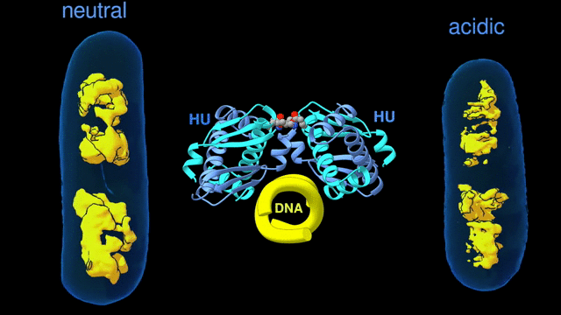
How Proteins Remodel DNA in Bacteria under Stress
Scientific Achievement
Multiscale, multimodal visualization techniques at the Advanced Light Source (ALS) enabled researchers to clarify how proteins remodel bacterial DNA in response to stressful environments.
Significance and Impact
The discovery could lead to new strategies for controlling microbial behavior and, eventually, new ways to fight bacterial infections.
Research Details
The architecture of the bacterial chromosome (left) changes in an acidic environment (right), as visualized using soft x-ray tomography. The changes are controlled through interactions between DNA (center) and the DNA-binding protein called HU (blue), as visualized using protein crystallography and SAXS. (Credit: Michal Hammel/Berkeley Lab).
Research Details
Interactions between DNA and the DNA-binding protein, HU, from E. coli were visualized at the micro-, meso-, and nanoscales using soft x-ray tomography, small-angle x-ray scattering (SAXS), and protein crystallography, respectively.
Bundling of DNA by HU depends on electrostatically driven multimerization of HU.
Publication about this research: S.G. Remesh, S.C. Verma, J.-H. Chen, A.A. Ekman, C.A. Larabell, S. Adhya, and M. Hammel, Nat. Commun. 11, 2905 (2020). Work was performed at Lawrence Berkeley National Laboratory, ALS Beamlines 2.1, 8.3.1, and 12.3.1. Operation of the ALS is supported by the U.S. Department of Energy, Office of Science, Basic Energy Sciences program.
Notes:
When bacteria are put in different environments, such as one that is more acidic or anaerobic, their genes start to adapt remarkably quickly. They’re able to do so because the proteins making up their chromosomes can pack and unpack rapidly, regulating the expression of genes that could help them respond to the changing environment. The proteins responsible for DNA packing in bacteria are called HU proteins. They are dimers—made up of two identical or nearly identical subunits that, when joined, form a bilaterally symmetrical “body” with two “arms.” To perform their packing function, these dimers “hug” the DNA, with arms on either side of a strand. They link up with each other (multimerize) to form arrays that hold the DNA strands parallel to each other. Changes that loosen or tighten this DNA bundling make the genetic information in the DNA more or less accessible to the enzymes responsible for gene expression. In this work, the researchers focused on how external environmental factors, such as acidity or salinity, affect HU function.
Researchers: S.G. Remesh (National Cancer Institute and Berkeley Lab); S.C. Verma and S. Adhya (National Cancer Institute); J.-H. Chen, A.A. Ekman, and C.A. Larabell (Berkeley Lab and Univ. of California, San Francisco); and M. Hammel (Berkeley Lab).
Funding: U.S. Department of Energy (DOE), Office of Science, Biological and Environmental Research program; National Institutes of Health; University of California Office of the President; Plexxicon Inc.; and International Union of Crystallography. Operation of the ALS is supported by the DOE Office of Science, Basic Energy Sciences program.
Full highlight: https://als.lbl.gov/how-proteins-remodel-dna-in-bacteria-under-stress/

