Slide 1
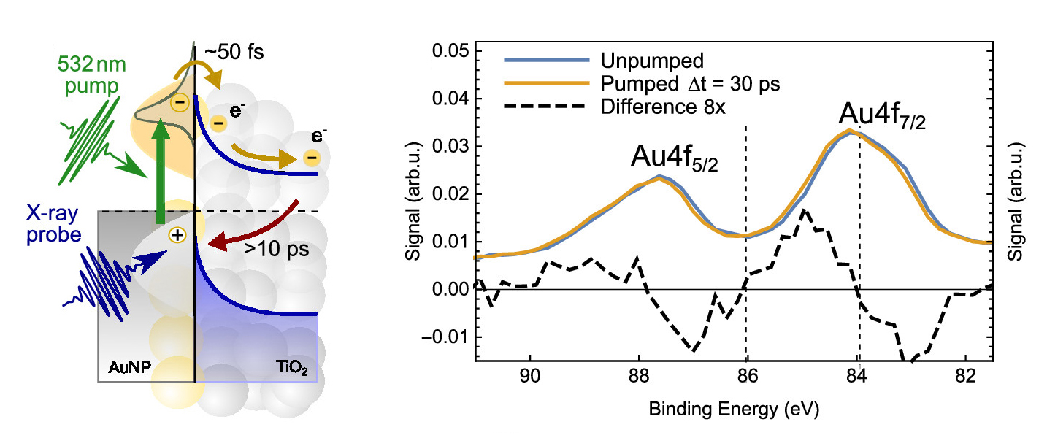
A Probe of Light-Harvesting Efficiency at the Nanoscale
Scientific Achievement
Using time-resolved experiments at the Advanced Light Source (ALS), researchers found a way to count electrons moving back and forth across a model interface for photoelectrochemical cells.
Left: Laser pulses (green) excite electrons in gold nanoparticles (AuNP) on a TiO₂ substrate. Time-delayed x-ray pulses (blue) probe element-specific binding energies. Right: Differences in the pumped and unpumped binding-energy spectra provided key information.
Significance and Impact
The findings provide real-time, nanoscale insight into the efficiency of nanomaterial catalysts that help turn sunlight and water into fuel through artificial photosynthesis.
Research Details
X-ray photoelectron spectroscopy (XPS) was expanded to time-resolved studies.
First application to charge-transfer dynamics in nanoplasmonic systems (Au/TiO₂).
Observed a shift in spectra of Au nanoparticles to higher binding energies.
Revealed lower-than-expected electron-transfer number: ~2 per nanoparticle.
Publication about this research: M. Borgwardt, J. Mahl, F. Roth, L. Wenthaus, F. Brauße, M. Blum, K. Schwarzburg, G. Liu, F.M. Toma, and O. Gessner, J. Phys. Chem. Lett. 11, 5476 (2020). Work was performed at Lawrence Berkeley National Laboratory, ALS Beamline 11.0.2. Operation of the ALS is supported by the U.S. Department of Energy, Office of Science, Basic Energy Sciences program.
Notes:
In the search for clean-energy alternatives to fossil fuels, one promising solution relies on photoelectrochemical (PEC) cells: water-splitting, artificial-photosynthesis devices that turn sunlight and water into solar fuels such as hydrogen. In just a decade, researchers have achieved great progress in the development of PEC systems made of light-absorbing gold nanoparticles (NPs) attached to a semiconductor film of titanium dioxide (TiO₂). Despite these advancements, researchers still struggle to make a device that can produce solar fuels on a commercial scale. Electron–hole pairs are critical ingredients for enabling the chemical reaction that produces solar fuels. The longer the lifetime of the electron–hole pair, the more time there is for the chemical reaction to take place. Thus, to understand how efficiently a PEC device is working, it’s necessary to know the number of electrons moving between the gold and TiO₂ as well as how long the electron–hole pairs last. By tracing the movement of electrons in these complex systems with chemical specificity and picosecond time resolution, an accurate calculation of the conversion efficiency of plasmonic light-harvesting devices can be obtained.
Researchers: M. Borgwardt, J. Mahl, F. Brauße, G. Liu, F.M. Toma, and O. Gessner (Berkeley Lab); F. Roth (Technische Universität Bergakademie Freiberg); L. Wenthaus (Deutsches Elektronen Synchrotron); M. Blum (Berkeley Lab and ALS); and K. Schwarzburg (Helmholtz-Zentrum Berlin für Materialien und Energie).
Funding: U.S. Department of Energy, Office of Science, Basic Energy Sciences program (DOE BES); Joint Center for Artificial Photosynthesis; and Alexander von Humboldt Foundation. Operation of the ALS is supported by DOE BES.
Full highlight: https://als.lbl.gov/a-probe-of-light-harvesting-efficiency-at-the-nanoscale/

