Slide 1
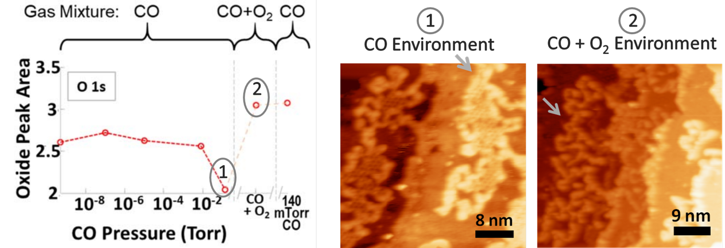
Increasing the Efficiency of CO Catalytic Conversion
Scientific Achievement
Using a combination of tools at the Advanced Light Source (ALS) and other facilities, researchers probed specific mechanisms affecting the efficiency of catalysts for CO-to-CO₂ conversion.
Significance and Impact
Combining APXPS results with HPSTM showed that the deactivation of oxide sites on a Pt/CoO catalyst was accompanied by transformations in the oxide structure.
Significance and Impact
The work brings us closer to the rational design of more effective catalysts for cleaning up toxic CO exhaust and advances our understanding of fundamental catalytic reactions.
Research Details
Surface oxidation states on a CoO/Pt catalyst, measured using ambient-pressure x-ray photoelectron spectroscopy (APXPS), were correlated with nanoscale surface structures, revealed by high-pressure scanning tunneling microscopy (HPSTM).
The creation of oxygen vacancies on the CoO surface enables CO₂ formation at significantly lower temperatures, making it a much more energy-efficient reaction.
Publication about this research: H. Kersell, Z. Hooshmand, G. Yan, D. Le, H. Nguyen, B. Eren, C.H. Wu, I. Waluyo, A. Hunt, S. Nemšák, G. Somorjai, T.S. Rahman, P. Sautet, and M. Salmeron, J. Am. Chem. Soc. 142, 8312 (2020). Work was performed at Lawrence Berkeley National Laboratory, ALS Beamline 11.0.2, and Brookhaven National Laboratory, NSLS-II Beamline 23-ID-2. Operation of the ALS is supported by the U.S. Department of Energy, Office of Science, Basic Energy Sciences program.
Notes:
The conversion CO into CO₂ is important for cleaning up exhaust gases—mostly from vehicles that burn fossil fuels but also from stationary sources such as power plants and refineries. Platinum (Pt) catalysts are widely used to process CO into CO₂, but the high cost of platinum-group metals has driven efforts to replace these materials with more earth-abundant alternatives. One of the most promising ways of reducing the cost of metal catalysts is to mix them with oxide compounds. In a previous investigation, researchers tested various mesoporous transition-metal oxides and loaded them with Pt nanoparticles. Each oxide exhibited enhanced CO-to-CO₂ conversion activity, but the enhancement was largest for cobalt oxide. To understand the origin of this enhanced activity, the researchers investigated the atomic and electronic structure of Pt/CoO model catalysts under operating conditions (i.e., in the presence of CO gas and/or oxygen). While their earlier study looked at platinum nanoparticles on oxide surfaces, in this study, the researchers used so-called “inverse” catalysts, where the oxide was formed on a platinum surface. The well-defined platinum surfaces enabled them to correlate the nanoscale surface structure, revealed by high-pressure scanning tunneling microscopy (HPSTM), with surface oxidation states, measured using ambient-pressure x-ray photoelectron spectroscopy (APXPS) at NSLS-II and the ALS.
Researchers: H. Kersell, B. Eren, and C.H. Wu (Berkeley Lab); Z. Hooshmand, D. Le, and T.S. Rahman (Univ. of Central Florida); G. Yan, H. Nguyen, and P. Sautet (Univ. of California, Los Angeles); I. Waluyo and A. Hunt (Brookhaven National Laboratory); S. Nemšák (ALS); and G. Somorjai and M. Salmeron (Berkeley Lab and Univ. of California, Berkeley).
Funding: U.S. Department of Energy, Office of Science, Basic Energy Sciences program (DOE BES), National Science Foundation. Operation of the ALS is supported by DOE BES.
Full highlight: https://als.lbl.gov/increasing-the-efficiency-of-co-catalytic-conversion/

