Slide 1
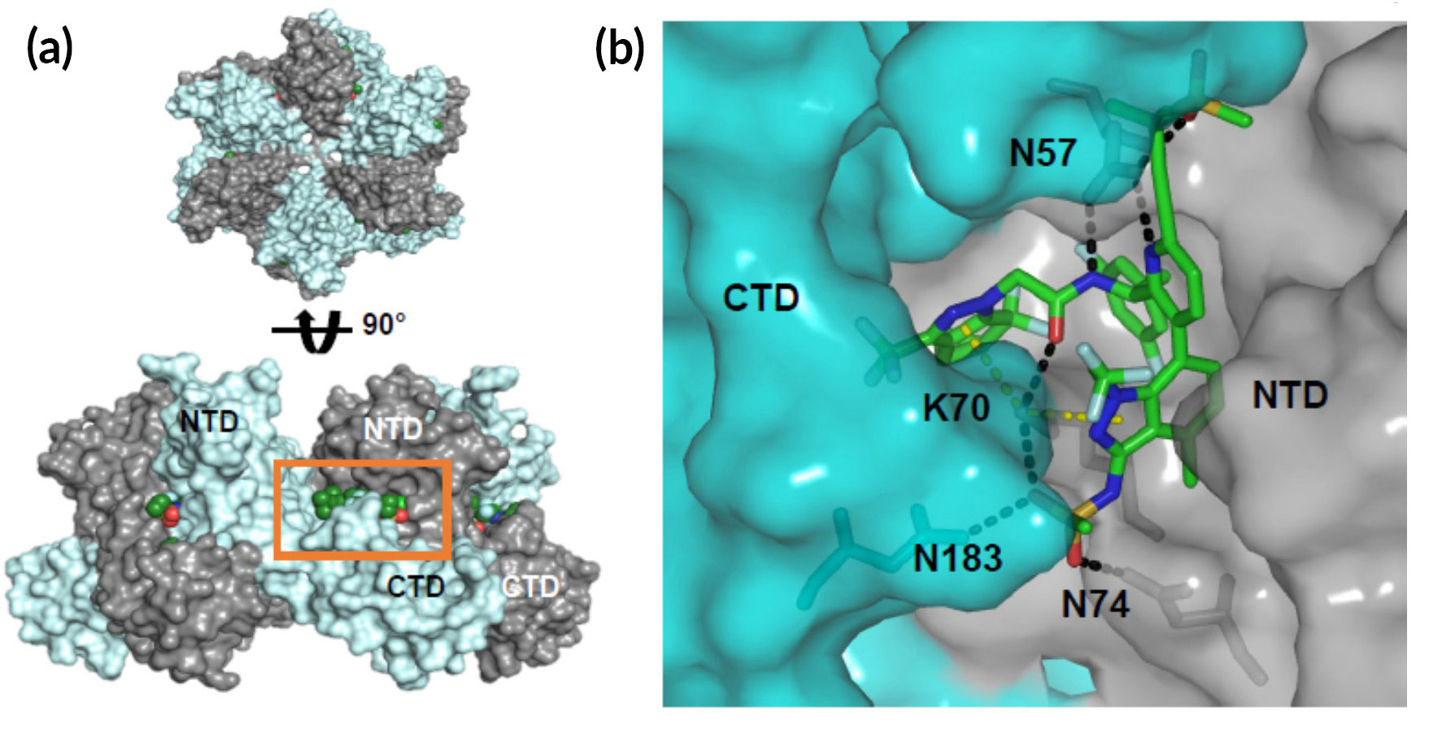
Experimental Drug Targets HIV in a Novel Way
Scientific Achievement
Using the Advanced Light Source (ALS), researchers from Gilead Sciences Inc. solved the structure of an experimental HIV drug bound to a novel target: the capsid protein that form a shield around the viral RNA.
(a) Top and side views of a capsid protein (CA) hexa-mer, a basic building block of the viral capsid. The box shows the location of the drug binding site. (b) Inter-actions between the drug and CA.
Significance and Impact
The work could lead to a long-lasting treatment for HIV that overcomes the problem of drug resistance and avoids the need for burdensome daily pill-taking.
Research Details
Drug molecule (GS-6207) was designed to target the capsid protein (CA) of HIV-1.
X-ray crystallography provided high-resolution view of drug–protein interactions.
Drug binding leads to malformed HIV capsids, disrupting viral replication.
Early clinical trials validate GS-6207’s promise as a potent, long-acting drug.
Publication about this research: J.O. Link et al., Nature 584, 614 (2020). Work was performed at Lawrence Berkeley National Laboratory, ALS Beamline 5.0.1. Operation of the ALS is supported by the U.S. Department of Energy, Office of Science, Basic Energy Sciences program.
Notes:
Over the past couple of decades, safe and effective treatment for HIV infection has turned what was once a death sentence into a chronic disease. Today, people on the latest HIV drugs have near-normal life expectancy. However, many people are still living with multidrug-resistant HIV, unable to control their virus loads with currently available HIV drugs. The virus develops resistance when people take their pills inconsistently due to forgetfulness, side effects, or a complex schedule. To some, taking a pill every day is a burden: they schedule their lives around it for fear of missing a dose. To others, it is a stigma, as it makes it difficult to hide one’s HIV status from close friends and family. In this work, researchers from Gilead Sciences Inc. investigated a promising small-molecule drug (GS-6207) they developed that works in a novel way: by targeting the HIV-1 capsid protein (CA), a structural protein that forms pinwheel-like hexamers that assemble into an conical shell (a capsid) around the viral genome. If successful, GS-6207 could avoid issues of drug resistance while imparting longer-lasting viral suppression, enabling a more manageable regimen.
Researchers: J.O. Link, M.S. Rhee, W.C. Tse, J. Zheng, J.R. Somoza, W. Rowe, R. Begley, A. Chiu, A. Mulato, D. Hansen, E. Singer, L.K. Tsai, R.A. Bam, C.-H. Chou, E. Canales, G. Brizgys, J.R. Zhang, J. Li, M. Graupe, P. Morganelli, Q. Liu, Q. Wu, R.L. Halcomb, R.D. Saito, S.D. Schroeder, S.E. Lazerwith, S. Bondy, D. Jin, M. Hung, N. Novikov, X. Liu, A.G. Villaseñor, C.E. Cannizzaro, E.Y. Hu, R.L. Anderson, T.C. Appleby, B. Lu, J. Mwangi, A. Liclican, A. Niedziela-Majka, G.A. Papalia, M.H. Wong, S.A. Leavitt, Y. Xu, D. Koditek, G.J. Stepan, H. Yu, N. Pagratis, S. Clancy, S. Ahmadyar, T.Z. Cai, S. Sellers, S.A. Wolckenhauer, J. Ling, C. Callebaut, N. Margot, R.R. Ram, Y.-P. Liu, R. Hyland, D.M. Brainard, L. Lad, S. Swaminathan, R. Sakowicz, A.E. Chester, W.E. Lee, S.R. Yant, and T. Cihlar (Gilead Sciences, Inc.); G.I. Sinclair (AIDS Arms Inc., DBA Prism Health North Texas); P.J. Ruane (Ruane Clinical Research Group Inc.); G.E. Crofoot (The Crofoot Research Center Inc.); C.K. McDonald (Texas Centers for Infectious Disease Associates); W.I. Sundquist (University of Utah School of Medicine); and E.S. Daar (UCLA).
Funding: Gilead Sciences, Inc. Operation of the ALS is supported by the U.S. Department of Energy, Office of Science, Basic Energy Sciences program.
Full highlight: https://als.lbl.gov/experimental-drug-targets-hiv-in-a-novel-way/

