Slide 1
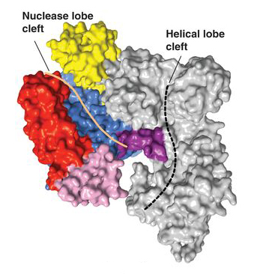
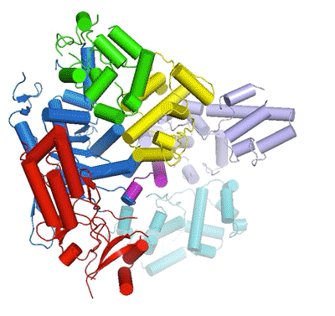
ALS CRISPR-Cas9 Studies Support 2020 Chemistry Nobel
Structural biology research performed at the Advanced Light Source (ALS) contributed to Jennifer Doudna’s recognition as a 2020 Nobel laureate
Crystallography to determine the structure of the CRISPR-Cas9 protein complex was performed almost entirely at BES light sources.
Two publications based on ALS work were high-lighted in the Nobel Prize scientific background (Jinek 2014; Jiang 2015).
Structural information was essential to under-standing the complex’s function and thus its potential for adaptation into a revolutionary tool for quickly and easily editing DNA.
Doudna co-authored 35 papers based on ALS work between 2000–2020.
ALS work was performed on UC Berkeley/UCSF Beamline 8.3.1 and HHMI Beamlines 8.2.1 and 8.2.2
The crystal structure of a Cas9 protein from the bacterium S. pyogenes reveals an open, two-lobe architecture and nucleic-acid-binding clefts.
Conformational rearrangements of Cas9 upon binding of guide RNA and recog-nition of target DNA.
Publications about this research: M. Jinek et al., Science 343, 1247997 (2014), and F. Jiang et al., Science 348, 1477 (2015). Work was performed at Lawrence Berkeley National Laboratory, ALS Beamlines 8.2.1, 8.2.2, and 8.3.1. Operation of the ALS is supported by the U.S. Department of Energy, Office of Science, Basic Energy Sciences program.
Notes:
In 2020, Jennifer Doudna and Emmanuelle Charpentier won the Nobel Prize in Chemistry for the development of extremely precise, programmable “genetic scissors” for editing DNA. This technology, based on CRISPR-Cas9 proteins, revolutionized biomedicine and life sciences and offers promising new approaches to solving energy and environmental challenges. Hard x-ray crystallography is the tool of choice for scientists interested in gaining an atomic-level understanding of molecular structure, and Doudna was particularly interested in understanding the molecular basis for genetic control. She published the first of her 35 ALS-based papers in 2000, while still a professor at Yale. She transferred to UC Berkeley in 2002 and quickly became involved in the ALS community, joining the Scientific Advisory Committee and serving as chair of the Users’ Executive Committee in 2003. Two of her papers based on protein crystallography at the ALS, Jinek et al. (2014) and Jiang et al. (2015), were cited in the Nobel Committee’s scientific background document.
Researchers: M. Jinek and C. Anders (Univ. of Zurich, Switzerland); F. Jiang, S.H. Sternberg, E. Kaya, E. Ma, M. Hauer, and A.T. Lavarone (Univ. of California, Berkeley); D.W. Taylor and S. Lin (Howard Hughes Medical Institute and Univ. of California, Berkeley); K.-J. Zhou, M. Kaplan, and L. Ma (Howard Hughes Medical Institute); E. Charpentier (Umeå Univ., Sweden; Helmholtz Centre for Infection Research, Germany; and Hannover Medical School, Germany); S. Gressel (Max Planck Institute for Biophysical Chemistry, Germany); and E. Nogales and J.A. Doudna (Univ. of California, Berkeley; Howard Hughes Medical Institute; and Berkeley Lab).
Funding: Howard Hughes Medical Institute (HHMI), Bill and Melinda Gates Foundation, National Science Foundation, University of Zurich, European Research Council, China Scholarship Council, German Academic Exchange Program (DAAD), National Defense Science and Engineering Graduate Research Fellowship, Swedish Foundation for International Cooperation in Research and Education, and Damon Runyon Cancer Research Foundation. Beamline 8.3.1 is funded by UC Berkeley and UC San Francisco. Beamlines 8.2.1 and 8.2.2 are funded by HHMI. Operation of the ALS is supported by the U.S. Department of Energy, Office of Science, Basic Energy Sciences program.
Full highlight: https://als.lbl.gov/jennifer-doudna-and-the-nobel-prize-the-advanced-light-source-perspective

