Slide 1
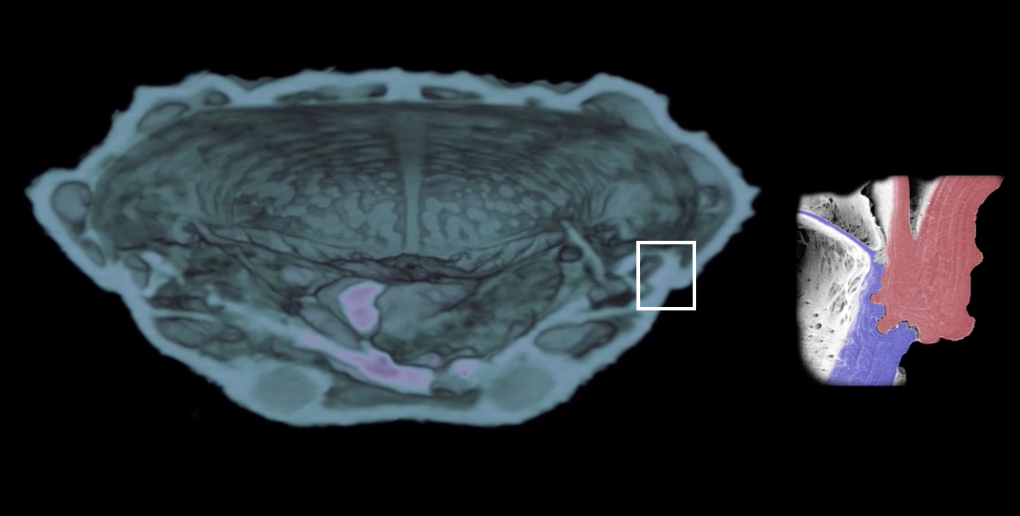
Microstructures Explain Beetle Exoskeleton Strength
Scientific Achievement
Using microtomography at the Advanced Light Source (ALS) and other techniques, researchers identified the exoskeletal toughening mechanisms that explain the crush resistance of the aptly named diabolical ironclad beetle.
Microtomographic cross section of the elytra (exoskeletal forewings) of a diabolical ironclad beetle. Inset shows details of area in white rectangle, where an interdigitated joining architecture helps provide mechanical strength.
Significance and Impact
The observations could be applied in developing tough, impact- and crush- resistant materials for joining dissimilar materials.
Research Details
X-ray microtomography provided high-resolution, 3D images of the microscopic architecture of interlocking parts at different stages of compression.
Biomimetic composites based on the observed structures show a considerable increase in toughness compared with a frequently used engineering joint.
Publication about this research: J. Rivera et al., Nature 586, 543 (2020). Work was performed at Lawrence Berkeley National Laboratory, ALS Beamline 8.3.2. Operation of the ALS is supported by the U.S. Department of Energy, Office of Science, Basic Energy Sciences program.
Notes:
The appropriately named diabolical ironclad beetle can take a shelling thanks to the incredibly crush-resistant architecture of its exoskeleton, which could serve as the blueprints for designing tougher materials and stronger connections between different material types. To see, in microscopic detail, what makes the beetle so uniquely ironclad, researchers used x-ray microtomography and other techniques to explore a protective covering known as the “elytra” (forewings), its abdomen, and other parts. In flying beetles and other insects, the elytra serves as a cover for their wings, though the diabolical ironclad beetle is flightless and the researchers learned its elytra plays an important function in protecting its internal organs from crushing. The ability to study the internal structure, in 3D and at high resolution, was critical to observing and understanding the structures.
Researchers: J. Rivera and Drago Vasile (Univ. of California, Riverside), M.S. Hosseini and P. Zavattieri (Purdue Univ.), D. Restrepo (Purdue Univ. and Univ. of Texas at San Antonio), S. Murata and A. Arakaki (Tokyo Univ. of Agriculture and Technology), D.Y. Parkinson and H.S. Barnard (ALS), and D. Kisailus (Univ. of California, Riverside, and Univ. of California, Irvine).
Funding: Air Force Office of Scientific Research, Army Research Office, and Institute of Global Innovation Research at Tokyo University of Agriculture and Technology. Operation of the ALS is supported by the U.S. Department of Energy, Office of Science, Basic Energy Sciences program.
Full highlight: https://als.lbl.gov/microstructures-explain-beetle-exoskeleton-strength/

