Slide 1
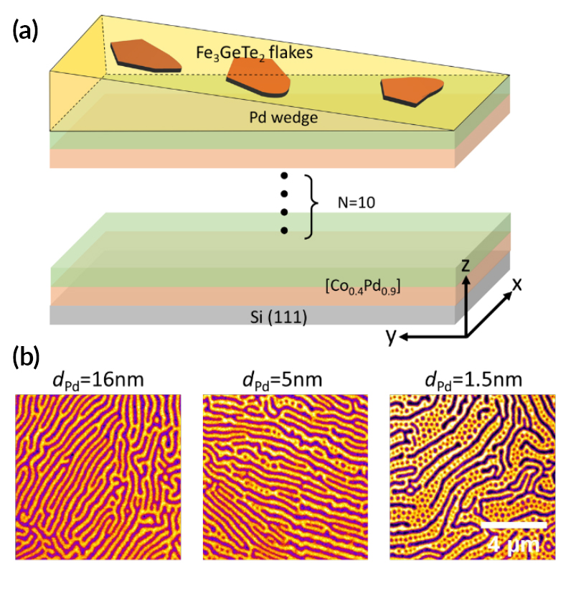
From Stripes to Skyrmions in a Surprising Material
Scientific Achievement
Researchers using the Advanced Light Source (ALS) showed that tiny bubbles of ordered spins (skyrmions) can be induced to form in a type of material previously considered incompatible with skyrmion formation.
Significance and Impact
The discovery opens up a new class of material sys-tems that exhibit technologically desirable nanoscale features attractive for spintronic applications.
Research Details
Fe₃GeTe₂ (FGT), a magnetic van der Waals material, was placed on a Pd spacer over Co/Pd multilayers.
The wedge-shaped spacer tuned the strength of the FGT–Co/Pd coupling.
Photoemission electron microscopy (PEEM) of the magnetic domains revealed that stripe domains broke down into bubbles with decreasing spacer thickness.
Lorentz transmission electron microscopy (LTEM) confirmed that the bubbles were Néel-type skyrmions (radial pattern as opposed to vortex).
(a) Schematic of the sample. (b) PEEM images of FGT magnetic domains at three different thicknesses of the Pd spacer layer. d_{Pd} = spacer thickness.
Publication about this research: M. Yang, Q. Li, R.V. Chopdekar, R. Dhall, J. Turner, J.D. Carlström, C. Ophus, C. Klewe, P. Shafer, A.T. N’Diaye, J.W. Choi, G. Chen, Y.Z. Wu, C. Hwang, F. Wang, and Z.Q. Qiu, Sci. Adv. 6, eabb5157 (2020). Work was performed at Lawrence Berkeley National Laboratory, Beamlines 4.0.2, 6.3.1, and 11.0.1. Operation of the ALS is supported by the U.S. Department of Energy, Office of Science, Basic Energy Sciences program.
Notes:
In spintronics research, two equally important topics have emerged in recent years: magnetic skyrmions and magnetic van der Waals materials. Magnetic skyrmions are extremely tiny and stable (i.e., “topologically protected”) swirls of spin. Their small size and high stability make skyrmions very attractive for use in high-density, low-power spintronic applications. Van der Waals (vdW) materials consist of weakly bonded, two-dimensional layers that exhibit highly tunable electronic properties. Recently, in some cases, vdW materials were also found to exhibit ferromagnetism, an exciting development that bodes well for new and potentially useful properties. The merging of these two developments would greatly expand the possibilities for fundamental and applied research. However, because magnetic vdW materials have lacked a key structural characteristic—the breaking of inversion symmetry—necessary for the formation of skyrmions, there has been little overlap between the two subject areas. In this work, researchers show unambiguously that magnetic coupling between a vdW material and cobalt/palladium multilayers leads to the spontaneous formation of magnetic skyrmions in the vdW material, without the need for inversion symmetry breaking or an external magnetic field.
Researchers: M. Yang, Q. Li, J.D. Carlström, F. Wang, and Z.Q. Qiu (Univ. of California, Berkeley); R.V. Chopdekar, C. Klewe, P. Shafer, and A.T. N’Diaye (ALS); R. Dhall, J. Turner, and C. Ophus (Berkeley Lab); J.W. Choi (Korea Institute of Science and Technology); G. Chen (Univ. of California, Davis); Y.Z. Wu (Fudan University, China); and C. Hwang (Korea Research Institute of Standards and Science).
Funding: U.S. Department of Energy, Office of Science, Basic Energy Sciences program (DOE BES), Korea Institute of Science and Technology Institutional Program, National Research Foundation of Korea, National Science Foundation, Univ. of California Office of the President, National Natural Science Foundation of China. Operation of the ALS is supported by DOE BES.
https://als.lbl.gov/from-stripes-to-skyrmions-in-a-surprising-material/

