Slide 1
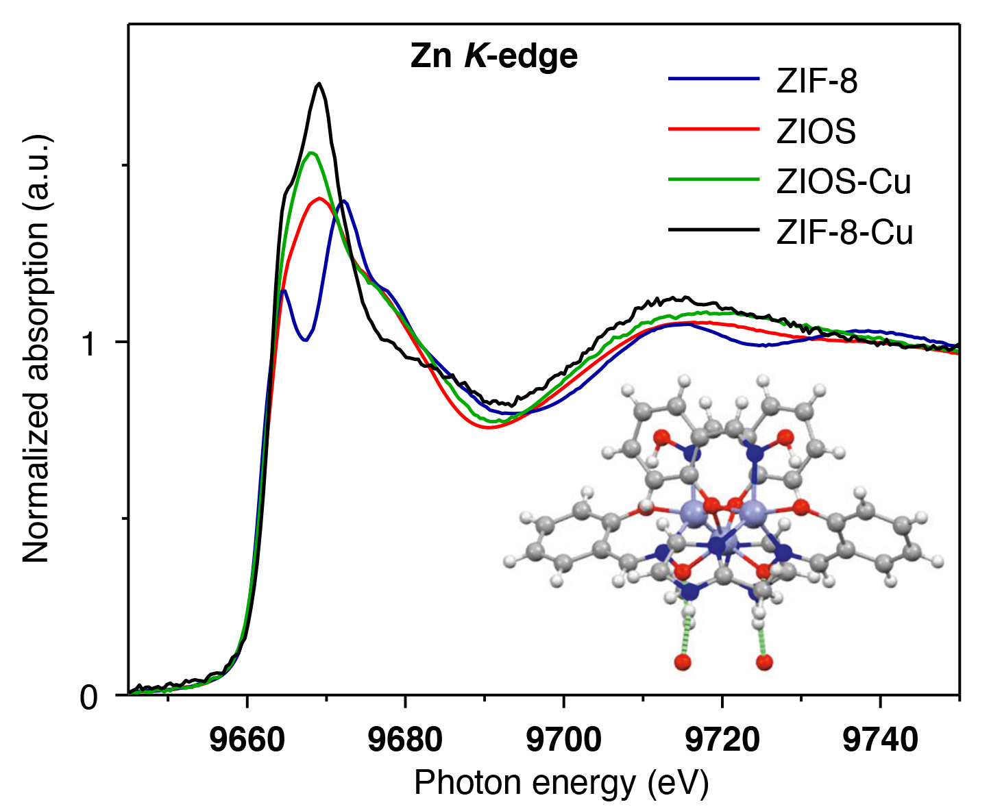
Molecular Complex Removes Copper Ions from Water
Scientific Achievement
X-ray analyses at the Advanced Light Source (ALS) provided key insights into the copper uptake mech- anisms in a new organic-inorganic hybrid material that quickly and selectively removes copper ions from water.
Significance and Impact
The material provides an efficient tool for copper remediation as well as a blueprint for creating other hybrid materials for removing toxic metals from water.
Example of spectroscopy data for ZIOS and ZIF-8 (a state-of-the-art ion adsorbent) before and after copper adsorption. Inset: Structure of ZIOS obtained from x-ray diffraction data.
Research Details
Bio-inspired ZIOS (zinc imidazole salicylaldoxime) designed at Molecuar Foundry.
ALS x-ray diffraction and spectroscopy provided structural and chemical clues as to the mechanism behind ZIOS’s surprisingly high copper-ion uptake.
Molecular dynamics simulations confirmed hypothesis that framework expands in water, opening channels for adsorption of copper ions.
Publication about this research: N.T. Bui, H. Kang, S.J. Teat, G.M. Su, C.-W. Pao, Y.S. Liu, E.W. Zaia, J. Guo, J.-L. Chen, K.R. Meihaus, C. Dun, T.M. Mattox, J.R. Long, P. Fiske, R. Kostecki, and J.J. Urban, Nat. Commun. 11, 3947 (2020). Work was performed at Lawrence Berkeley National Laboratory, Molecular Foundry and ALS Beamlines 6.3.2 and 12.2.1. Operation of the ALS is supported by the U.S. Department of Energy, Office of Science, Basic Energy Sciences program.
Notes:
A team of scientists from Berkeley Lab’s Molecular Foundry has designed a new crystalline material—called ZIOS (zinc imidazole salicylaldoxime)—that targets and traps copper ions from wastewater with unprecedented precision and speed. In designing ZIOS, the researchers were inspired by the way some copper-binding proteins use ring-shaped organic molecules (imidazoles) to capture copper ions in active sites. To mimic this, the researchers incorporated imidazole groups into supramolecular coordination complexes—large multimolecular complexes in which organic molecules are bound to a central metal atom. Intriguingly, ZIOS adsorbs copper ions 30 to 50 times faster than state-of-the-art copper adsorbents. The researchers used several x-ray techniques, including x-ray diffraction and near-edge x-ray absorption fine-structure (NEXAFS) spectroscopy at the ALS, to characterize the material and better understand the mechanisms leading to its ability to adsorb copper ions.
Researchers: N.T. Bui, E.W. Zaia, C. Dun, T.M. Mattox, P. Fiske, R. Kostecki, and J.J. Urban (Berkeley Lab); H. Kang and J.R. Long (Berkeley Lab and UC Berkeley); S.J. Teat, G.M. Su, Y.S. Liu, and J. Guo (ALS); C.-W. Pao and J.-L. Chen (National Synchrotron Radiation Research Center, Taiwan); and K.R. Meihaus (UC Berkeley).
Funding: Berkeley Lab (Laboratory Directed Research and Development Program, Molecular Foundry) and the U.S. Department of Energy (DOE), Office of Energy Efficiency and Renewable Energy, Geothermal Technologies Office. Operation of the ALS is supported by the DOE Office of Science, Basic Energy Sciences program.
Full highlight: https://als.lbl.gov/molecular-complex-removes-copper-ions-from-water/

