Slide 1
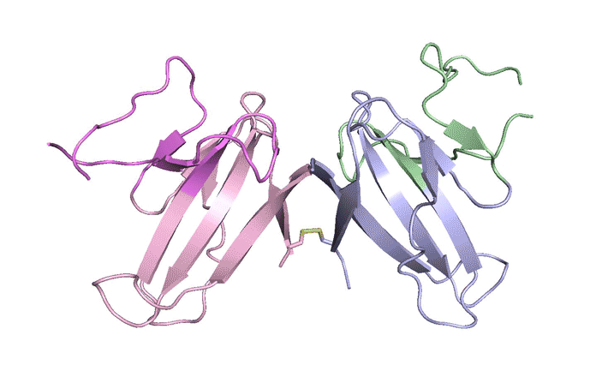
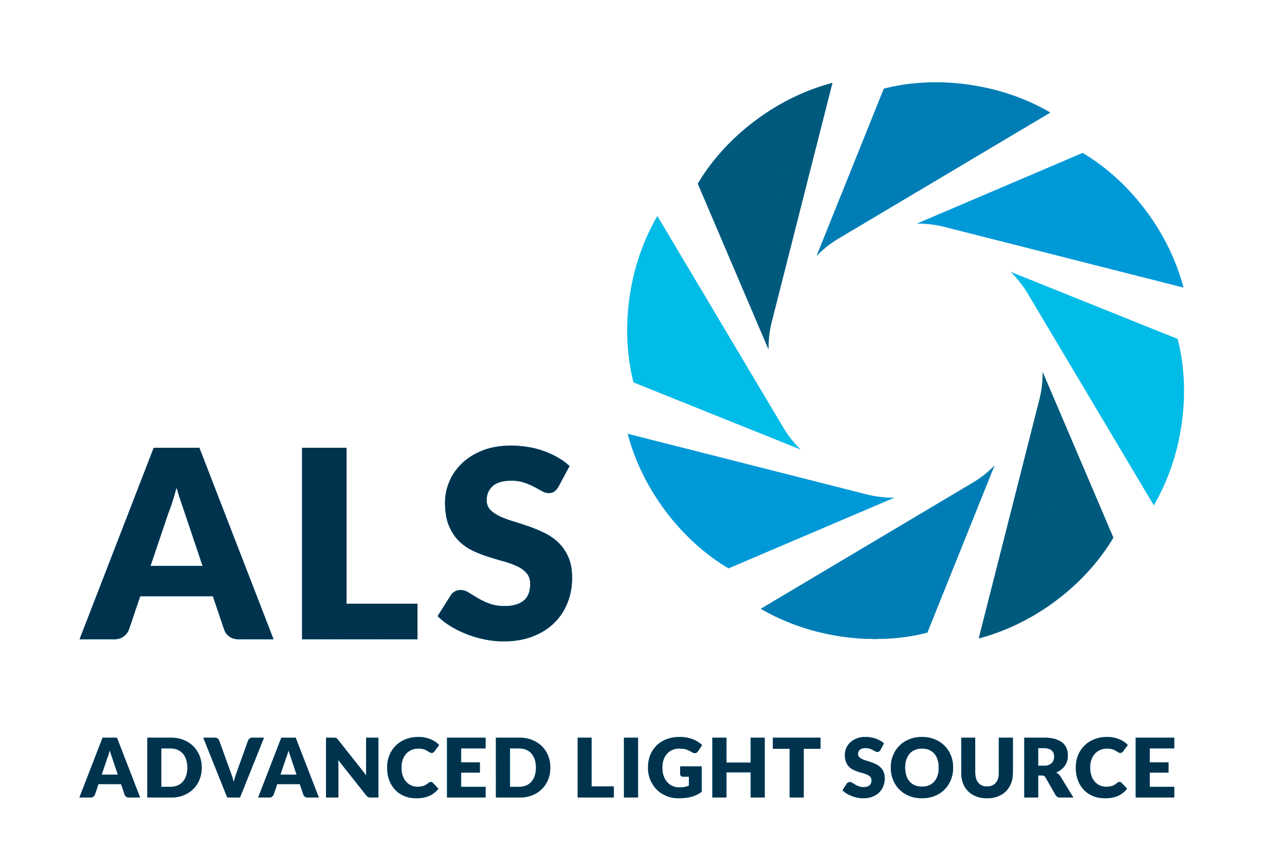
Mystery Protein Helps COVID-19 Avoid Immunity
Scientific Achievement
Using the Advanced Light Source (ALS), researchers solved the structure of ORF8, a protein specific to SARS-CoV-2.
Significance and Impact
Understanding the structure of ORF8 opens the door to therapy studies targeting SARS-CoV-2, the virus responsible for causing COVID-19.
A ribbon diagram of the ORF8 structure. This protein is composed of two units with identical amino acid sequences that are bound together by specific protein–protein interactions and a disulfide bridge.
Research Details
X-ray crystallography at the Berkeley Center for Structural Biology (BCSB) at the ALS revealed that ORF8 has new regions never before seen in other coronaviruses—not even the proteins from which ORF8 evolved.
These new regions allow the ORF8 protein to form large complexes that may increase SARS-CoV-2 pathogenicity by suppressing or evading immune responses.
The results laid the groundwork for studying the structure/function relationships of ORF8, enabling a full understanding of the role of ORF8 in the COVID-19 pandemic.
Publication about this research: T.G. Flower et al., PNAS 118, 2 (2021). Work was performed at Lawrence Berkeley National Laboratory, ALS Beamline 5.0.2. Operation of the ALS is supported by the U.S. Department of Energy, Office of Science, Basic Energy Sciences program.
Notes:
As COVID-19 rapidly spread around the globe in 2020, researchers sought explanations for the disease’s peculiar virulence. Structural biologists at UC Berkeley and Berkeley Lab compared SARS-CoV-2, the virus that causes COVID-19, with other coronaviruses to determine a molecular basis for the severity of the disease. They found a mutation that produced a protein twice the size of corresponding proteins in other coronaviruses. In x-ray crystallography studies at the Berkeley Center for Structural Biology and the Advanced Light Source, they solved the crystal structure of this protein, ORF8, and discovered new regions never before seen in other coronaviruses. These regions allow the ORF8 protein to form large complexes, which may enable the virus to evade or suppress an immune response. By characterizing a completely new viral protein structure, these researchers have laid the groundwork for further studies into the structure/function relationships of ORF8 enabling a full understanding of the role of ORF8 in the COVID-19 pandemic.
Researchers: T.G. Flower, C.Z. Buffalo, R.M. Hooy, and X. Ren (University of California, Berkeley); M. Allaire (Berkeley Lab); and J.H. Hurley (University of California, Berkeley, and Berkeley Lab).
Funding: University of California Office of the President, National Institutes of Health, and Howard Hughes Medical Institute. Operation of the ALS is supported by the U.S. Department of Energy, Office of Science, Basic Energy Sciences program.
Full highlight: https://als.lbl.gov/mystery-protein-increases-covid-19-severity/

