Slide 1
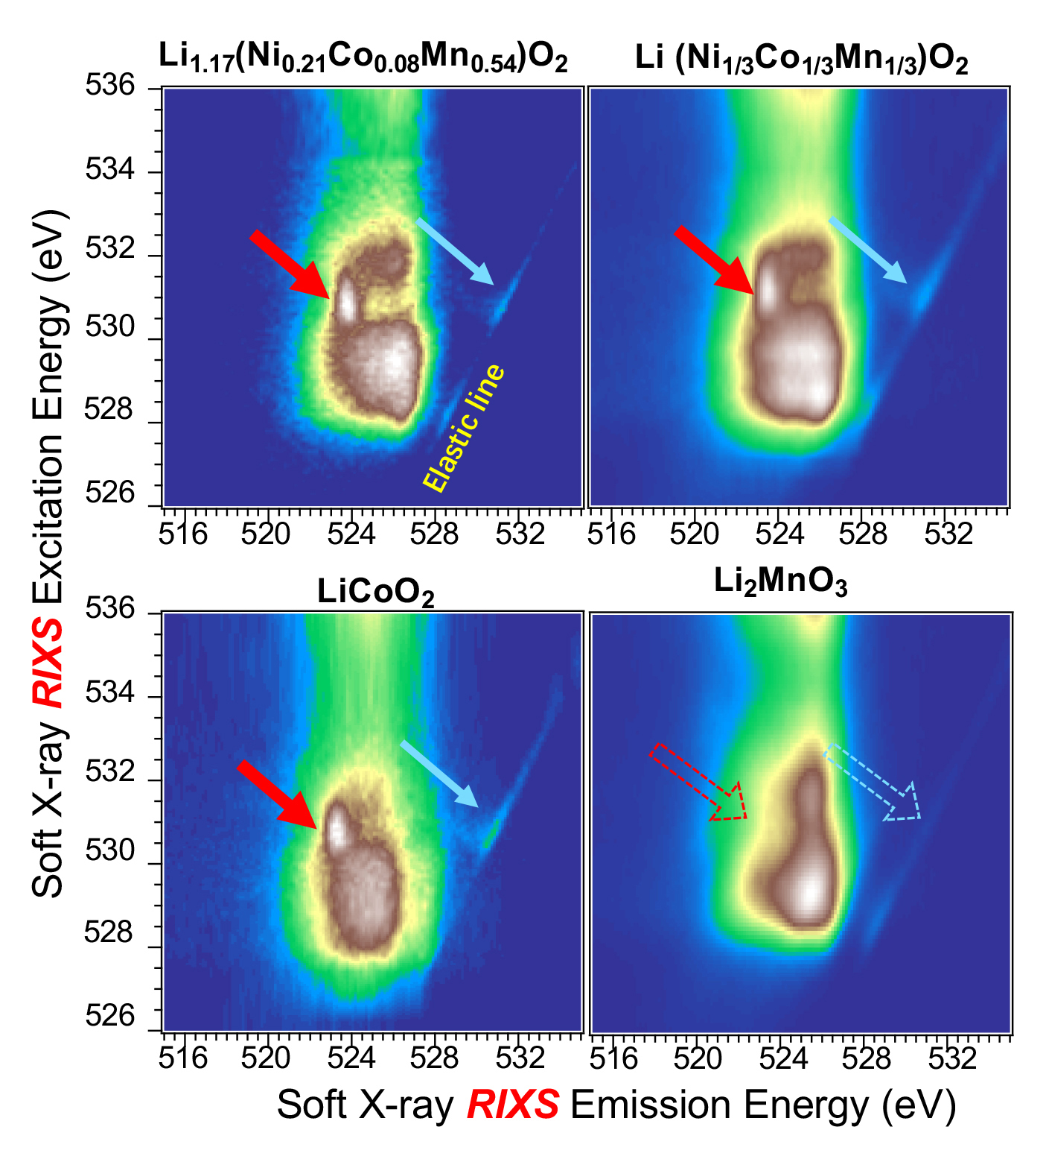
Study Shines New Light on Li-Battery Cathode Materials
Scientific Achievement
Spectroscopic studies done at the Advanced Light Source (ALS) clarified key reaction mechanisms in a Li-battery cathode material, revealing its surprising utility as a catalyst for next-generation batteries.
Significance and Impact
The work refutes widely held ideas about reversible reac-tions in a highly debated material for Li-based batteries and expands the range of materials suitable for use in high-power batteries and fuel cells.
Research Details
Resonant inelastic x-ray scattering (RIXS) was used to study reversible redox reactions in a Li-rich cathode material (Li₂MnO₃).
The RIXS “fingerprint” for oxygen re-dox activity (red and blue arrows) was observed in various electrodes, but was unexpectedly absent in Li₂MnO₃.
Mn redox is responsible for reversible charge cycling in the bulk (not O redox, as widely believed).
Surface reactions involving carbonate compounds were observed; could catalyze reversible chemical reactions required for exotic, next-generation technologies such as lithium-CO₂ batteries.
Publication about this research: Z. Zhuo, K. Dai, R. Qiao, R. Wang, J. Wu, Y. Liu, J. Peng, L. Chen, Y.-D. Chuang, F. Pan, Z.-X. Shen, G. Liu, H. Li, T.P. Devereaux, and W. Yang, Joule, doi:10.1016/j.joule.2021.02.004 (2021). Work was performed at Lawrence Berkeley National Laboratory, Beamlines 8.0.1 and 4.0.3. Operation of the ALS is supported by the U.S. Department of Energy, Office of Science, Basic Energy Sciences program.
Notes:
The pressing demand for high-energy batteries capable of extending the range of electric vehicles and the operation of electronic devices has triggered tremendous efforts to develop high-voltage cathode materials for lithium-ion batteries. High-voltage operation, however, gives rise to complex chemical reactions at the cathode, involving concepts and mechanisms that are under active debate. Through a fundamental spectroscopic study using a unique x-ray instrument at the ALS, an international team of researchers clarified the reaction mechanisms at work in a lithium-rich high-voltage cathode material. In the process, they discovered an alternate use for the material—as a catalyst in more advanced types of lithium-based batteries.
Researchers: Z. Zhuo (Peking University and ALS); K. Dai (Tianjin Normal University, China; Northeastern University, China; and ALS); R. Qiao, Y.-D. Chuang, and W. Yang (ALS); R. Wang, Y. Liu, J. Peng, L. Chen, and H. Li (Institute of Physics, Chinese Academy of Sciences); J. Wu (Stanford University, SLAC National Accelerator Laboratory, and ALS); F. Pan (Peking University); Z.-X. Shen and T.P. Devereaux (Stanford and SLAC); and G. Liu (Berkeley Lab).
Funding: National Key R&D Program of China, Beijing Municipal Science & Technology Commission, National Natural Science Foundation of China, and U.S. Department of Energy, Office of Science, Basic Energy Sciences program (DOE BES). Operation of the ALS is supported by DOE BES.
https://als.lbl.gov/study-shines-new-light-on-li-battery-cathode-materials/
1

