Slide 1
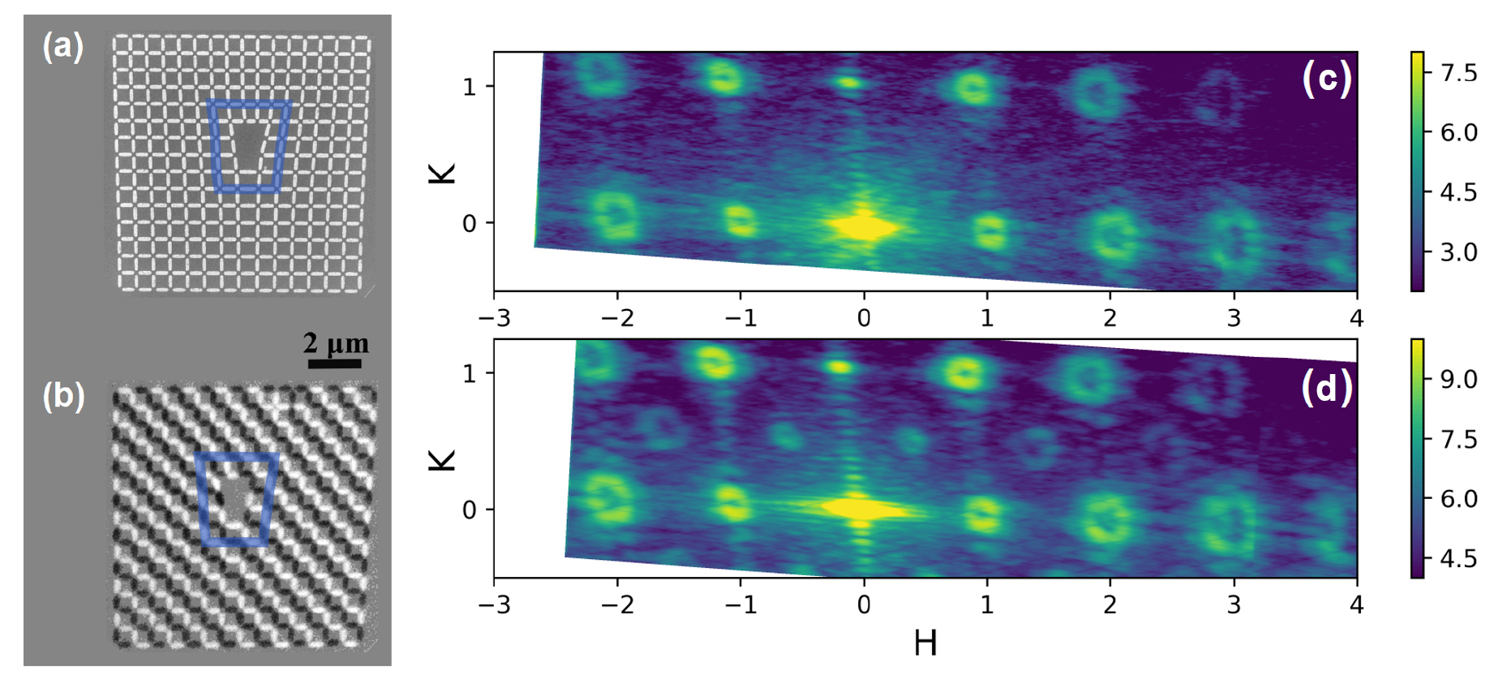
Artificial Spin Ice Toggles Twist in X-Ray Beams on Demand
Scientific Achievement
Advanced Light Source (ALS) studies helped scientists understand how a nanoscale magnetic lattice (an artificial spin ice) acts as a toggle switch for x-ray beams with spiral character.
Significance and Impact
The findings represent an important step toward the development of a versatile new tool for probing or controlling exotic phenomena in electronic and magnetic systems.
(a) SEM image of structural ASI lattice with defect. (b) PEEM image shows magnetic lattice of same ASI. (c) Off-resonance coherent x-ray magnetic scattering shows OAM beams scattered by structural lattice. (d) On-resonance scattering shows OAM beams from both structural and magnetic lattices. Modest variations in temperature or applied magnetic field caused latter to switch on and off.
Research Details
A square-grid artificial spin ice (ASI) of permalloy on silicon was constructed with a double edge dislocation to produce soft x-rays with orbital angular momentum (OAM).
Photoemission electron microscopy (PEEM) verfied existence of antiferromagnetically ordered ground state (a “magnetic lattice”), responsive to changes in temperature and external magnetic field.
Coherent x-ray magnetic scattering confirmed ability to switch OAM from magnetic lattice on and off.
Publication about this research: J.S. Woods, X.M. Chen, R.V. Chopdekar, B. Farmer, C. Mazzoli, R. Koch, A.S. Tremsin, W. Hu, A. Scholl, S. Kevan, S. Wilkins, W.-K. Kwok, L.E. De Long, S. Roy, and J.T. Hastings, Phys. Rev. Lett. 126, 117201 (2021). Work was performed at Lawrence Berkeley National Laboratory, ALS Beamlines 7.0.1 and 11.0.1, and at Brookhaven National Laboratory, NSLS-II Beamline 23-ID-1. Operation of the ALS is supported by the U.S. Department of Energy, Office of Science, Basic Energy Sciences program.
Notes:
In the visible-light regime, beams carrying orbital angular momentum (OAM) have a wide range of applications, including quantum cryptography, optical tweezers, and telecommunications. While OAM in x-ray light is much less common, it holds great promise for imaging and probing, for example, topological spin textures in magnetic systems, polar vortices in ferroelectrics, and chiral systems and nanostructures. However, x-rays with OAM are more difficult to generate, and previous efforts using gratings with a particular type of defect (forked dislocations) produced only static beams. Artificial spin ices (ASIs), whose properties can be tuned based on geometry and competing interactions, often exhibit different ordered phases in response to temperature and external magnetic fields. Thus, the researchers hypothesized that square-patterned ASIs with forked defects could generate OAM beams that could be switched on and off at will.
Researchers: J.S. Woods (Univ. of Kentucky and Argonne National Laboratory); X.M. Chen (Berkeley Lab and Univ. of Kentucky); R.V. Chopdekar, R. Koch, A. Scholl, S. Kevan, and S. Roy (ALS); B. Farmer, L.E. De Long, and J.T. Hastings (Univ. of Kentucky); C. Mazzoli, W. Hu, and S. Wilkins (Brookhaven National Laboratory); A.S. Tremsin (Univ. of California, Berkeley); and W.-K. Kwok (Argonne National Laboratory).
Funding: U.S. Department of Energy, Office of Science, Basic Energy Sciences program (DOE BES). Operation of the ALS is supported by DOE BES.
Full highlight: https://als.lbl.gov/artificial-spin-ice-toggles-twist-in-x-ray-beams-on-demand/
1

