Slide 1
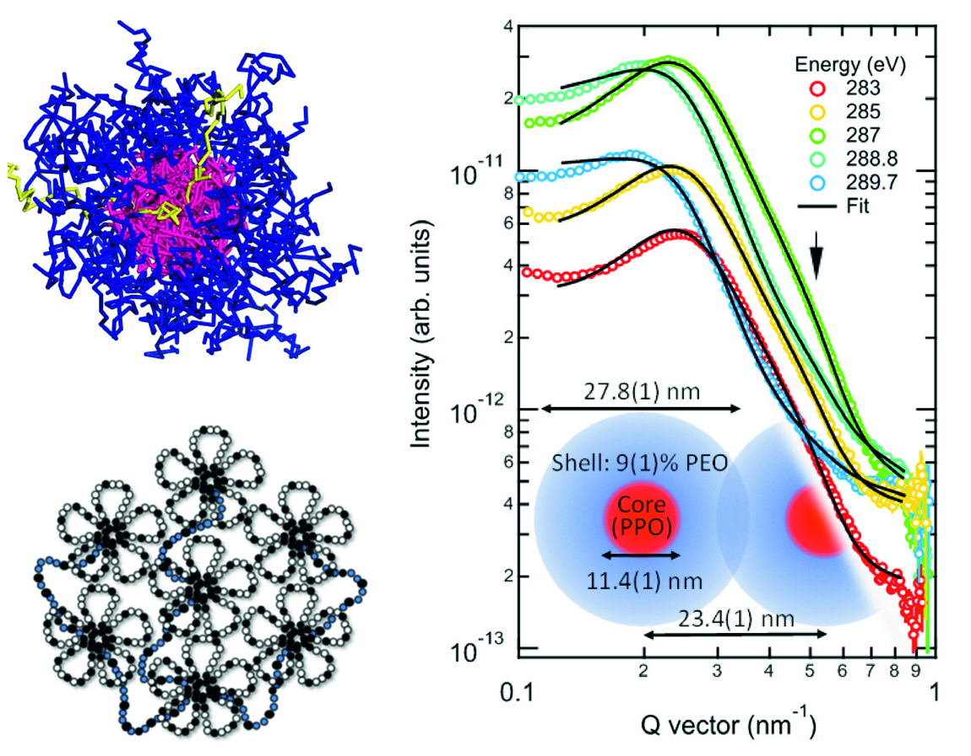
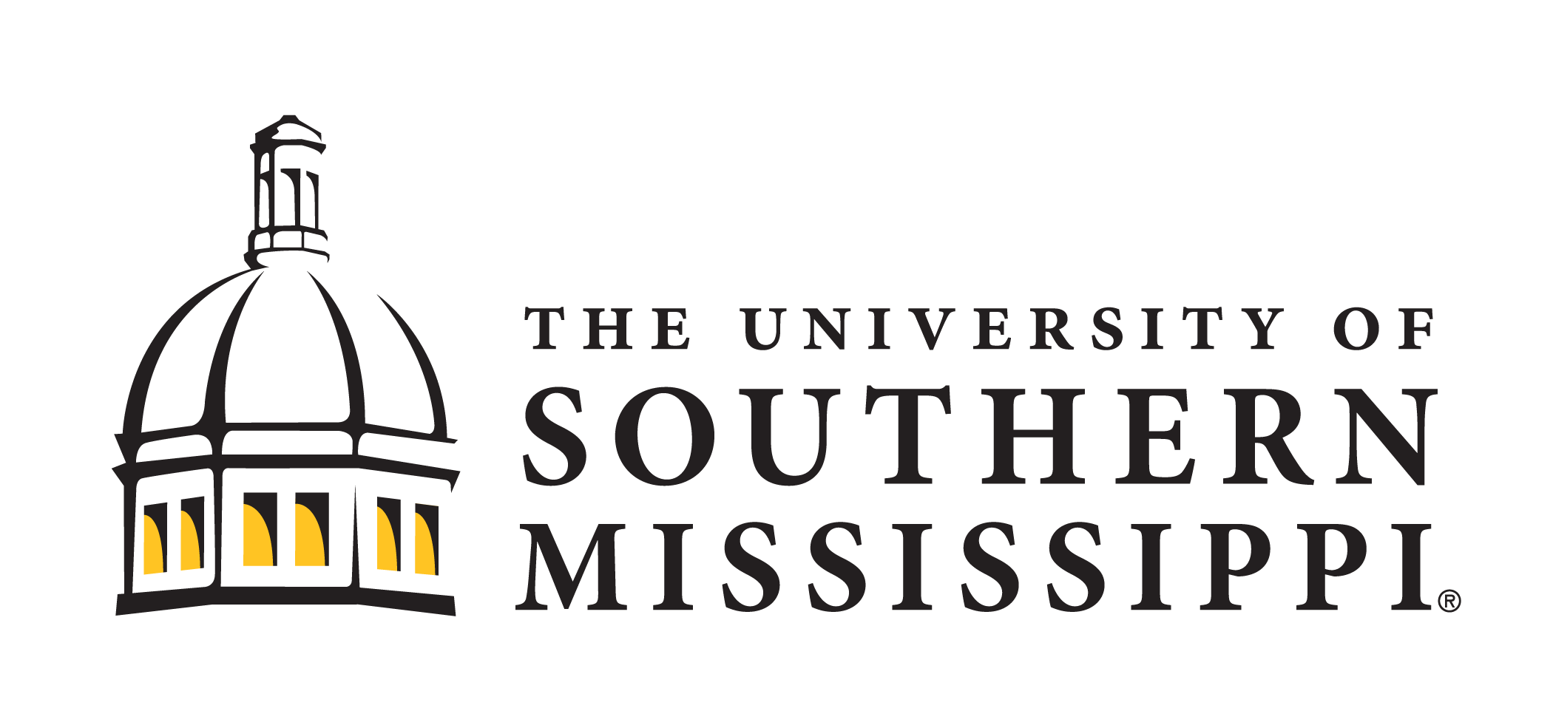
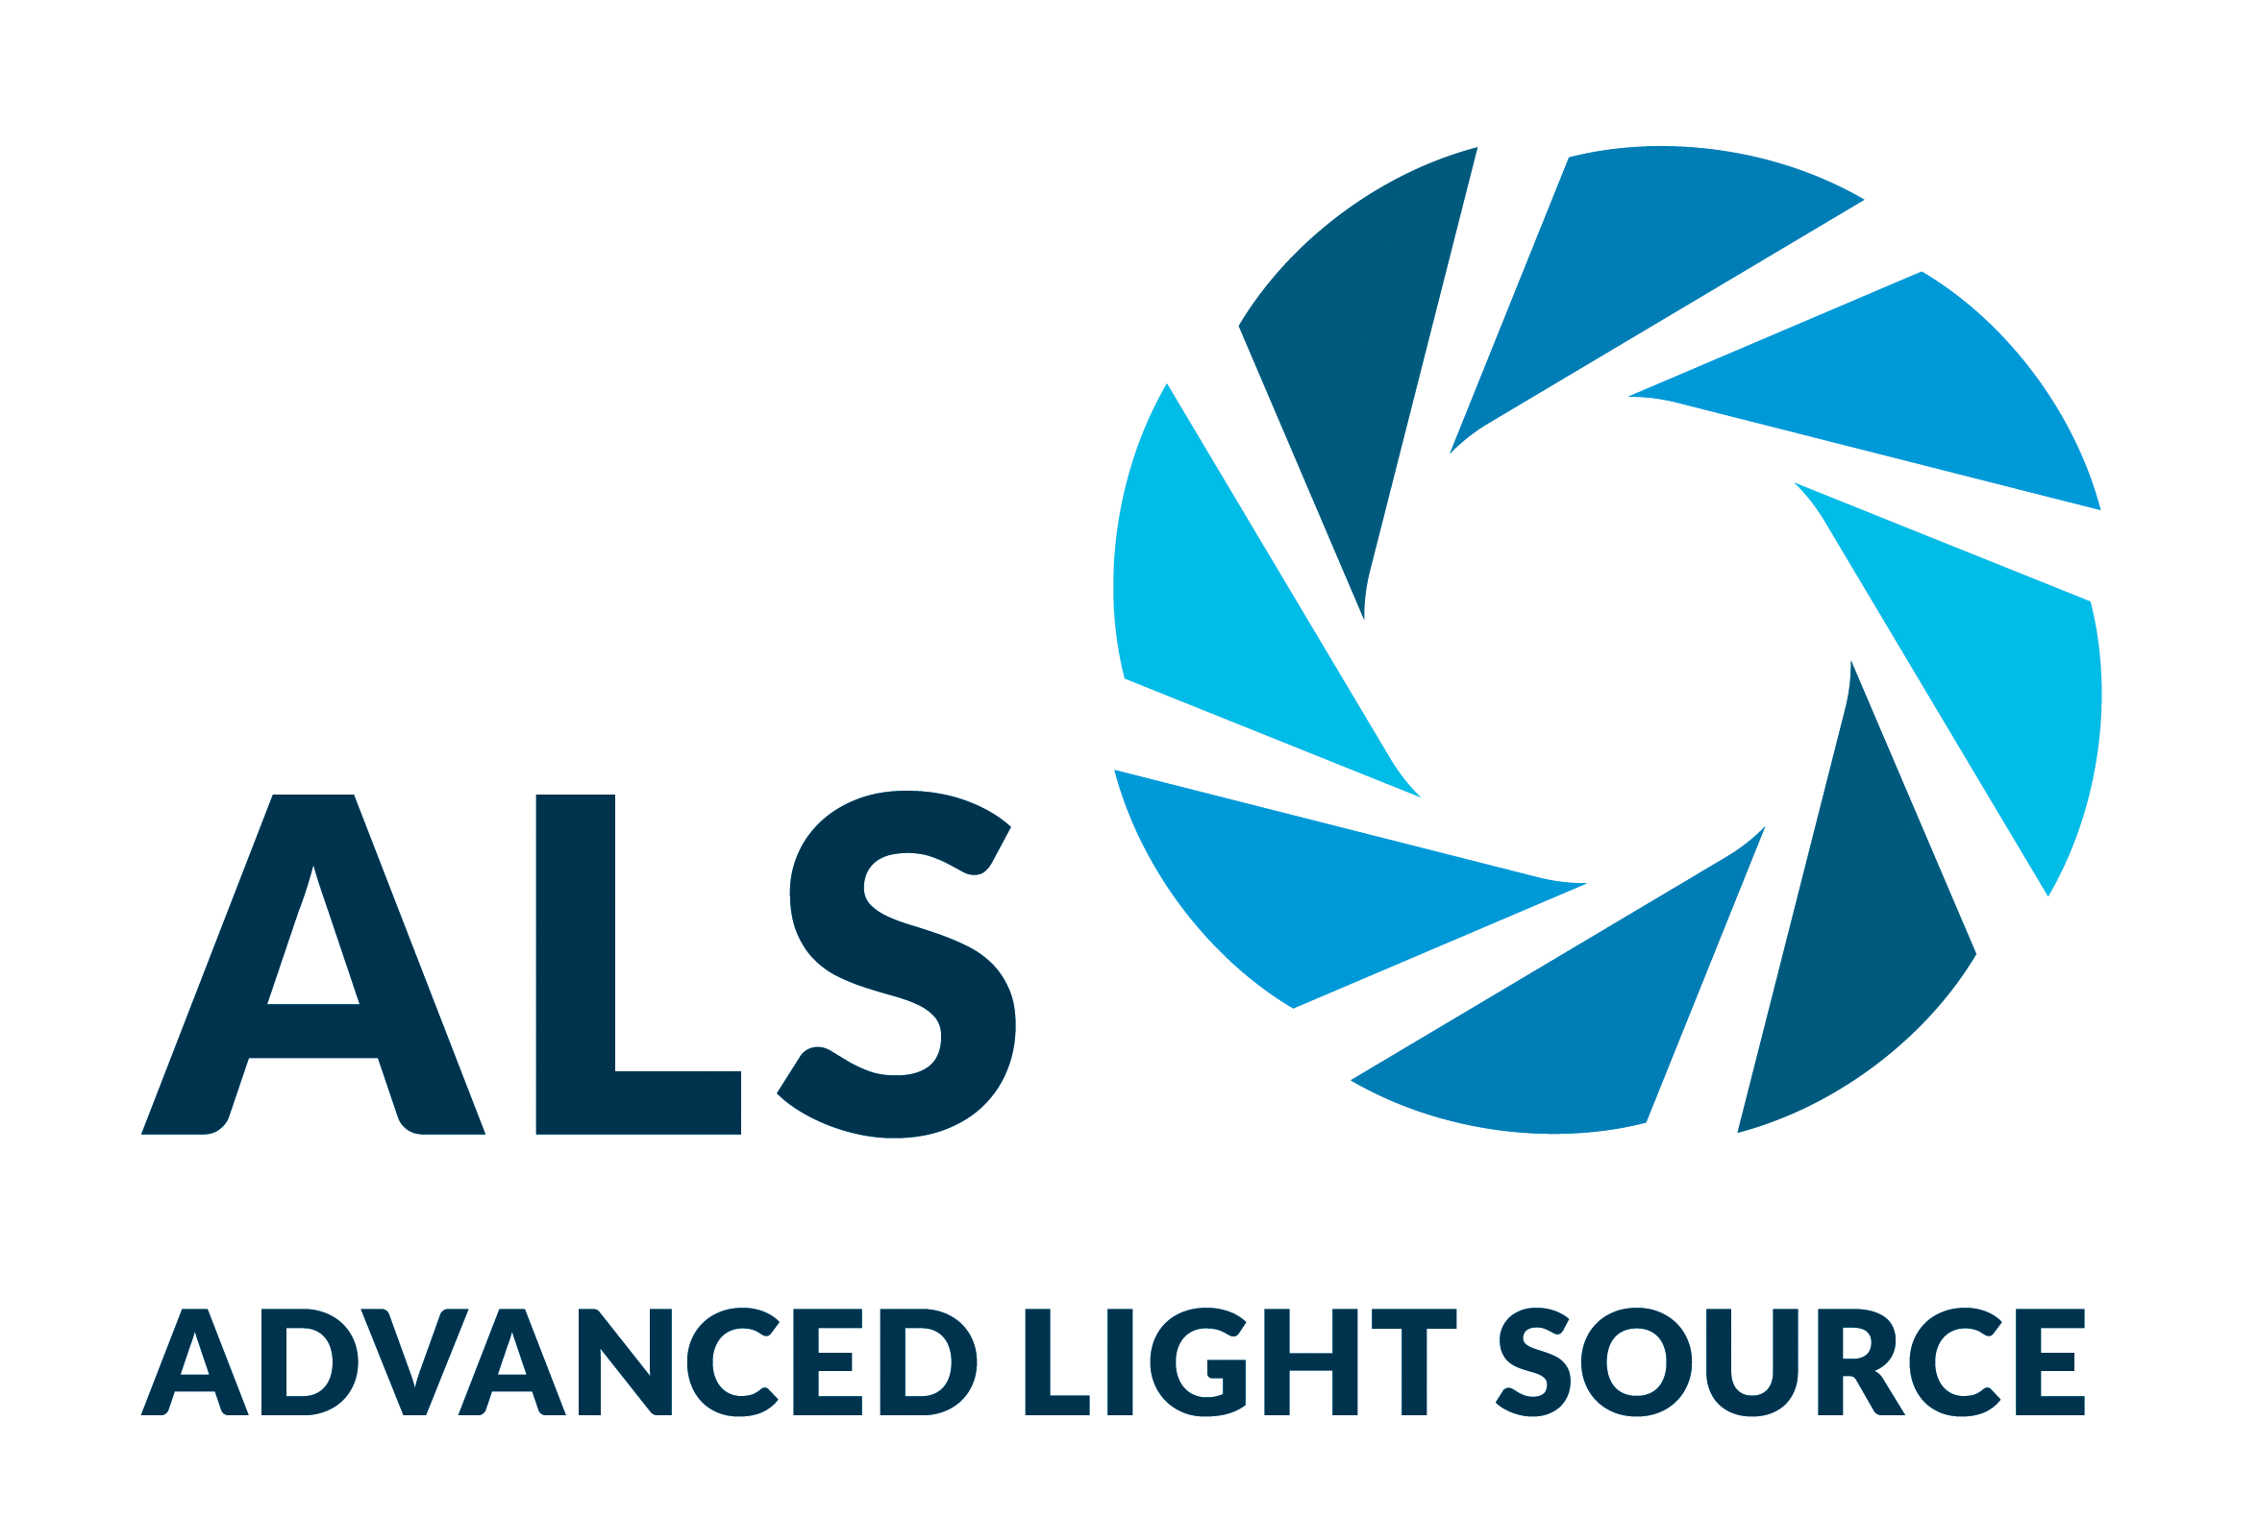
Label-Free Characterization of Organic Nanocarriers
Scientific Achievement
A technique developed at the Advanced Light Source (ALS) enables accurate characterization of organic nanocarriers (molecules that encapsulate other molecules) without the need for disruptive labeling.
Significance and Impact
The method will enable faster, more precise development of exciting new technologies, ranging from targeted drug delivery to oil-spill remediation.
Research Details
Research Details
Two types of nanocarriers were studied: a drug-delivery triblock copolymer and an oil-sequestering polysoap.
Resonant soft x-ray scattering (RSoXS) was performed in a liquid flow and mixing cell that allows rapid, direct, dynamic measurements of structure and behavior.
Technique distinguished between hydrophobic core and hydrophilic shell in drug-delivery copolymer.
Determined that polysoap micelles retained key unimeric structures even at high concentrations.
Left: Nanocarrier structures designed for drug delivery (top) and oil-spill remediation (bottom). Right: RSoXS profiles (shown here for the triblock copolymer) enable characterization of nanocarrier substructure and chemical composition.
Publication about this research: T. McAfee, T. Ferron, I.A. Cordova, P.D. Pickett, C.L. McCormick, C. Wang, and B.A. Collins, Nat. Commun. 12, 3123 (2021). Work was performed at Lawrence Berkeley National Laboratory, ALS Beamline 11.0.1. Operation of the ALS is supported by the U.S. Department of Energy, Office of Science, Basic Energy Sciences program.
Notes:
Micelles are self-assembling nanostructures made up of both water-averse (hydrophobic) and water-loving (hydrophilic) polymer chains. In water, the hydrophobic parts bunch together and become surrounded by the hydrophilic parts, which form a shell that can encapsulate other “guest” molecules. This ability to form neat molecular packages makes micelles attractive for the delivery of vaccines or targeted cancer therapies. A single-polymer (unimeric) form of micelle known as a “polysoap” could also be used for the sequestration and remediation of oil spills in water.The performance of these micelle nanocarriers depends on characteristics such as size, shape, and composition. And because they self-assemble in response to their surroundings, improvements in their design and function require studies performed in aqueous environments. However, most such investigations have involved labeling methods that can distort structure and disrupt behavior, especially for carbon-based materials. Now, a new technique developed at the ALS allows researchers to analyze nanocarriers in a fully natural state, immersed in water and without disruptive labels.
Researchers: T. McAfee (Washington State University and ALS), T. Ferron and B.A. Collins (Washington State University), I.A. Cordova and C. Wang (ALS), and P.D. Pickett and C.L. McCormick (University of Southern Mississippi).
Funding: National Science Foundation; U.S. Department of Energy (DOE) Early Career Research Program; DOE Office of Science, Basic Energy Sciences program (BES); and Gulf of Mexico Research Initiative. Operation of the ALS is supported by DOE BES.
Full highlight: https://als.lbl.gov/label-free-characterization-of-organic-nanocarriers/
1

