Slide 1
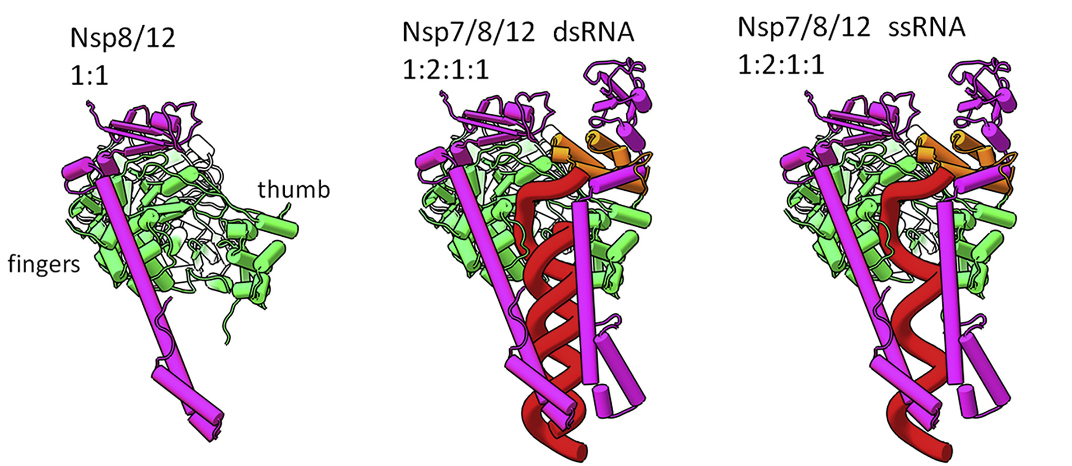
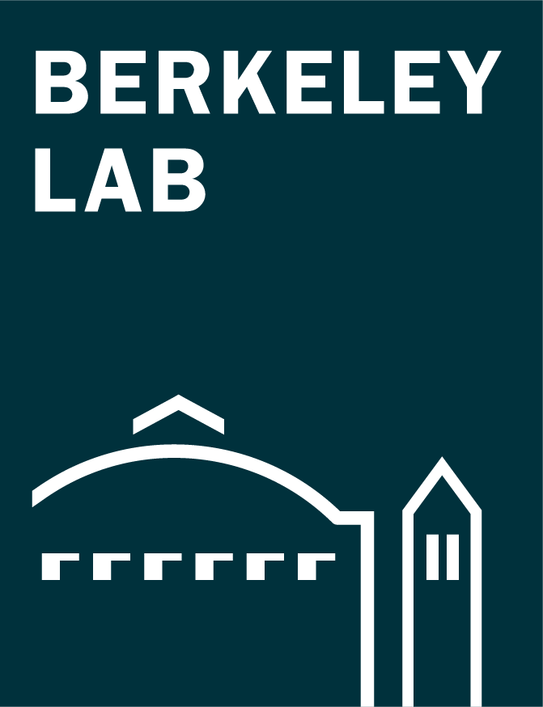
Assembly of the SARS-CoV-2 Replication Machine
Scientific Achievement
Using a multimodal approach that included x-ray scattering at the Advanced Light Source, researchers determined how components of the SARS-CoV-2 replication mechanism fit together.
Significance and Impact
A better understanding of how this protein complex works provides insight into potential structural or functional weak spots to exploit for drug development.
Examples of modeled protein structures used for fitting SAXS data from complexes of Nsp8/Nsp12 (left), Nsp7/Nsp8/Nsp12 + double-stranded RNA (center), and Nsp7/Nsp8/Nsp12 + single-stranded RNA (right). Purple = Nsp8, green = Nsp12, orange = Nsp7, red = RNA.
Research Details
Small-angle x-ray scattering (SAXS) at the ALS (at Berkeley Lab) was combined with other techniques, including protein crystallography (at Argonne) and small-angle neutron scattering (at Oak Ridge).
Revealed structures and interactions of nonstructural proteins (Nsp7, Nsp8, and Nsp12) of the SARS-CoV-2 replication transcription complex (RTC), with and without RNA.
Based on the results, the researchers proposed a mechanism in which the binding and position of two Nsp8s could play a key role in transitions that occur during RNA transcription.
Publication about this research: M. Wilamowski et al., Biophys. J., doi: 10.1016/j.bpj.2021.06.006 (2021). Work was performed at Lawrence Berkeley National Laboratory, ALS Beamline 12.3.1; Argonne National Laboratory, APS Beamline 19-ID; and Oak Ridge National Laboratory, High Flux Isotope Reactor and Spallation Neutron Source. Operation of the ALS is supported by the U.S. Department of Energy, Office of Science, Basic Energy Sciences program.
Notes:
The protein-based machine responsible for RNA replication and translation in coronaviruses—and many other viruses—is called the replication transcription complex (RTC). To successfully duplicate viral RNA for new virus particles and produce the new particles’ many proteins, the RTC must: distinguish between viral and host RNA, recognize and pair RNA bases instead of highly similar DNA bases that are also abundant in human cells, convert their RNA into mRNA (to dupe human ribosomes into translating viral proteins), interface with error-checking molecules, and transcribe specific sections of viral RNA to amplify certain proteins over others depending on need—all while trying to evade the host immune system. Multitasking proteins like the RTC aren’t static or rigid; they’re flexible and have associated molecules, called nonstructural proteins, that change form depending on the task at hand. Each arrangement exposes different parts of the RTC surface, which can be examined to find places where potential drug molecules could bind and inhibit the entire machine.
Researchers: M. Wilamowski (University of Chicago); M. Hammel, J. Bierma, A.H. Sarker, and S.E. Tsutakawa (Berkeley Lab); W. Leite, Q. Zhang, K. Weiss, Y. Fan, S.V. Pingali, and H.M. O’Neill (Oak Ridge National Laboratory); Y. Kim, R. Jedrzejczak, and A. Joachimiak (University of Chicago and Argonne National Laboratory); D.J. Rosenberg (Berkeley Lab and University of California, Berkeley); J. Wower (Auburn University); and G.L. Hura (Berkeley Lab and University of California, Santa Cruz).
Funding: U.S. Department of Energy (DOE) National Virtual Biotechnology Laboratory, a consortium of DOE National Laboratories with core capabilities relevant to the threats posed by COVID-19, and funded under the Coronavirus Aid, Relief, and Economic Security (CARES) Act; DOE Biological and Environmental Research Integrated Diffraction Analysis Technologies program; National Institutes of Health; United States–Israel Binational Science Foundation; U.S. Department of Agriculture; DOE Office of Science, Basic Energy Sciences (BES) program. Operation of the ALS is supported by DOE BES.
Full highlight: https://als.lbl.gov/assembly-of-the-sars-cov-2-replication-mechanism/
1

