Slide 1
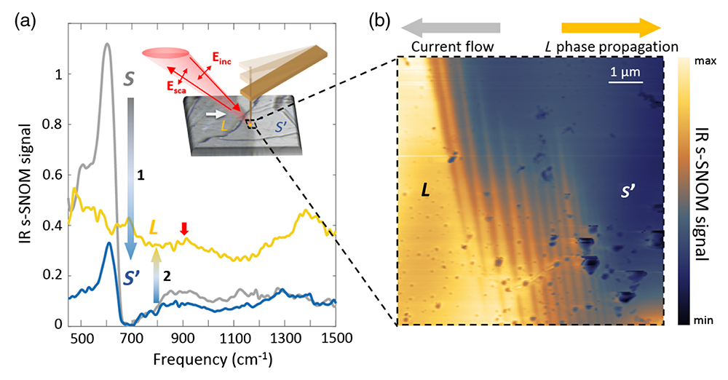
IR Light Reveals Microstripes at Insulator-Metal Transition
Scientific Achievement
Researchers found that the electrically driven insulator-to-metal transition (IMT) in Ca₂RuO₄ produces remarkable microstripe patterns.
Significance and Impact
The results shed light on the microscopic nature of the Ca₂RuO₄ IMT, which can potentially be useful in energy-efficient memory and transistor devices.
(a) Broadband IR spectra of insulating (S), intermediate (S′), and metallic (L) states. Inset: Schematic of the experimental setup. (b) Microstripes at the L–S′ phase boundary imaged using IR laser–based scattering-type scanning near-field microscopy (s-SNOM).
Research Details
The phase boundary in Ca₂RuO₄ was studied using optical microscopy and IR nano-imaging (including broadband IR nanospectroscopy at the ALS).
Under applied current, metallic phase percolates outward from negative electrode; switching electrode polarity changes the direction of the phase percolation.
Submicron stripe patterns formed at the phase boundary with orientation tied to crystallographic axes; possibly the result of strain due to elastic mismatch in lattice expansion and shrinking.
Publication about this research: J. Zhang, A.S. McLeod, Q. Han, X. Chen, H.A. Bechtel, Z. Yao, S.N. Gilbert Corder, T. Ciavatti, T.H. Tao, M. Aronson, G.L. Carr, M.C. Martin, C. Sow, S. Yonezawa, F. Nakamura, I. Terasaki, D.N. Basov, A.J. Millis, Y. Maeno, and M. Liu, Phys. Rev. X 9, 011032 (2019). Work was performed at Lawrence Berkeley National Laboratory, ALS Beamline 5.4. Operation of the ALS is supported by the U.S. Department of Energy, Office of Science, Basic Energy Sciences program.
Notes:
Many materials can make the transition from nonconducting (insulator) to conducting (metal) through applied pressure, temperature, or radiation. However, the transition-metal oxide Ca₂RuO₄ can make this switch using a very modest electric current, making potential applications to energy-efficient memory and transistor devices possible. To better understand the microscopic nature of this insulator-to-metal transition, researchers used infrared (IR) techniques to probe the metal-insulator boundary in a single Ca₂RuO₄ crystal. In particular, they studied changes in the domain wall separating the growing metallic state from the insulating state as the applied current increased. The results support an electrically induced insulator-to-metal transition scenario fundamentally distinct from the filamentary metallization common to high-field resistive switching reported in other oxides.
Researchers: J. Zhang, X. Chen, Z. Yao, S.N. Gilbert Corder, T. Ciavatti, and M. Liu (Stony Brook University); A.S. McLeod, Q. Han, and D.N. Basov (Columbia University); H.A. Bechtel and M.C. Martin (ALS); T.H. Tao (Shanghai Institute of Microsystem and Information Technology); M. Aronson (Texas A&M University); G.L. Carr (Brookhaven National Laboratory); C. Sow, S. Yonezawa, and Y. Maeno (Kyoto University); F. Nakamura (Kurume Institute of Technology, Japan); I. Terasaki (Nagoya University); and A.J. Millis (Columbia University and The Flatiron Institute).
Funding: Japan Society for the Promotion of Science; U.S. Department of Energy, Office of Science, Basic Energy Sciences program (DOE BES); and Gordon and Betty Moore Foundation. Operation of the ALS is supported by DOE BES.
Full highlight: https://als.lbl.gov/infrared-light-reveals-microstripes-at-insulator-metal-transition/

