Slide 1
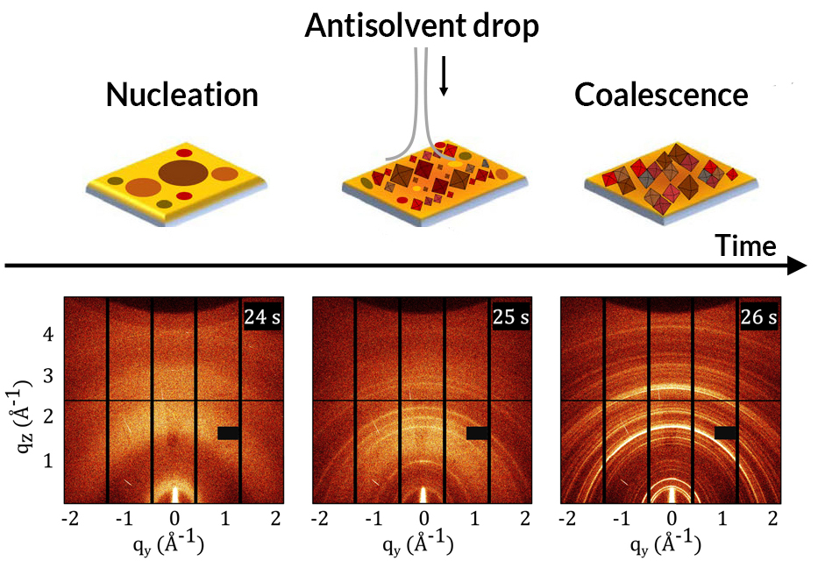
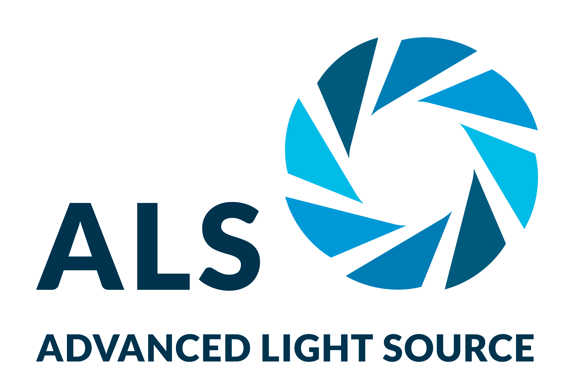
A Split-Screen View of Solar-Cell Crystallization
Scientific Achievement
At the Advanced Light Source (ALS), researchers simultaneously monitored both the structure and function of a photovoltaic material as it crystallized from solution.
Significance and Impact
The work raises the prospect of rationally tuning materials for optimal performance in photovoltaics and other light-manipulating devices, including light-emitting diodes, detectors, and lasers.
2D GIWAXS data during structural conversion of MAPI thin film before, during, and after antisolvent drop at t = 25 s.
Research Details
Thin films of methylammonium lead iodide (MAPI), a hybrid perovskite, were synthesized from solution.
Grazing-incidence wide-angle x-ray scattering (GIWAXS) provided structural information.
Photoluminescence spectroscopy provided information about the material’s optical response.
Simultaneous scattering and spectroscopy provided complementary views of crystallization kinetics, revealing how changes in optical response correlate with the evolution of the material structure.
Publication about this research: S. Pratap, F. Babbe, N.S. Barchi, Z. Yuan, T. Luong, Z. Haber, T.-B. Song, J.L. Slack, C.V. Stan, N. Tamura, C.M. Sutter-Fella, and P. Müller-Buschbaum, Nat. Commun. 12, 5624 (2021). Work was performed at Lawrence Berkeley National Laboratory, ALS Beamline 12.3.2. Operation of the ALS is supported by the U.S. Department of Energy, Office of Science, Basic Energy Sciences program.
Notes:
An exciting new solar material called organic–inorganic halide perovskites could one day help the U.S. achieve its solar ambitions and decarbonize the power grid. One thousand times thinner than silicon, perovskite solar materials can be tuned to respond to different colors of the solar spectrum simply by altering their composition mix. Typically fabricated from organic molecules such as methylammonium and inorganic metal halides such as lead iodide, hybrid perovskite solar materials have a high tolerance for defects in their molecular structure and absorb visible light more efficiently than silicon, the solar industry’s standard. Despite their potential, perovskites have yet to be commercialized because the synthesis of stable, high-quality perovskite materials involves many nonequilibrium structures transforming into one another, greatly increasing the complexity of the process. In this work, scientists used both x-rays and visible laser light to probe a perovskite material’s crystal structure and optical properties as it is synthesized.
Researchers: S. Pratap and P. Müller-Buschbaum (Technical University of Munich, Germany); F. Babbe, T. Luong, Z. Haber, T.-B. Song, and C.M. Sutter-Fella (Berkeley Lab); N.S. Barchi (Berkeley Lab and École Polytechnique Fédérale de Lausanne, Switzerland); Z. Yuan (Berkeley Lab and Pennsylvania State University); J.L. Slack and N. Tamura (ALS); and C.V. Stan (ALS and Lawrence Livermore National Laboratory).
Funding: Bavarian Collaborative Research Project Solar Technologies Go Hybrid (SolTech), German Research Foundation, TUM International Graduate School of Science and Engineering, Bavaria California Technology Center, Centre for Nanoscience (Munich, Germany), Nanosystems Initiative Munich, ALS Doctoral Fellowships in Residence, and Laboratory Directed Research and Development program at Berkeley Lab. Operation of the ALS is supported by the U.S. Department of Energy, Office of Science, Basic Energy Sciences program.
Full highlight: https://als.lbl.gov/a-split-screen-view-of-solar-cell-crystallization/
1

