Slide 1
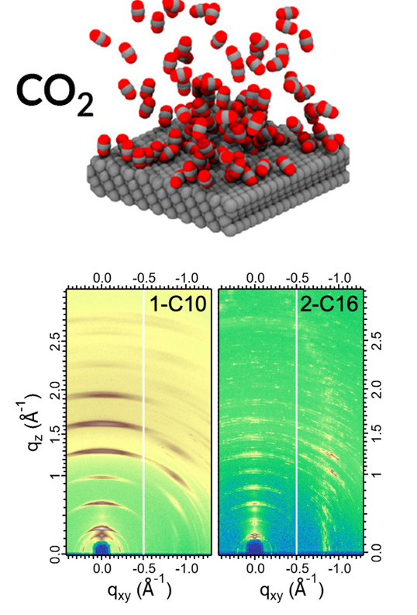
Exquisitely Selective CO₂ Reduction on Silver
Scientific Achievement
Researchers electrochemically reduced CO₂ to CO with nearly perfect selectivity over other products by adding an organic compound to the surface of a silver electrode.
Significance and Impact
With theoretical analyses and Advanced Light Source (ALS) data, the work revealed the key role of the microenvironment in promoting the conversion of CO₂, a greenhouse gas, into useful products.
Research Details
Organic compounds with one or two long chains of 10 or 16 carbons were known to tune CO₂ reduction on copper.
On silver, compound 2-C16 showed extreme selectivity for CO.
Molecular dynamics simulations predicted how 2-C16 affects the distribution of H₂O and CO₂ at the silver surface.
Grazing-incidence wide-angle x-ray scattering (GIWAXS) provided complementary data connecting structure with function.
Top: Simulations revealed that the compound 2-C16 concentrated CO₂ near the Ag surface. Bottom: GIWAXS provided complementary structural info about 2-C16.
Publication about this research: A.K. Buckley, T. Cheng, M.H. Oh, G.M. Su, J. Garrison, S.W. Utan, C. Zhu, F.D. Toste, W.A. Goddard III, and F.M. Toma, ACS Catal. 11, 9034 (2021). Work was performed at Lawrence Berkeley National Laboratory, ALS Beamline 7.3.3. Operation of the ALS is supported by the U.S. Department of Energy, Office of Science, Basic Energy Sciences program.
Notes:
Carbon dioxide (CO₂) makes up 80% of the greenhouse gases released into the atmosphere by the United States, mainly through the burning of fossil fuels. After a slight dip last year during the pandemic, the trend for CO₂ emissions is again on the rise. One thing we can do to help bend this curve downward again is to capture CO₂ and convert it into high-value feedstock chemicals such as ethylene and ethanol, which are chemical building blocks for other useful products. After years of searching for a material that improves on copper for the conversion of CO₂ into high-value chemicals, scientists found that copper remains the best performer overall. However, it still isn’t efficient enough for commercial applications. So, the focus shifted away from finding a better electrode material and toward re-engineering the microenvironment at the electrode’s surface. In this work, researchers drew from previous experiments in which they found that certain organic additives can tune copper’s ability to reduce CO₂. To clarify the mechanism behind this observation, they repeated the experiment with a less complicated system, silver.
Researchers: A.K. Buckley, J. Garrison, S.W. Utan, and F.D. Toste (Berkeley Lab and UC Berkeley); T. Cheng (Soochow University, China, and Caltech); M.H. Oh (Berkeley Lab and Korea Institute of Energy Technology); G.M. Su (ALS and Berkley Lab); C. Zhu (ALS); W.A. Goddard III (Caltech); and F.M. Toma (Berkeley Lab).
Funding: U.S. Department of Energy, Office of Science, Basic Energy Sciences program (DOE BES). Operation of the ALS is supported by DOE BES.
Full highlight: https://als.lbl.gov/exquisitely-selective-co2-reduction-on-silver/
1

