Slide 1
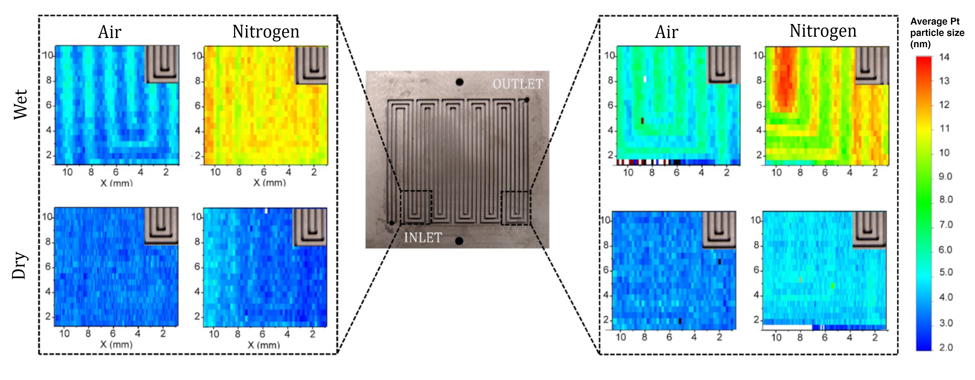
Strategies for Reducing Platinum Waste in Fuel Cells
Scientific Achievement
Industry and university researchers used the Advanced Light Source (ALS) to explore why the platinum used as a catalyst in hydrogen fuel cells degrades unevenly.
Scientific Achievement
X-ray microdiffraction maps (1 cm²) show Pt particle sizes at inlet and out- let regions of fuel-cell flow fields under various environmental conditions. Larger particle sizes (redder colors) indicate greater degradation.
The resulting knowledge has enabled the development of simple, effective strategies to reduce the waste of precious catalyst material, lowering the costs associated with a promising green technology.
Research Details
Catalyst-coated membranes were aged in wet/dry and air/nitrogen conditions at inlet/outlet locations.
X-ray microdiffraction revealed changes in Pt particle size (larger particles indicate greater degradation).
Higher-temperature operation would enable more uniformity in catalyst utilization, but must be balanced against degradation of other components; changes in flow-field design can also reduce waste.
Publication about this research: K. Khedekar, M.R. Talarposhti, M.M. Besli, S. Kuppan, A. Perego, Y. Chen, M. Metzger, S. Stewart, P. Atanassov, N. Tamura, N. Craig, L. Cheng, C.M. Johnston, and I.V. Zenyuk, Adv. Energy Mater. 11, 2101794 (2021). Work was performed at Lawrence Berkeley National Laboratory, ALS Beamlines 8.3.2 and 12.3.2. Operation of the ALS is supported by the U.S. Department of Energy, Office of Science, Basic Energy Sciences program.
Notes:
Fuel cells are electrochemical devices that generate electricity from hydrogen—a “clean” fuel that produces only water when burned. For automotive applications, polymer electrolyte fuel cells (PEFCs) are attractive because they are powerful yet compact, and can quickly ramp up power output as needed. To achieve the required power, hundreds of fuel cells are combined in parallel to form a fuel cell “stack.” Improving the durability of PEFC stacks and reducing their cost remain challenging, however. According to one Department of Energy breakdown for fuel cells in light-duty vehicles, precious-metal electrocatalysts accounts for 31% of stack cost. These precious metals are mostly platinum or platinum alloys that catalyze the required but sluggish oxygen reduction reaction on the PEFC cathode. Relatively large quantities of platinum are often used to maintain sufficient performance, since active catalyst surface area is lost as a result of degradation over time. If the degradation is not spatially uniform, some still-active platinum can be left underutilized. To improve fuel cell durability and reduce waste, the detailed causes of uneven platinum degradation need to be better understood.
Researchers: K. Khedekar, M.R. Talarposhti, A. Perego, Y. Chen, P. Atanassov, and I.V. Zenyuk (UC Irvine); M.M. Besli (Karlsruhe Institute of Technology); S. Kuppan, M. Metzger, S. Stewart, N. Craig, L. Cheng, and C.M. Johnston (Bosch Research and Technology Center North America); and N. Tamura (ALS).
Funding: Bosch Research. Operation of the ALS is supported by the U.S. Department of Energy, Office of Science, Basic Energy Sciences program.
Full highlight: https://als.lbl.gov/strategies-for-reducing-platinum-waste-in-fuel-cells/
1

