Slide 1
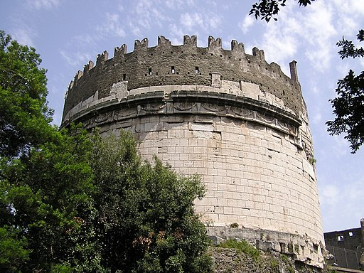
Unexpected Transformations Reinforce Roman Architectural Concrete
Scientific Achievement
Researchers used the Advanced Light Source to study binding phases in Roman architectural concrete, revealing reactions and profound transformations that contribute to the material’s long-term cohesion and durability.
Significance and Impact
The findings add to our growing understanding of cementing processes in Roman concretes, informing resilient materials of the future.
(a)
(b)
Mortar
(a) Tomb of Caecilia Metella and mortar in concrete wall. (b) Integrated intensity of the 5.4 Å reflection of the binding phase (C-A-S-H) revealed a nanocrystalline structure with preferred orientation (lower panel), indicating substantial beneficial chemical and material reorganization during the past 2,050 years.
Research Details
X-ray microdiffraction experiments probed mortar from the Tomb of Caecilia Metella (1st C BCE).
Researchers characterized the cementing phases at 10-micron steps, forming a phase map.
The data showed that leucite crystals in the volcanic aggregate dissolved over time, leading to the incorporation of potassium in the calcium-aluminum-silicate-hydrate (C-A-S-H) binder. A new C-A-S-H phase has nanocrystalline preferred orientation and further reinforces cohesion in the mortar.
Publication about this research: L.M. Seymour, N. Tamura, M.D. Jackson, and A. Masic, "Reactive binder and aggregate interfacial zones in the mortar of Tomb of Caecilia Metella concrete, 1C BCE, Rome," J. Am. Ceram. Soc. 105, 1503 (2021). Work was performed at Lawrence Berkeley National Laboratory, ALS Beamline 12.3.2. Operation of the ALS is supported by the U.S. Department of Energy, Office of Science, Basic Energy Sciences program.
Notes:
Modern concrete’s binder is typically Portland cement, formed by heating a mixture of limestone, clay, and sand to high temperatures. Roman concrete from the late Republican era (509–27 BCE), in contrast, consists of coarse brick or volcanic rock bound with mortar made from hydrated lime and glass and crystal fragments from volcanic eruptions. In this study, scientists from the University of Utah, MIT, and the Advanced Light Source examined a sample from the Tomb of Caecilia Metella (1st century BCE). The team hoped that the 2,050-year-old monument would provide insights into how Roman builders' selections of reactive volcanic rock influenced the material characteristics of the very robust concrete.
The researchers studied thin-sectioned samples from the tomb’s substructure with a variety of techniques, using scanning electron microscopy and energy dispersive spectroscopy to identify regions of interest, which they then studied at the ALS using x-ray microdiffraction at Beamline 12.3.2. Emerging from the perimeters of the calcium-aluminum-silicate-hydrate (C-A-S-H) binding phase, the team discovered delicate wisps and tendrils with nanocrystalline preferred orientation—evidence of long-term evolution of the material. These profound changes suggest that leucite crystals in the volcanic aggregate dissolved over time, leading to the incorporation of potassium in the C-A-S-H binder. A new C-A-S-H phase has nanocrystalline preferred orientation and further reinforces cohesion in the mortar.
Researchers: L.M. Seymour and A. Masic (Massachusetts Institute of Technology); N. Tamura (ALS); and M.D. Jackson (Univ. of Utah).
Funding: U.S. Department of Energy (DOE) Advanced Research Projects Agency-Energy (ARPA-E). Operation of the ALS is supported by the U.S. Department of Energy, Office of Science, Basic Energy Sciences program (DOE BES).
Full highlight: https://als.lbl.gov/unexpected-transformations-reinforce-roman-architectural-concrete/
1

